Slide 1
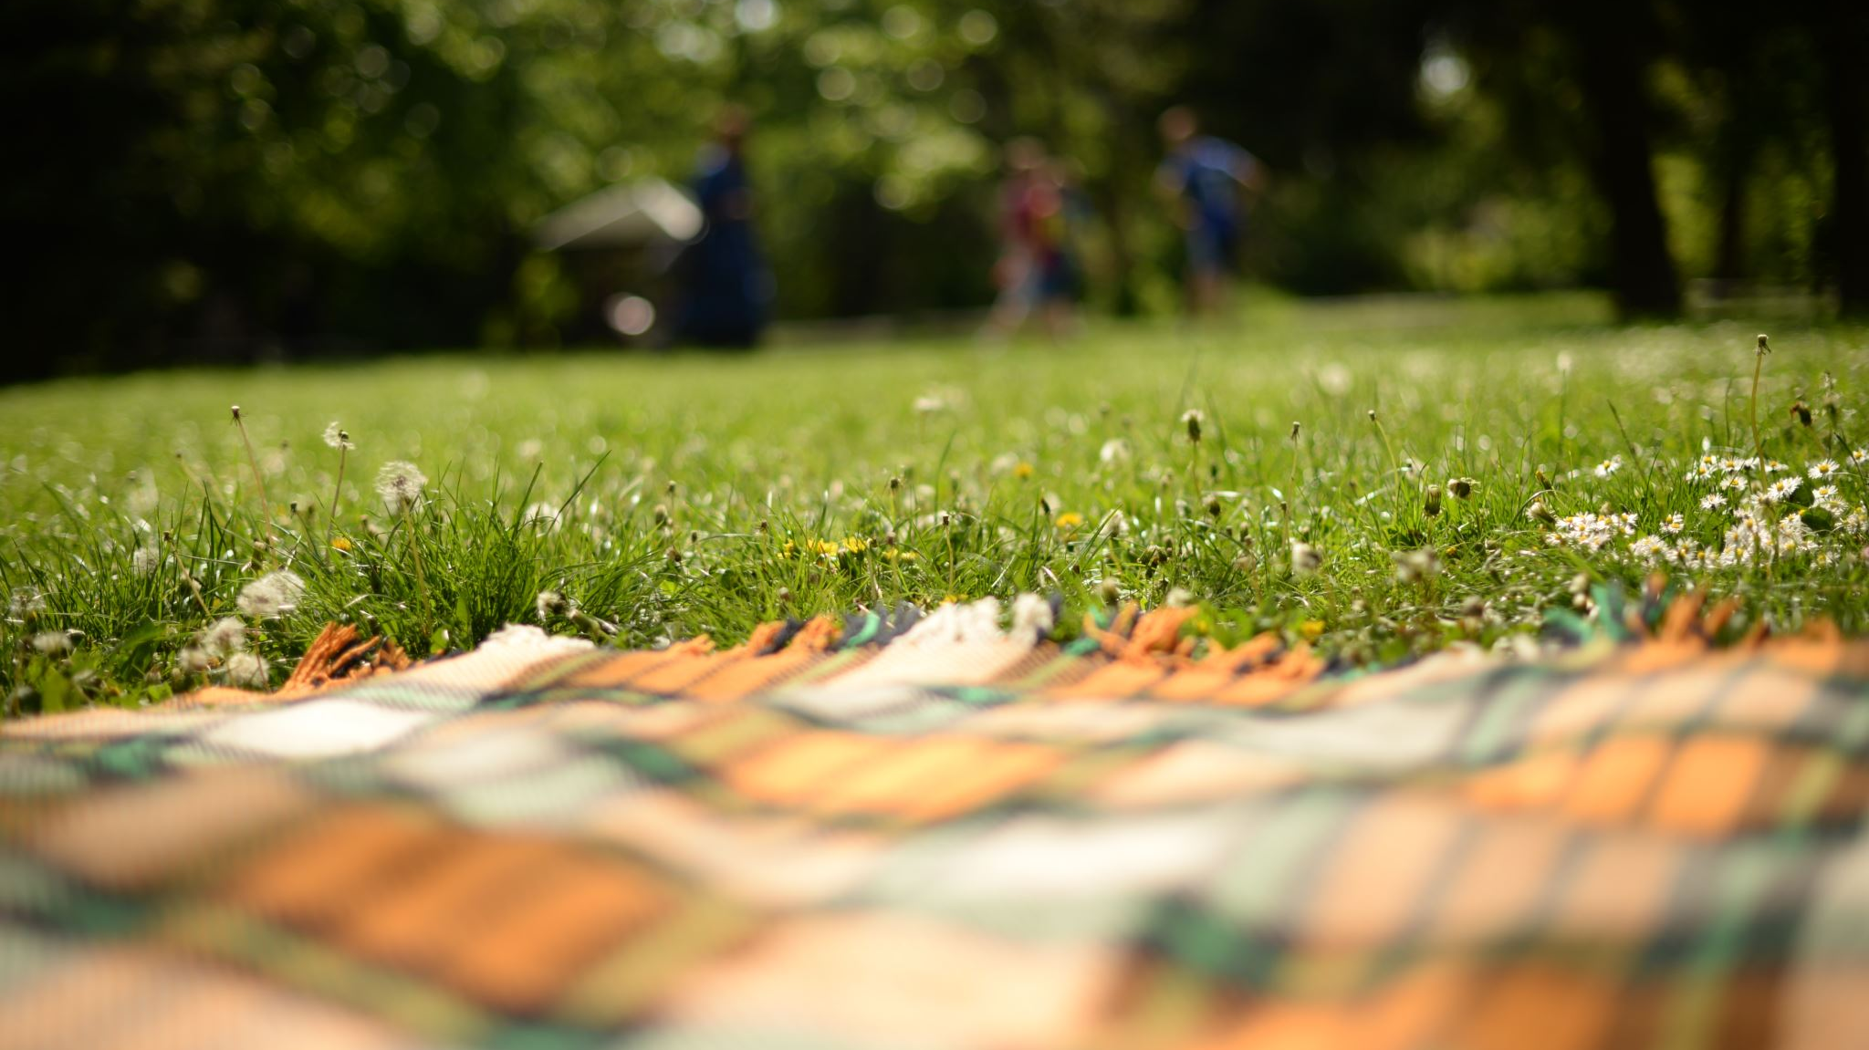
Forest Schools Diary
Mrs Fulton
12th June 2024

Slide 2
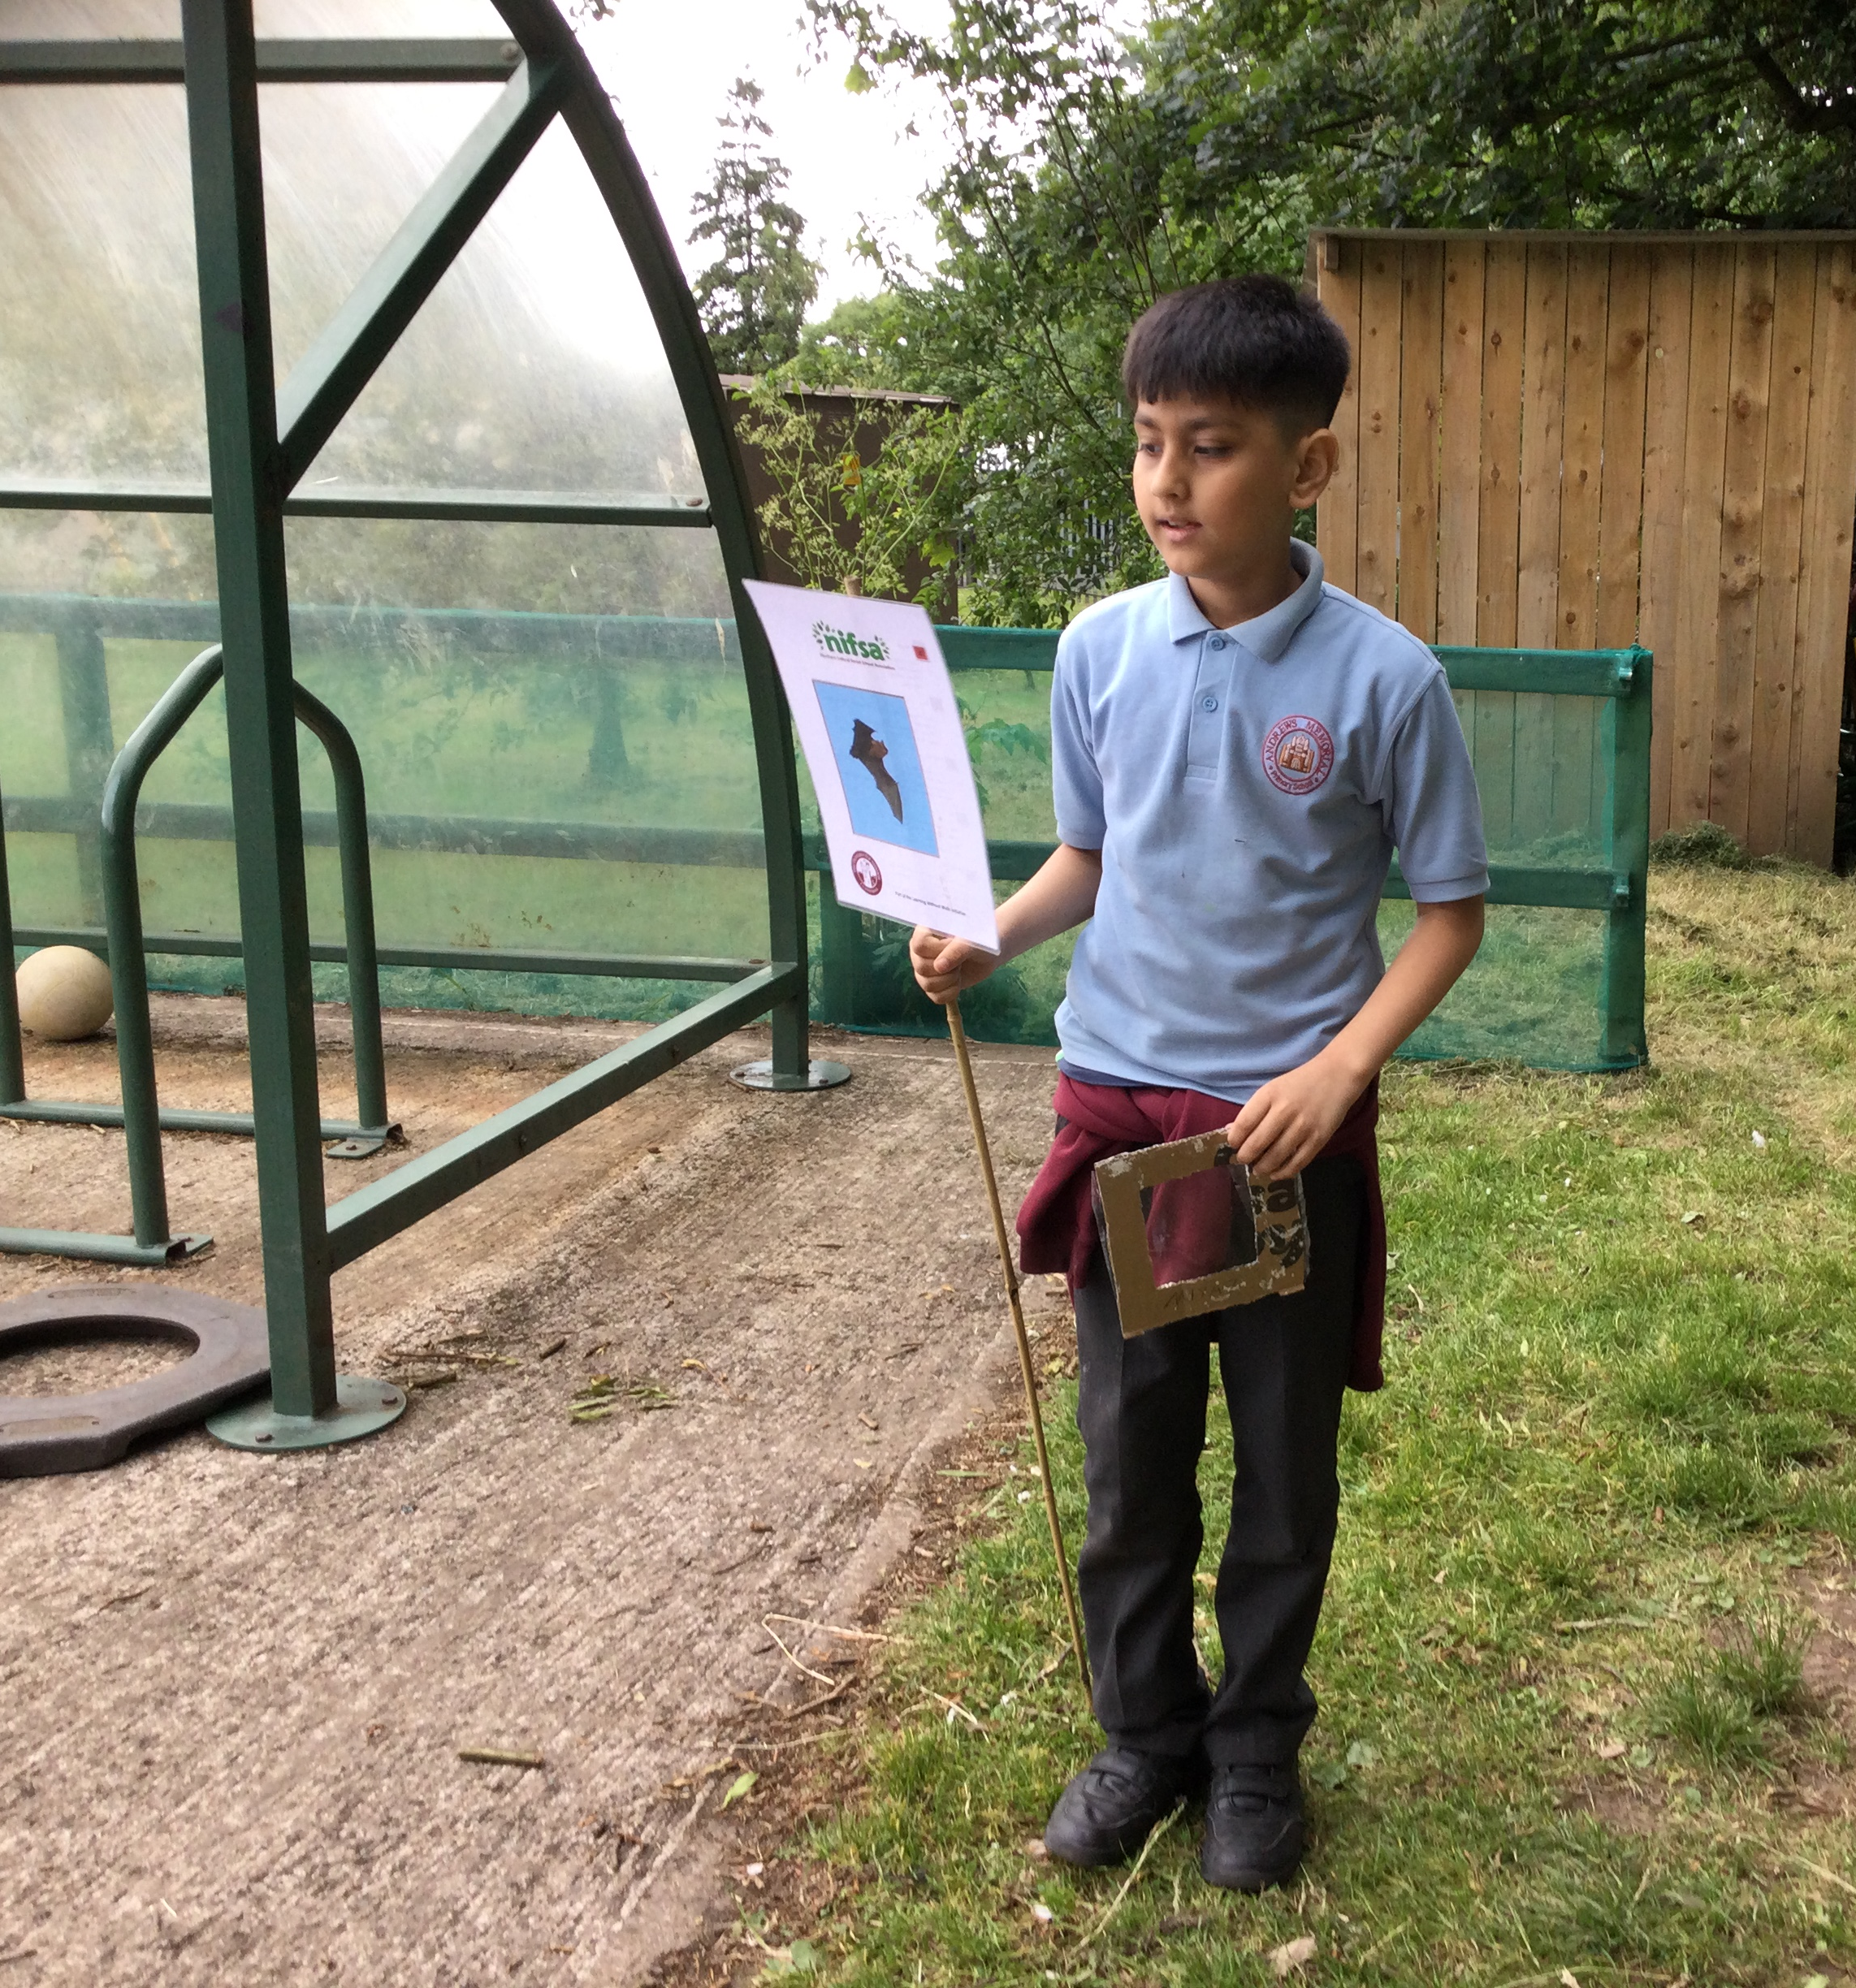
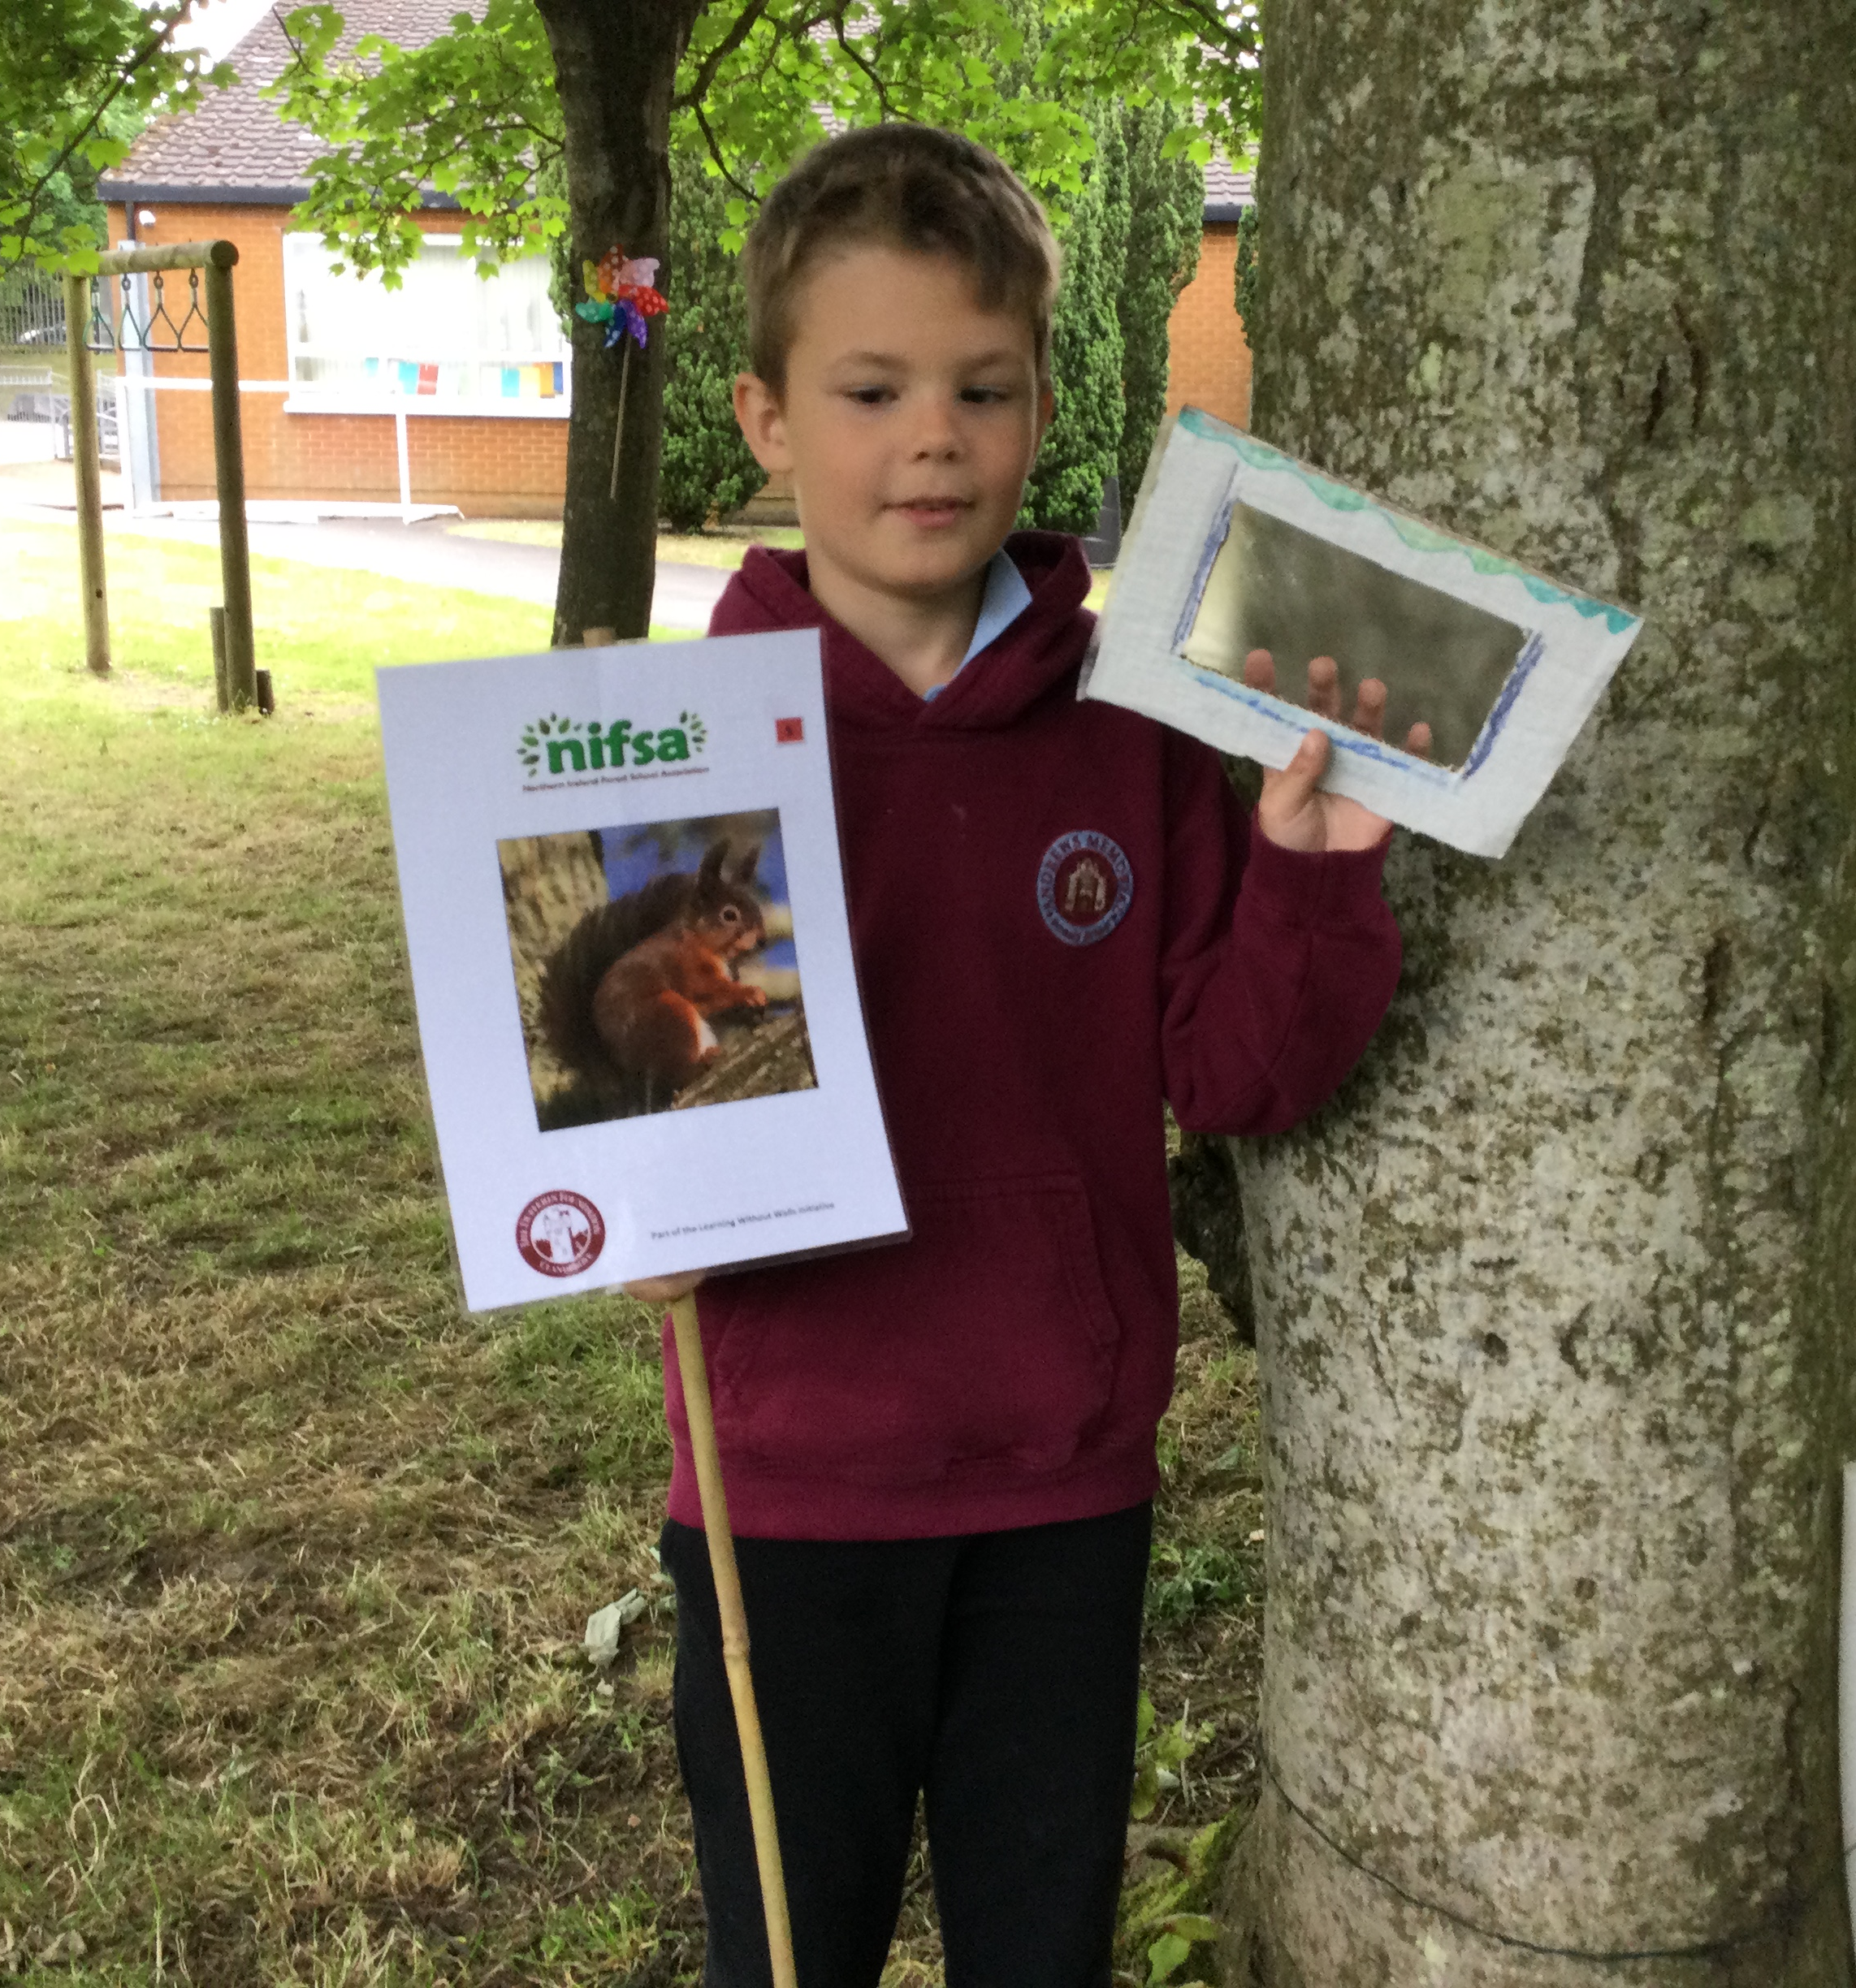
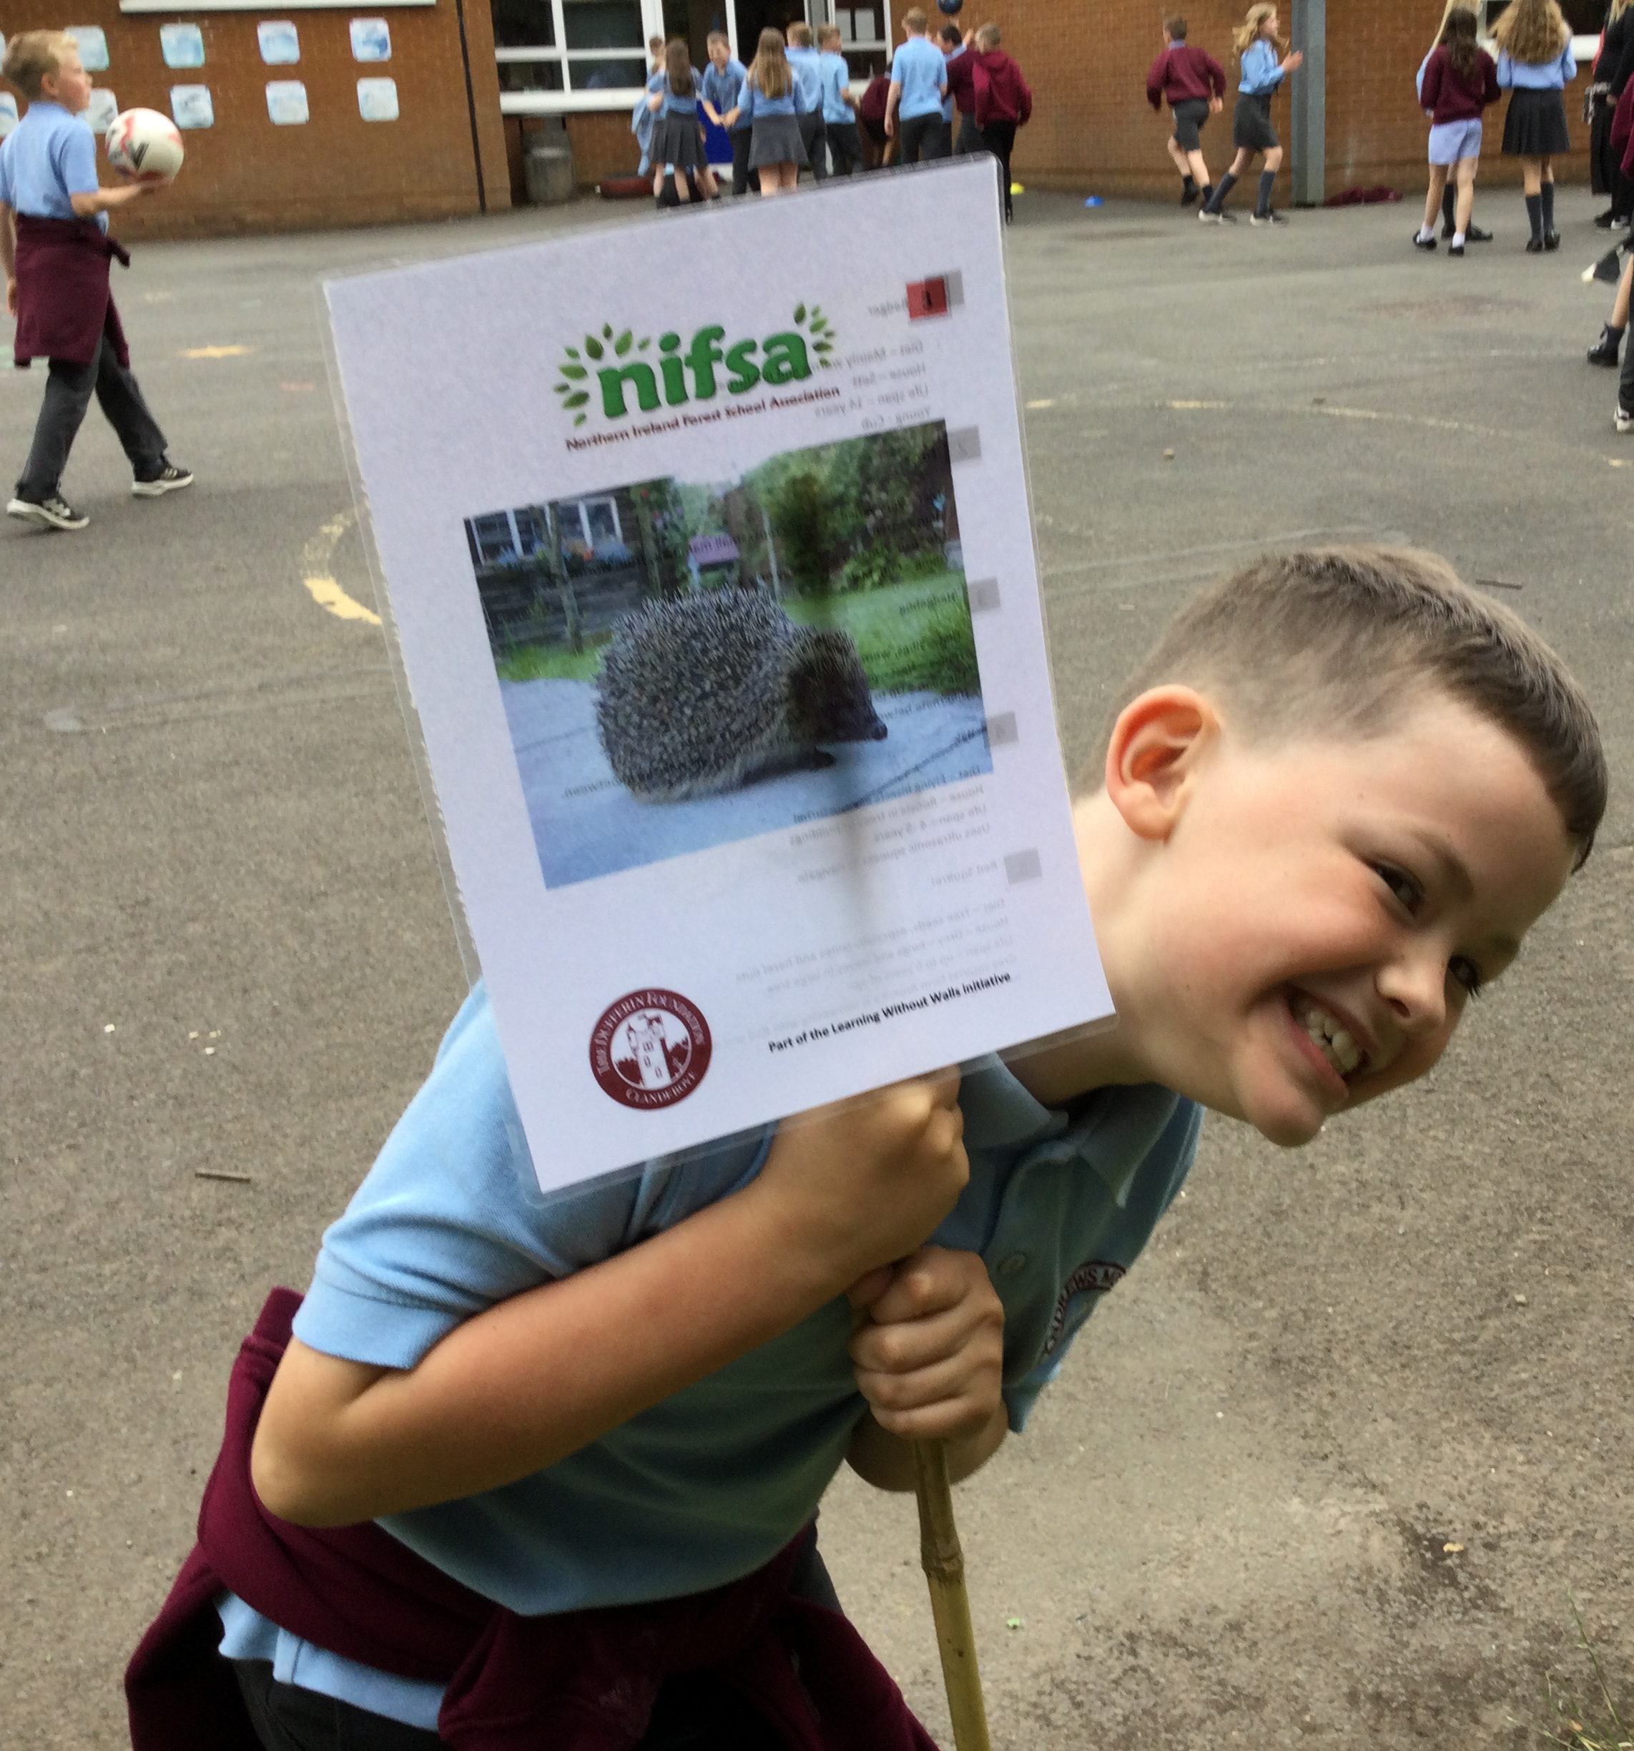
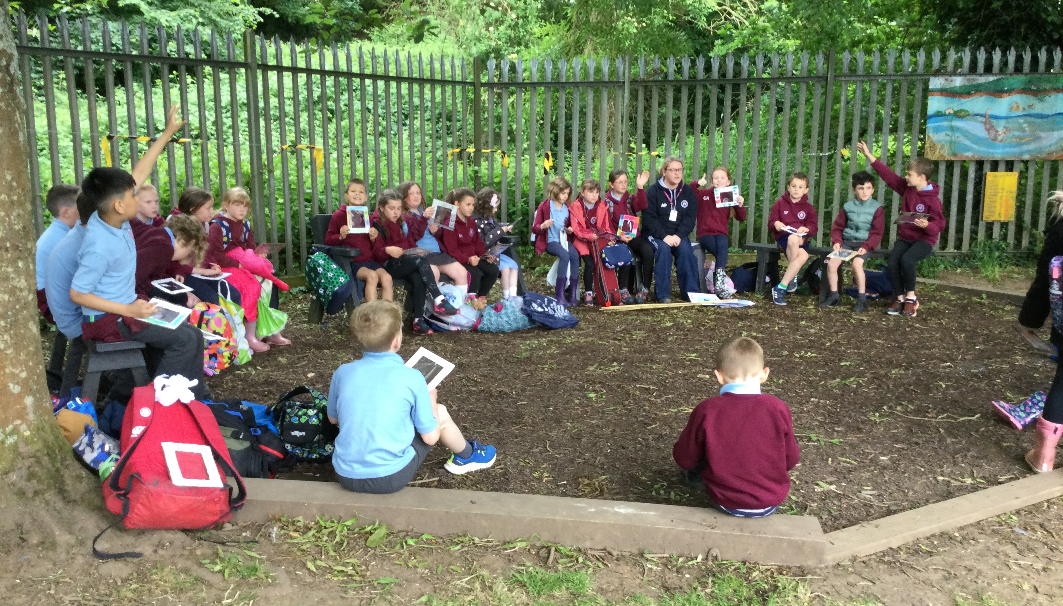
Health and Safety
To begin our lesson, we reminded ourselves of our Forest School rules.
Rule 1 – whistle
1 whistle blow – stop and become a tree
2 whistle blows – come back to base
Rule 2
Be safe and respect nature
Rule 3
Have fun and learn
We then put our boundary flags around the area.

Slide 3
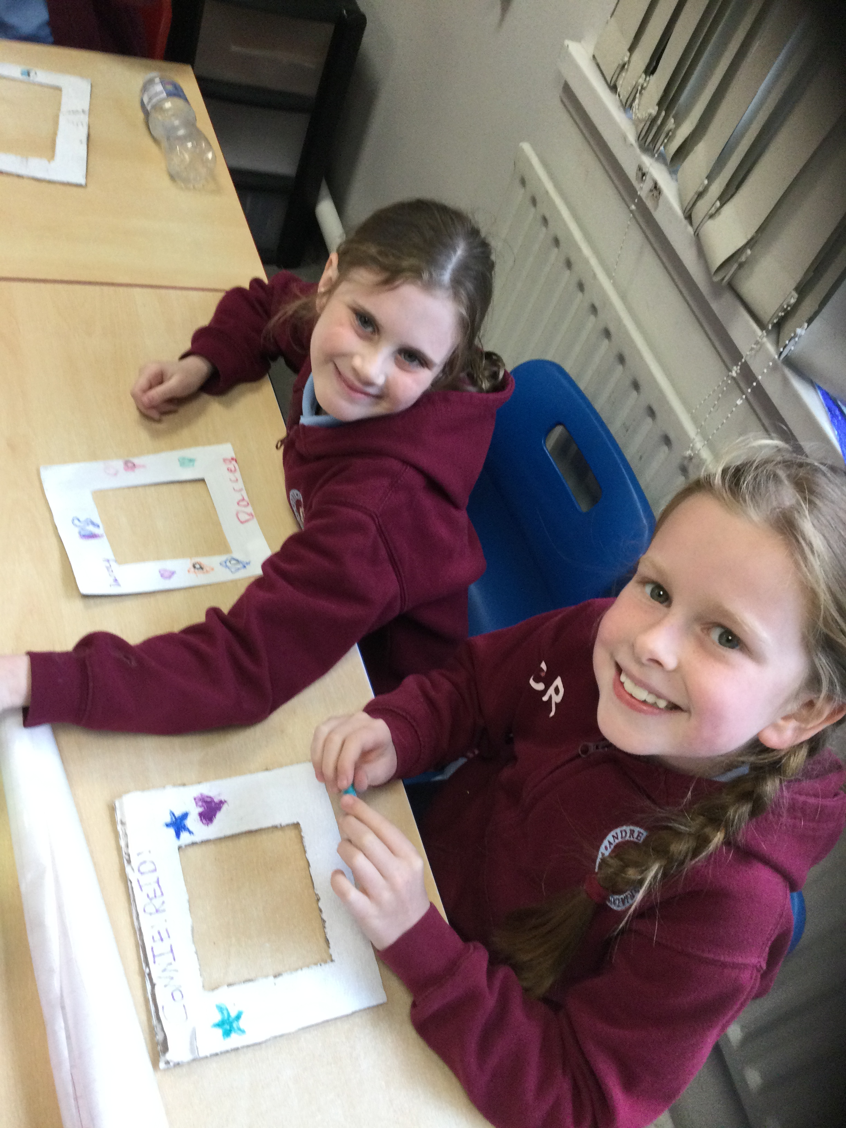
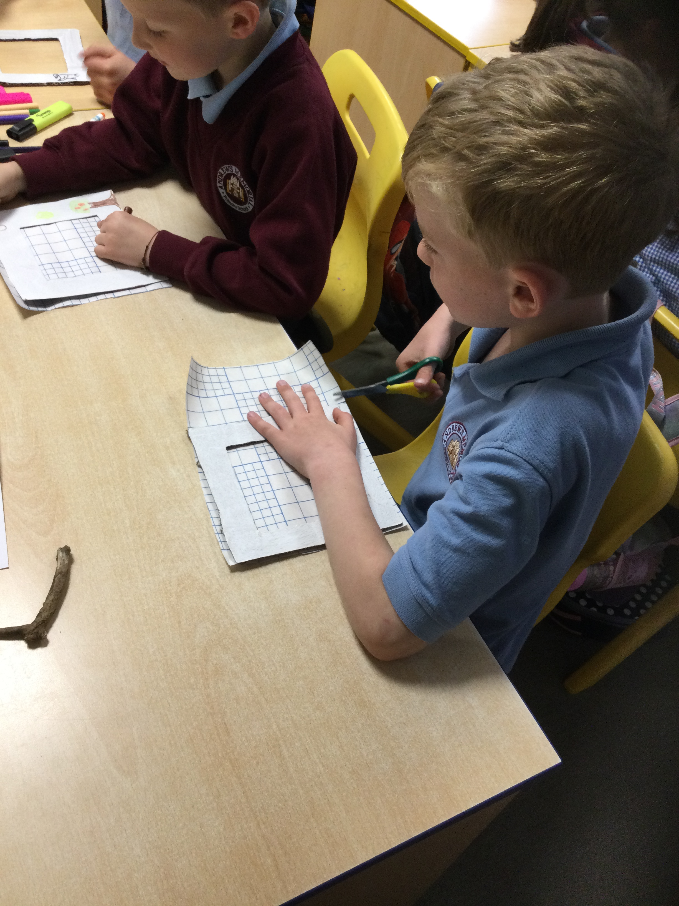
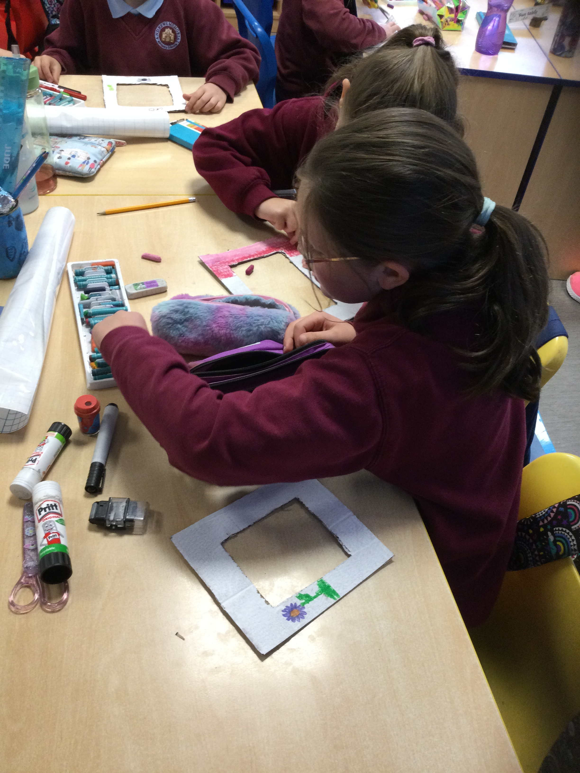
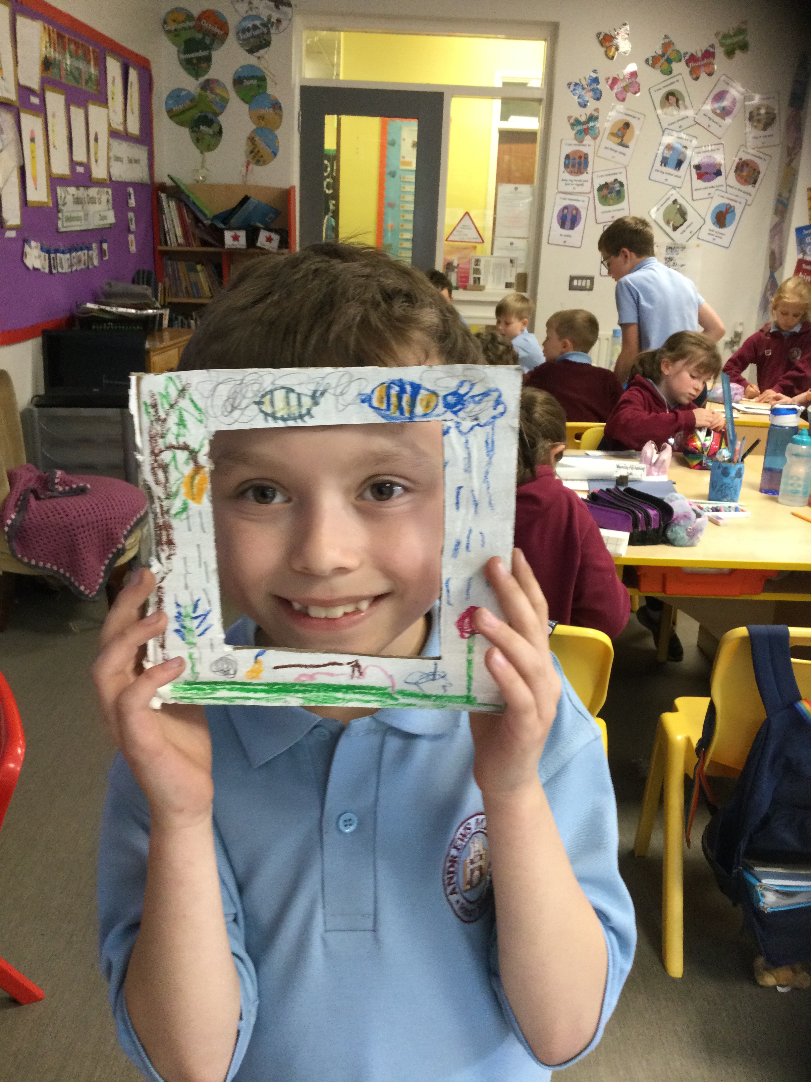
Nature Pictures
We’ve had several colouring competitions in class recently which we really enjoyed. For our Forest Schools lesson today, we are going to make our own nature pictures!
We used sticky back plastic to fill the spaces in our frames. Mrs Fulton had the frames cut for us but we needed to measure the plastic to fit. We enjoyed sitting with our friends to colour our frames.

Slide 4
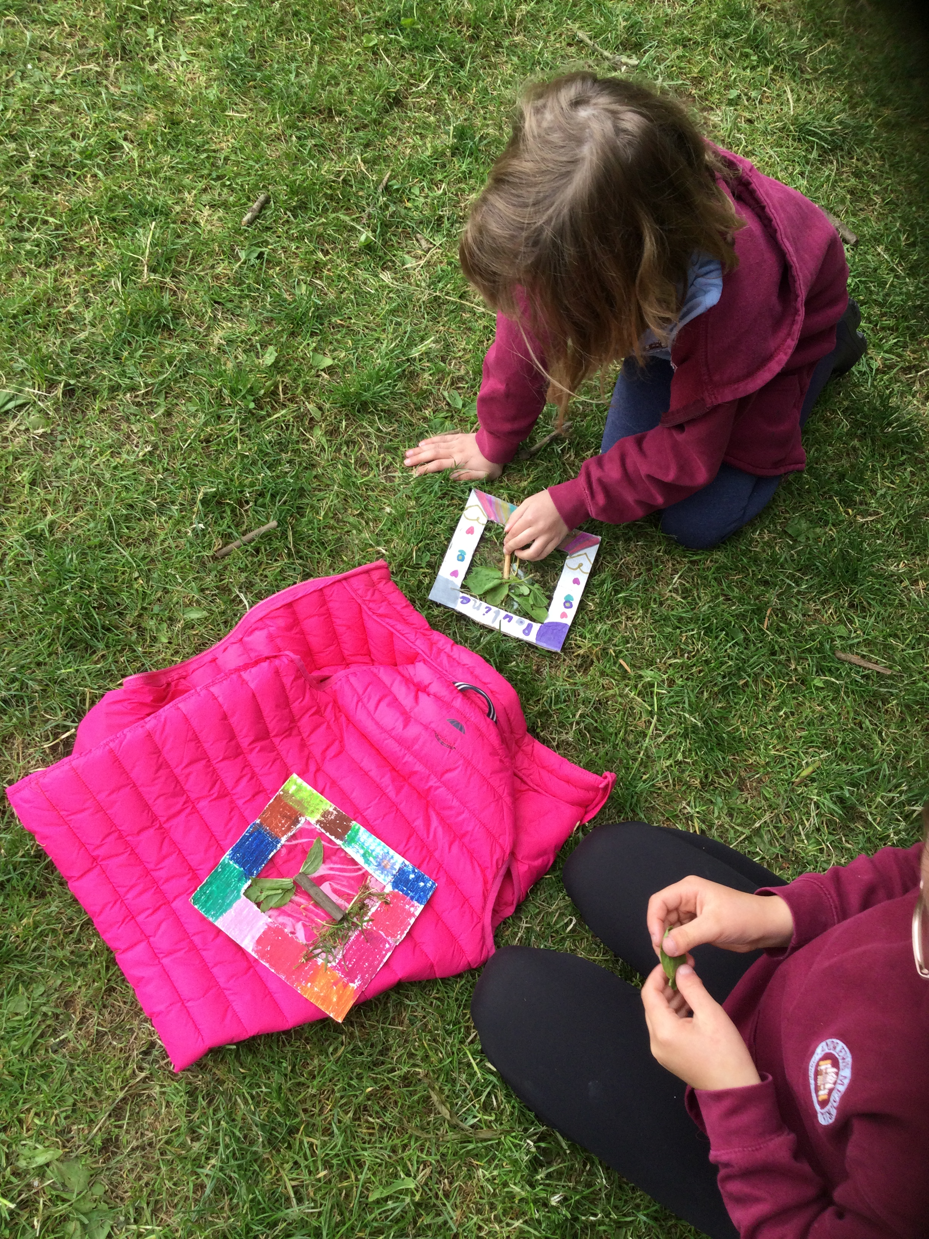
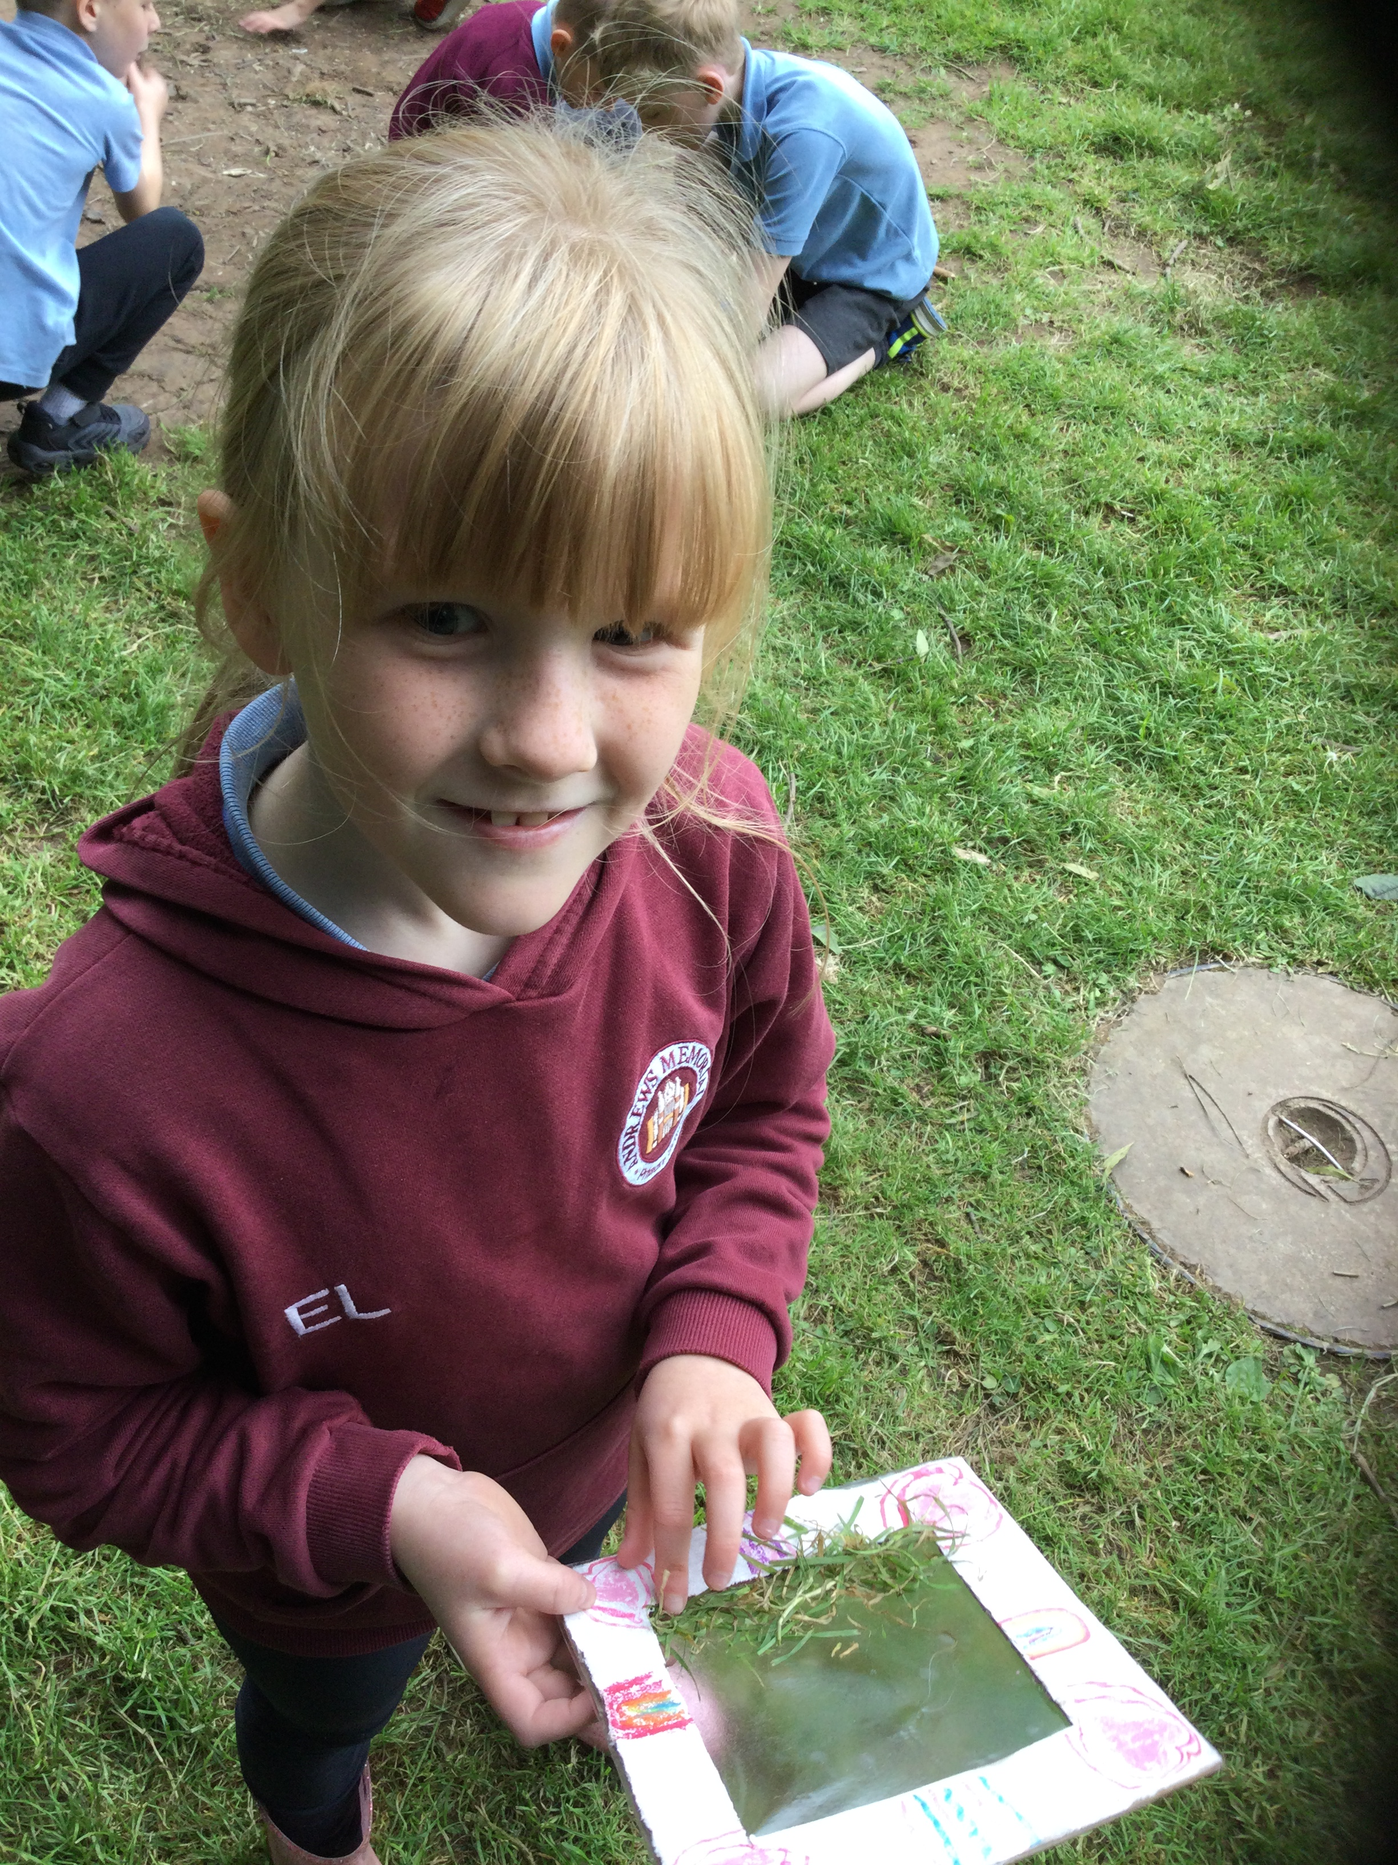
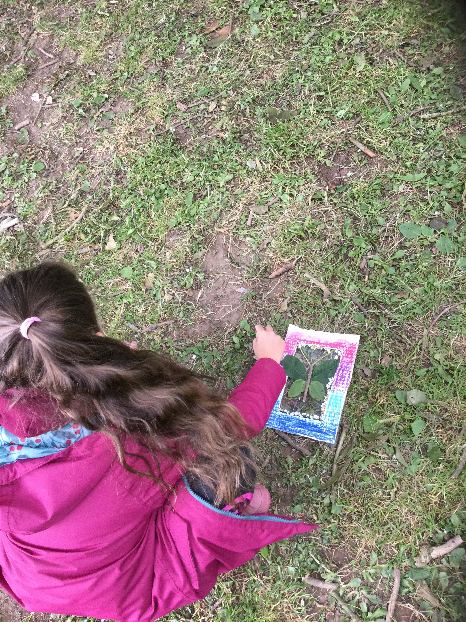
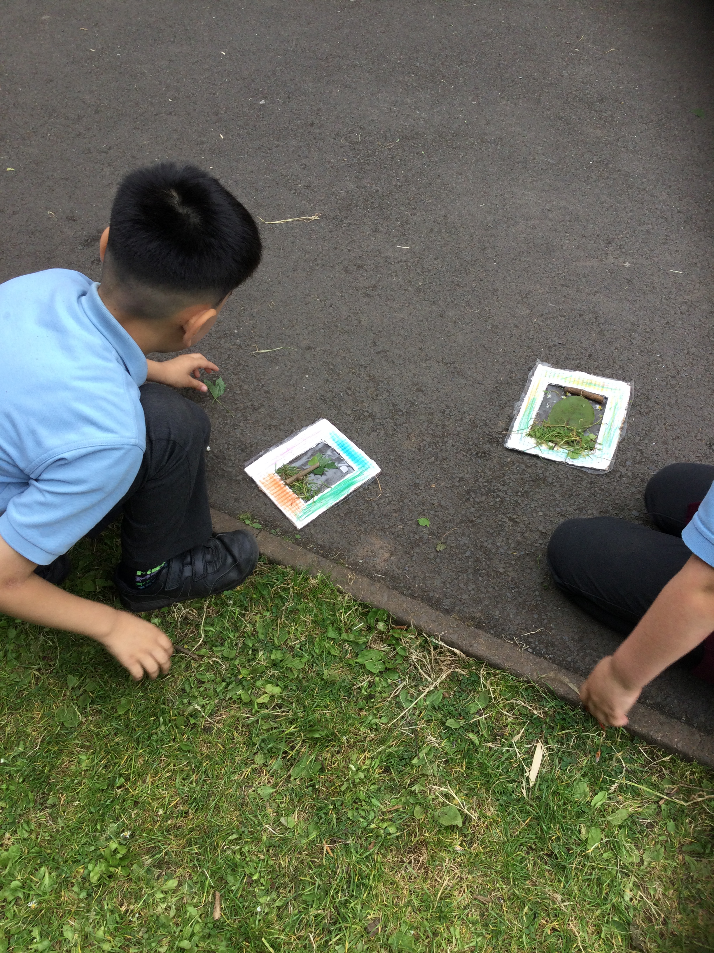
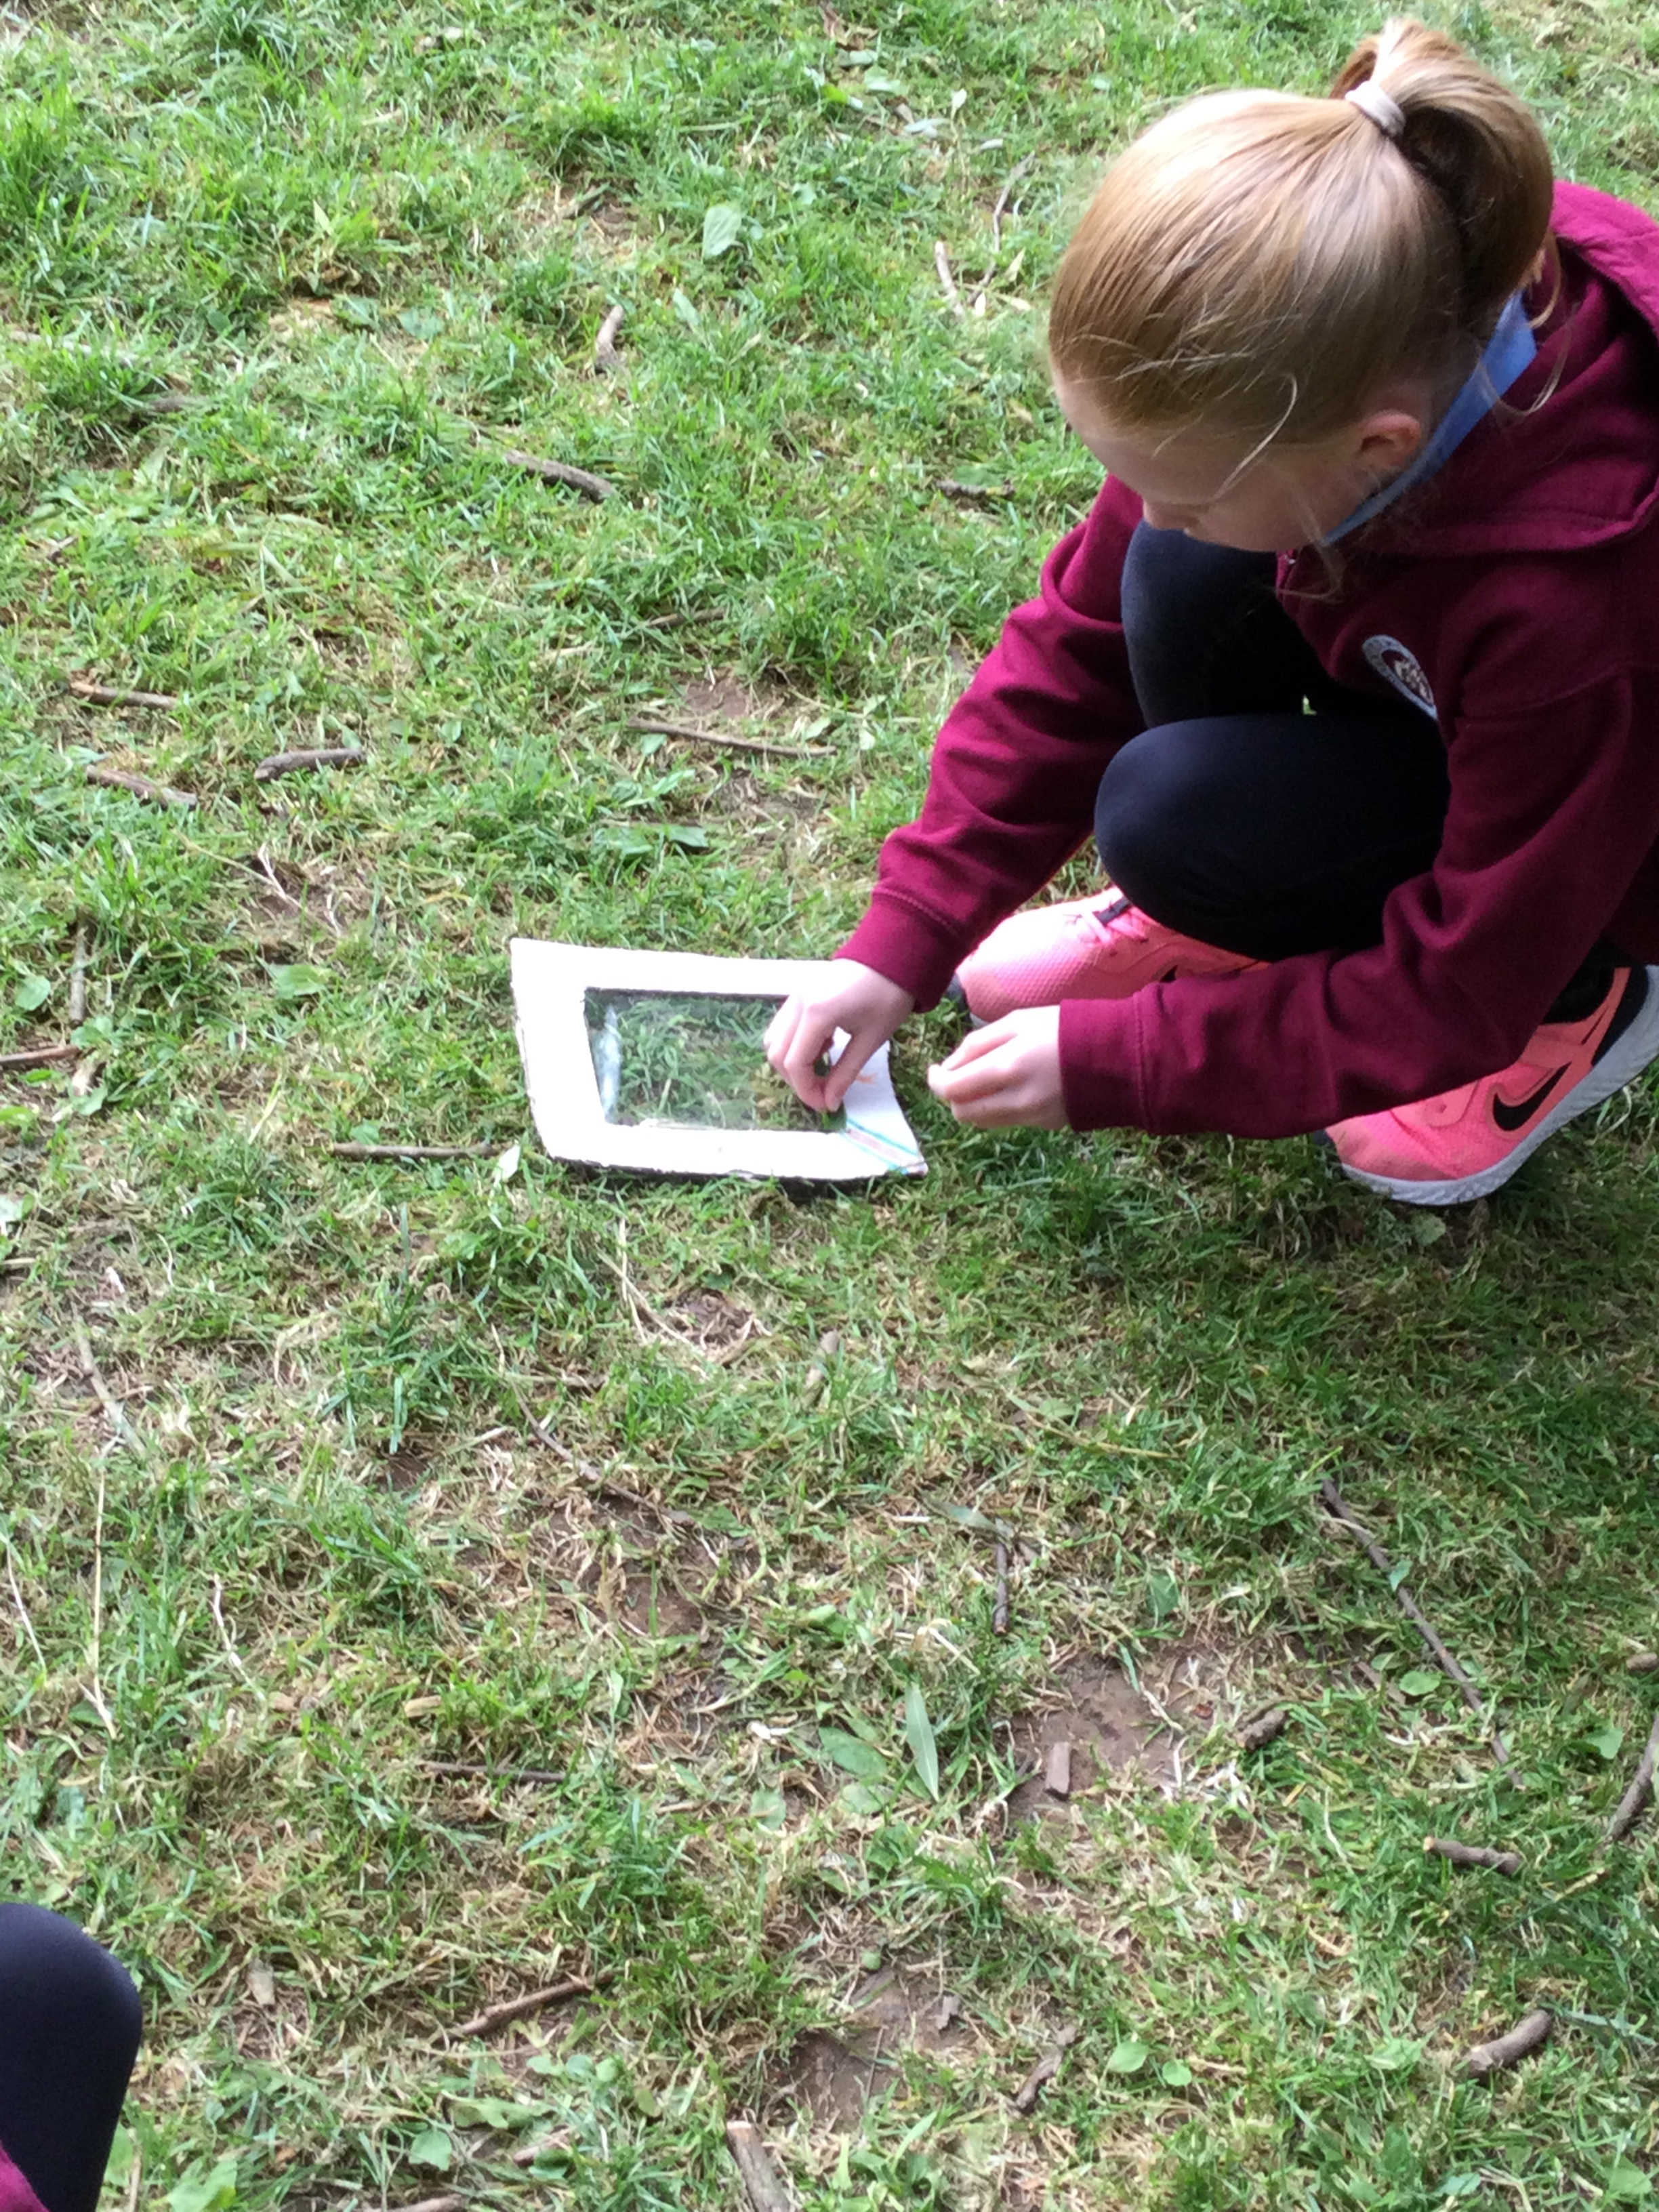
Nature Pictures
We had so much fun finding things to make our own nature pictures!

Slide 5
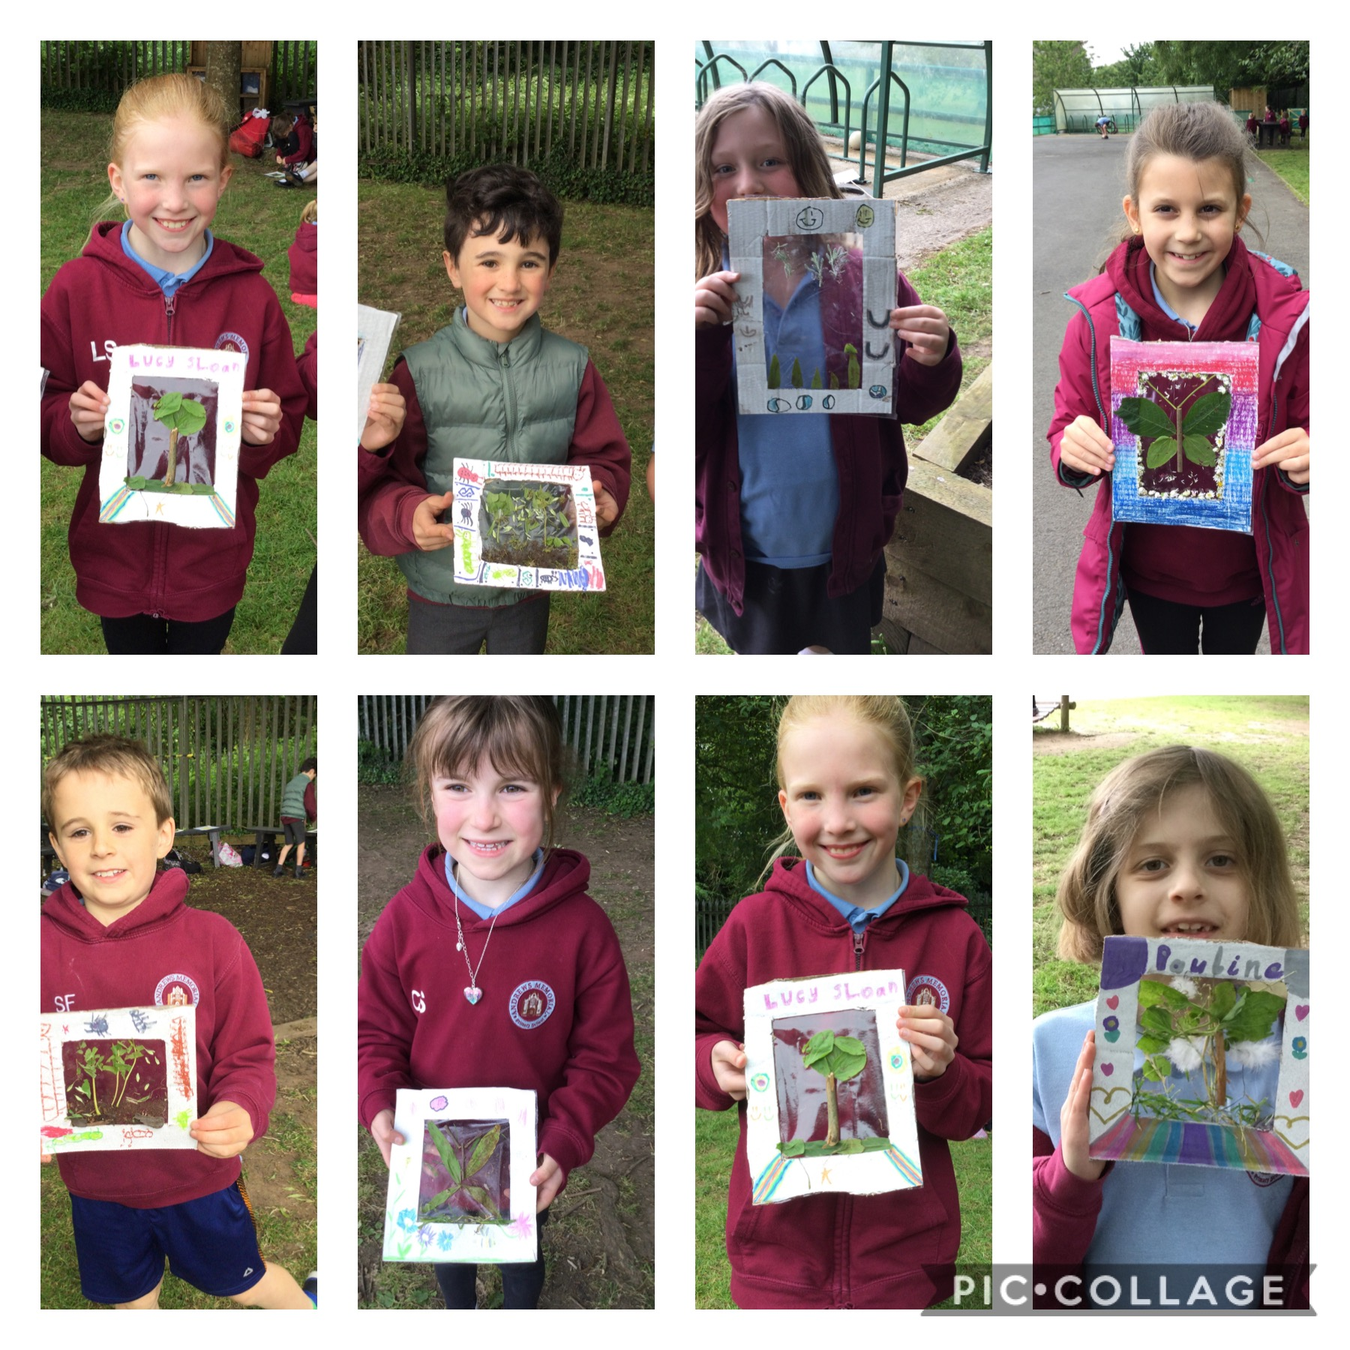
Nature pictures
Look at these wonderful pictures we created!

Slide 6
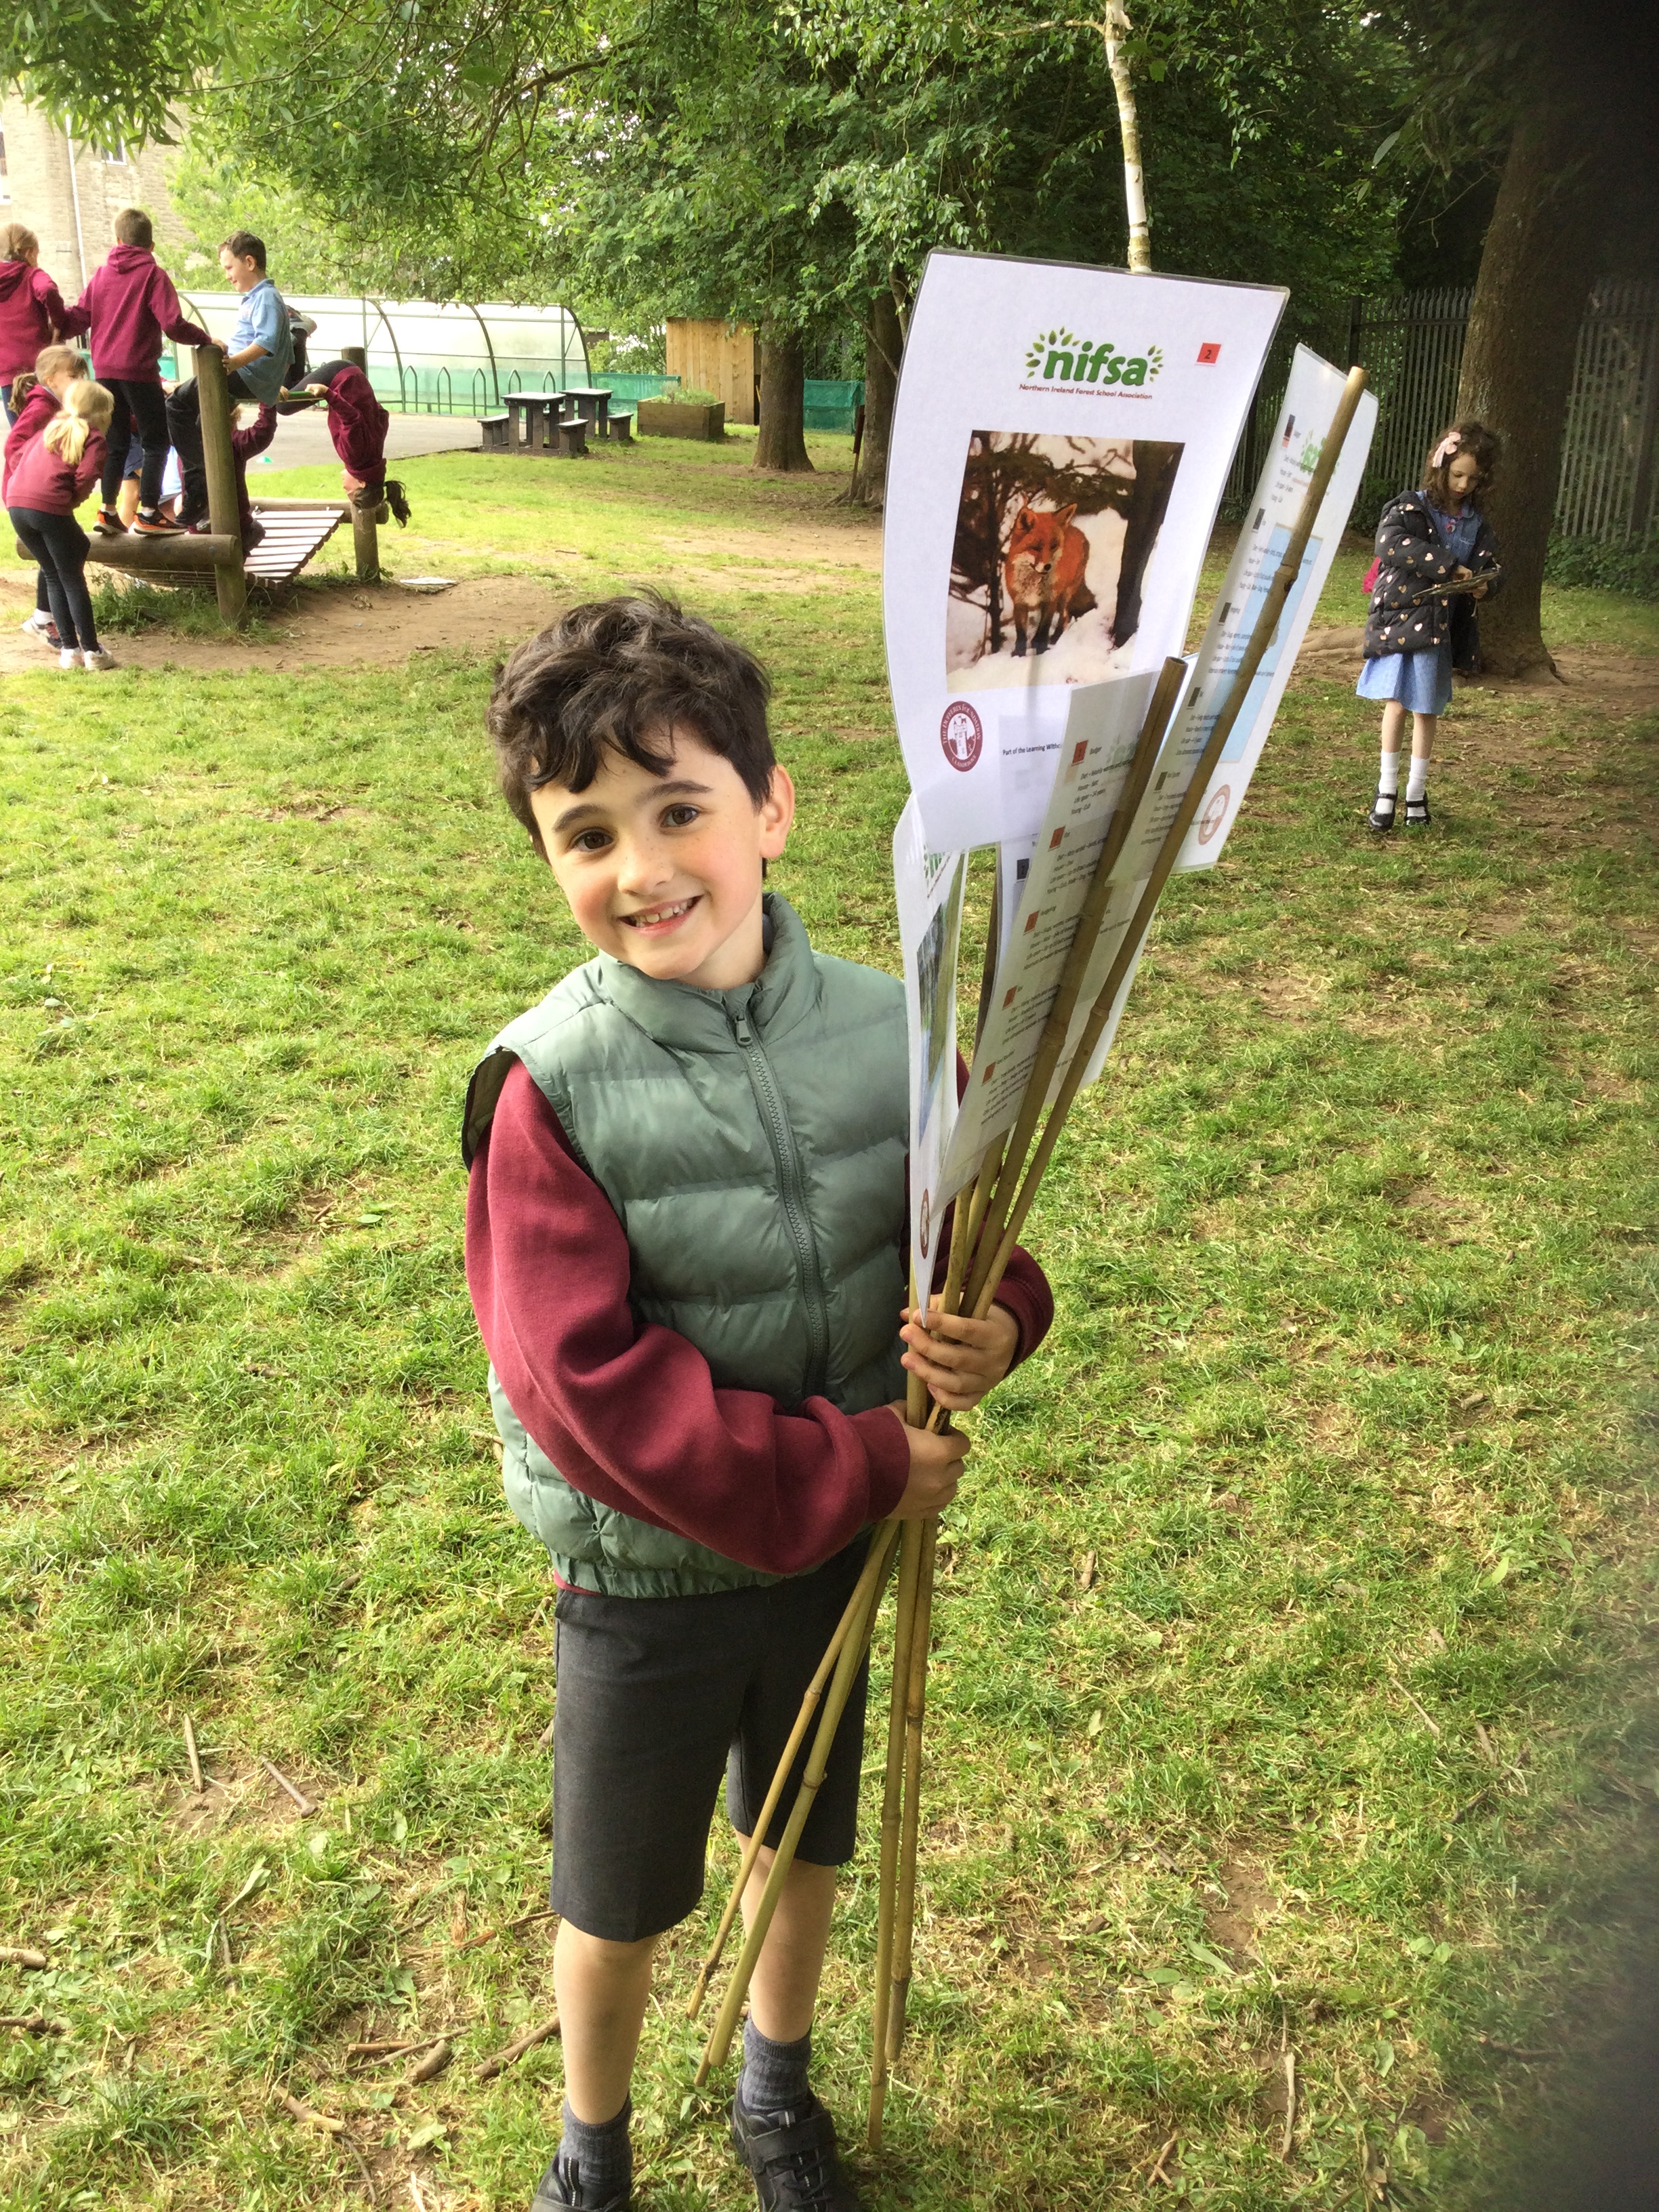
Leave no trace
We needed to make sure we tidied up after our lesson. We didn’t leave too much mess today so we only needed to tidy up our boundary lines.

Slide 7
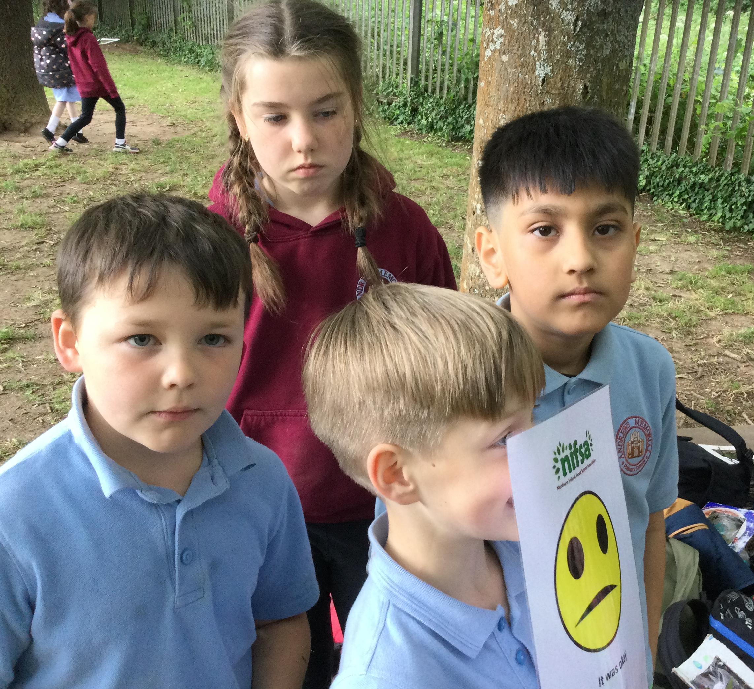
Evaluation
We had lots of happy faces today.
We had some sad faces today as our ‘sticky wouldn’t stick’. We had some other sad faces because our friends didn’t help us.

