Slide 1
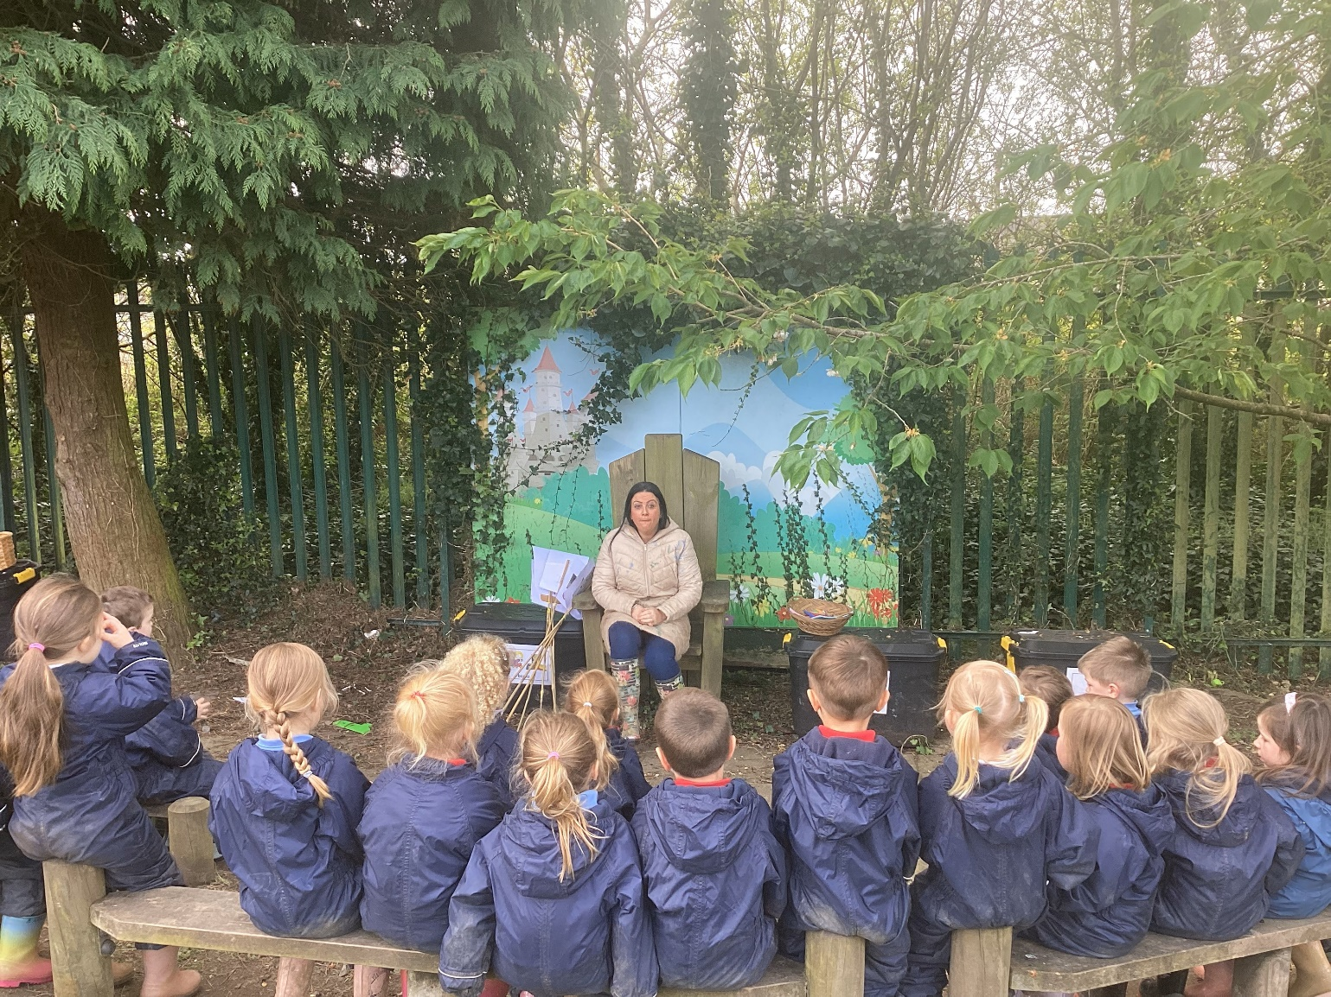
Glenbrook Nursery School
Forest School Diary
Class 2
25/4/24 Mud Painting

Slide 2
Our Rules
We listen to our rules –
1 whistle = stop, 2 whistles = back to base and 3rd rule = have fun and learn.
We also remember to respect nature

Slide 3
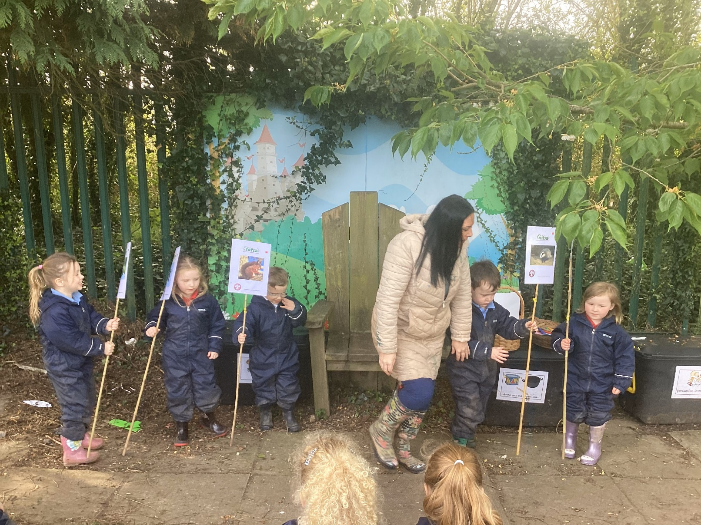
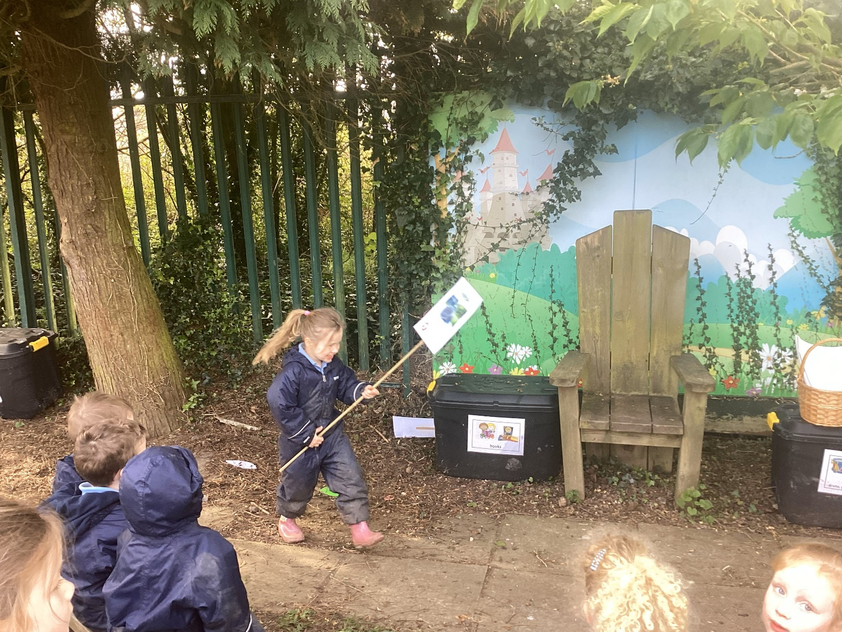
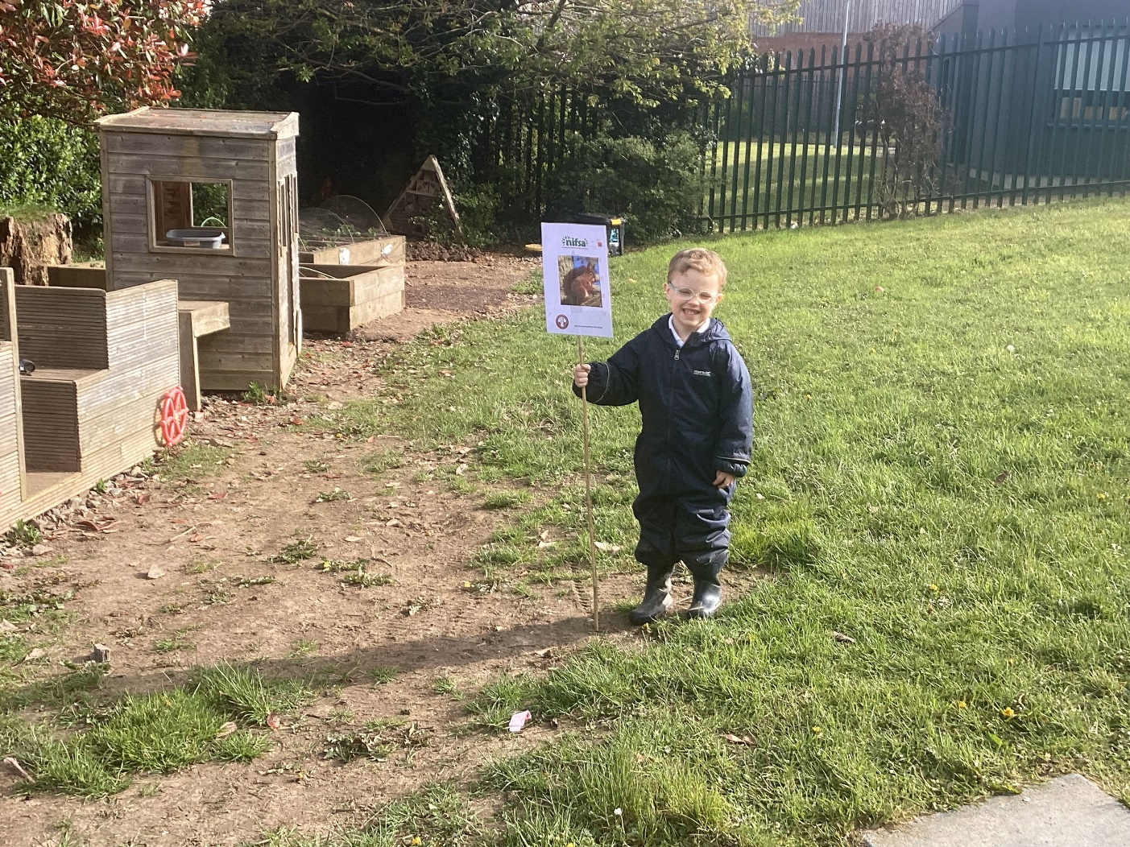
Staying Safe
We put out our boundary flags for us to stay inside.
We had some great helpers!

Slide 4
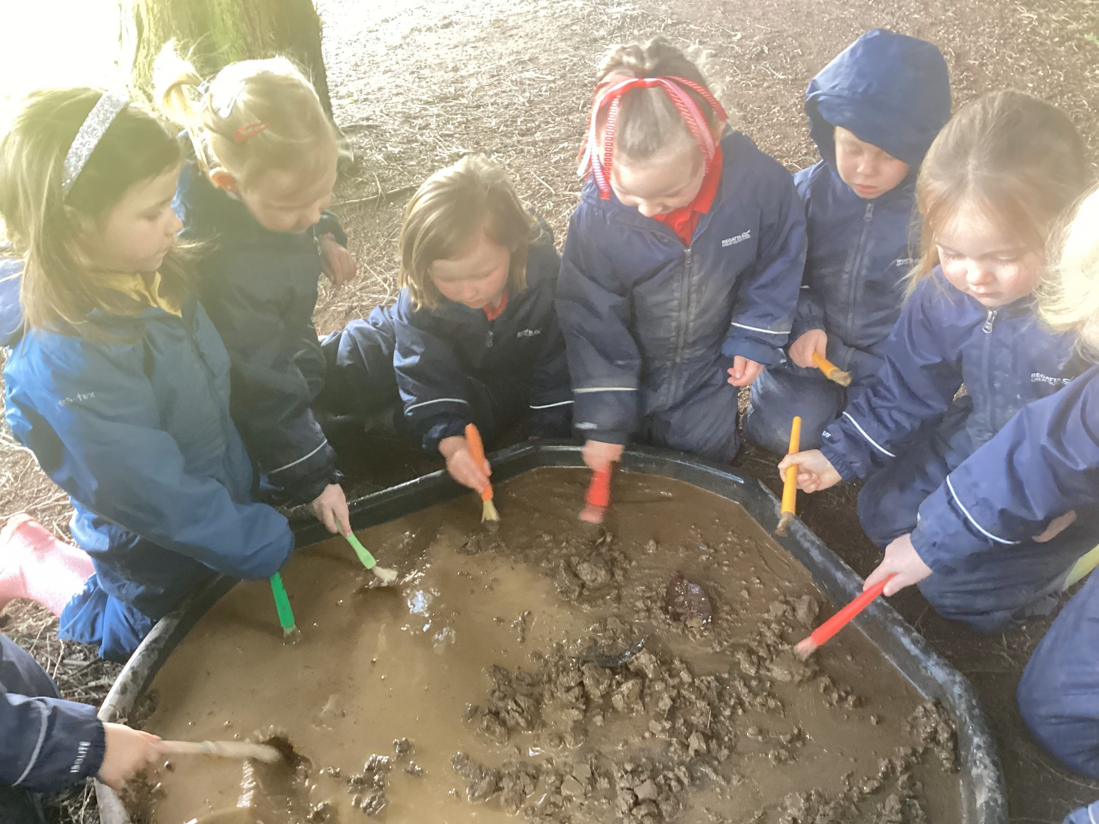
First we explored the mud with the paint brushes.

Slide 5
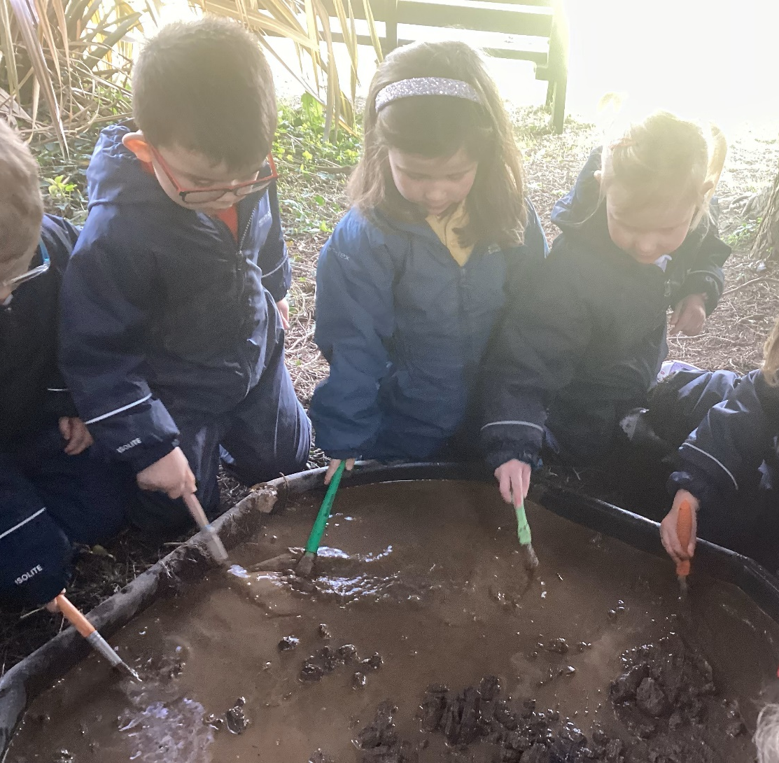
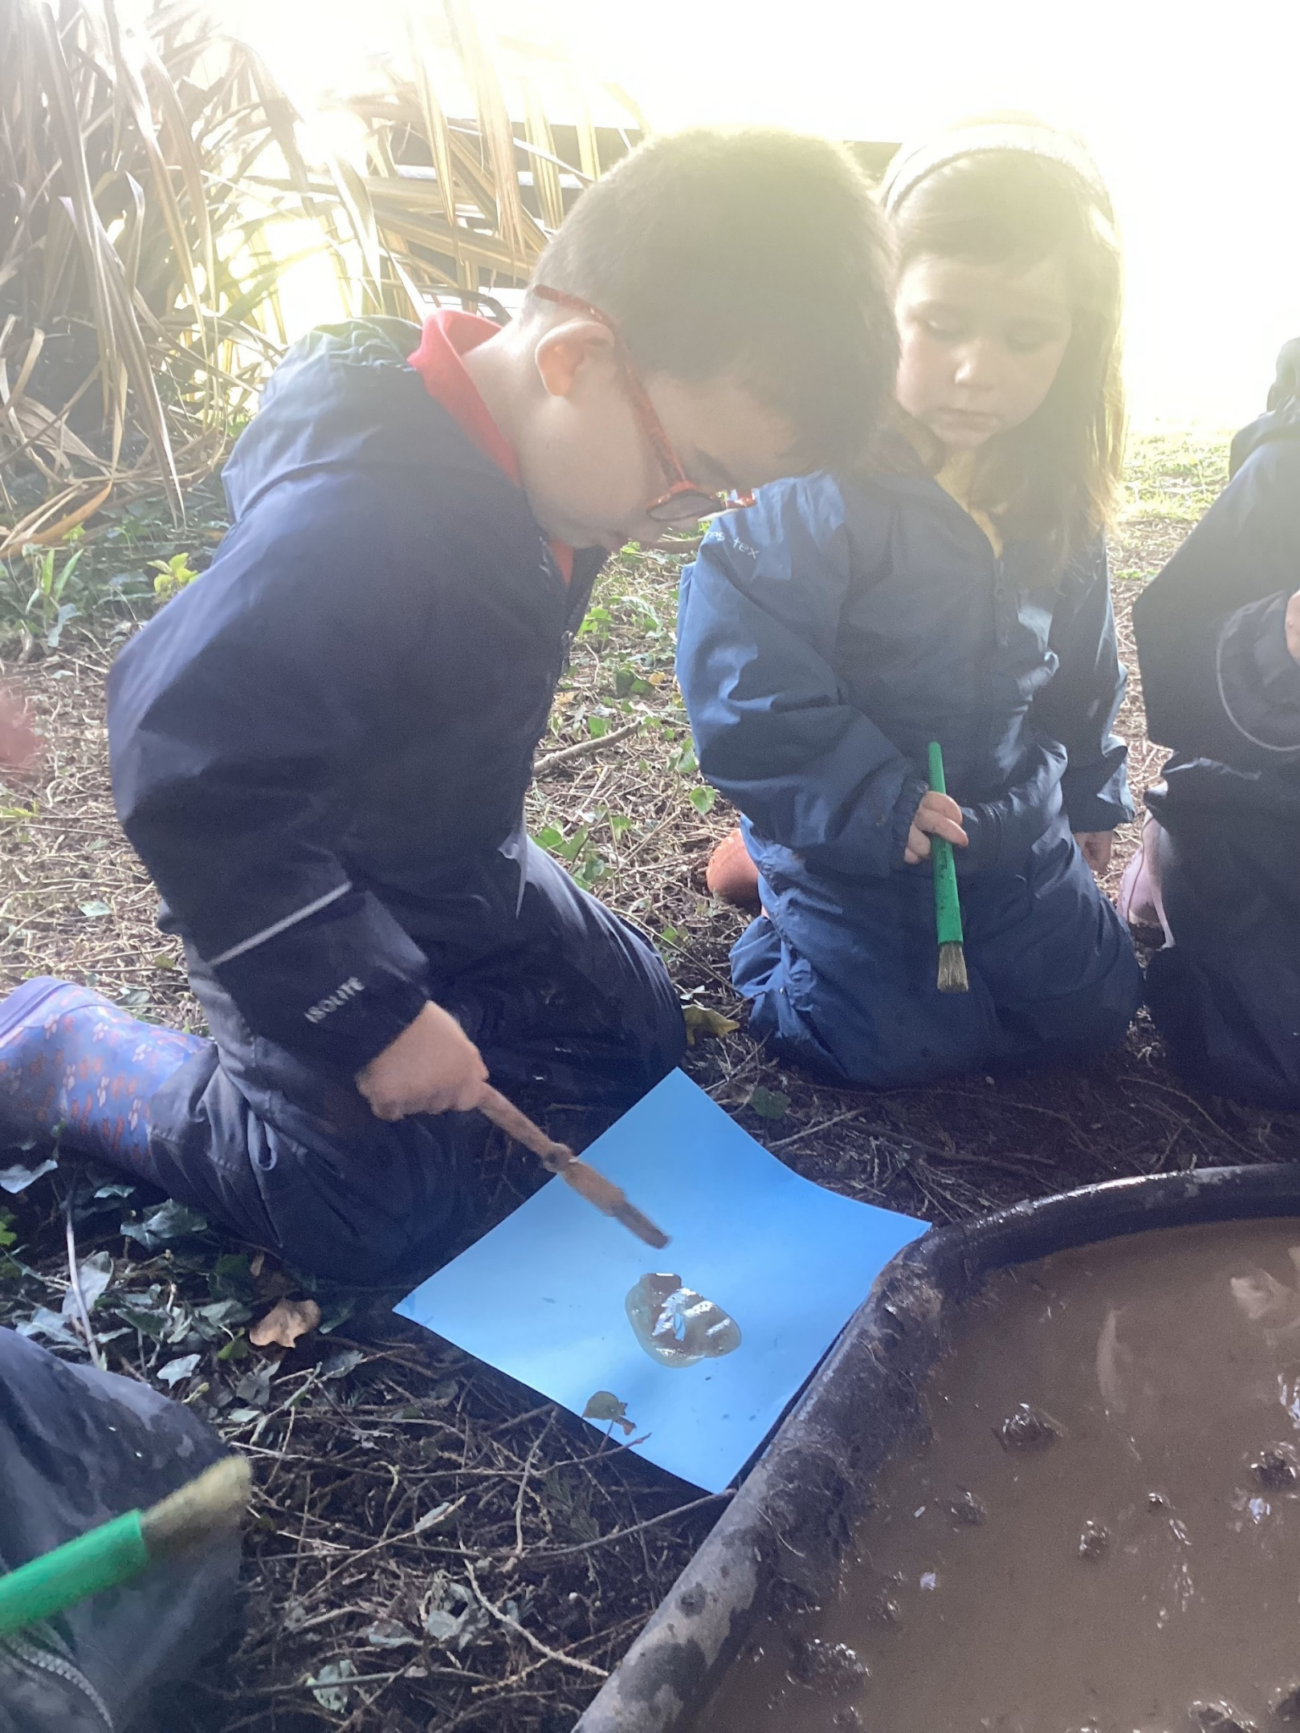
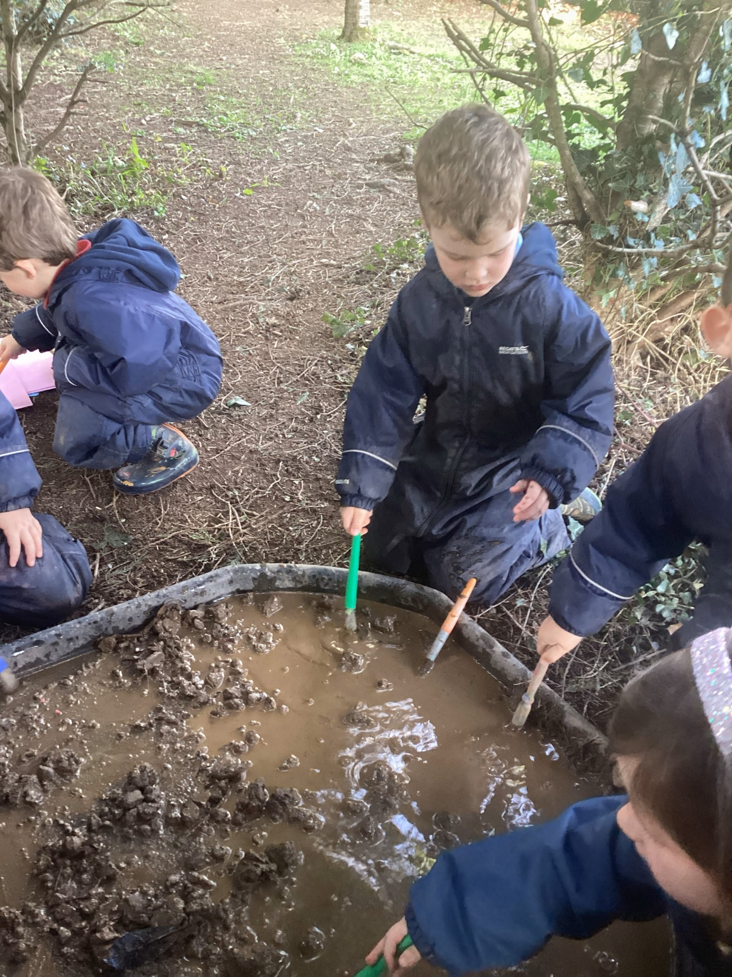

Slide 6
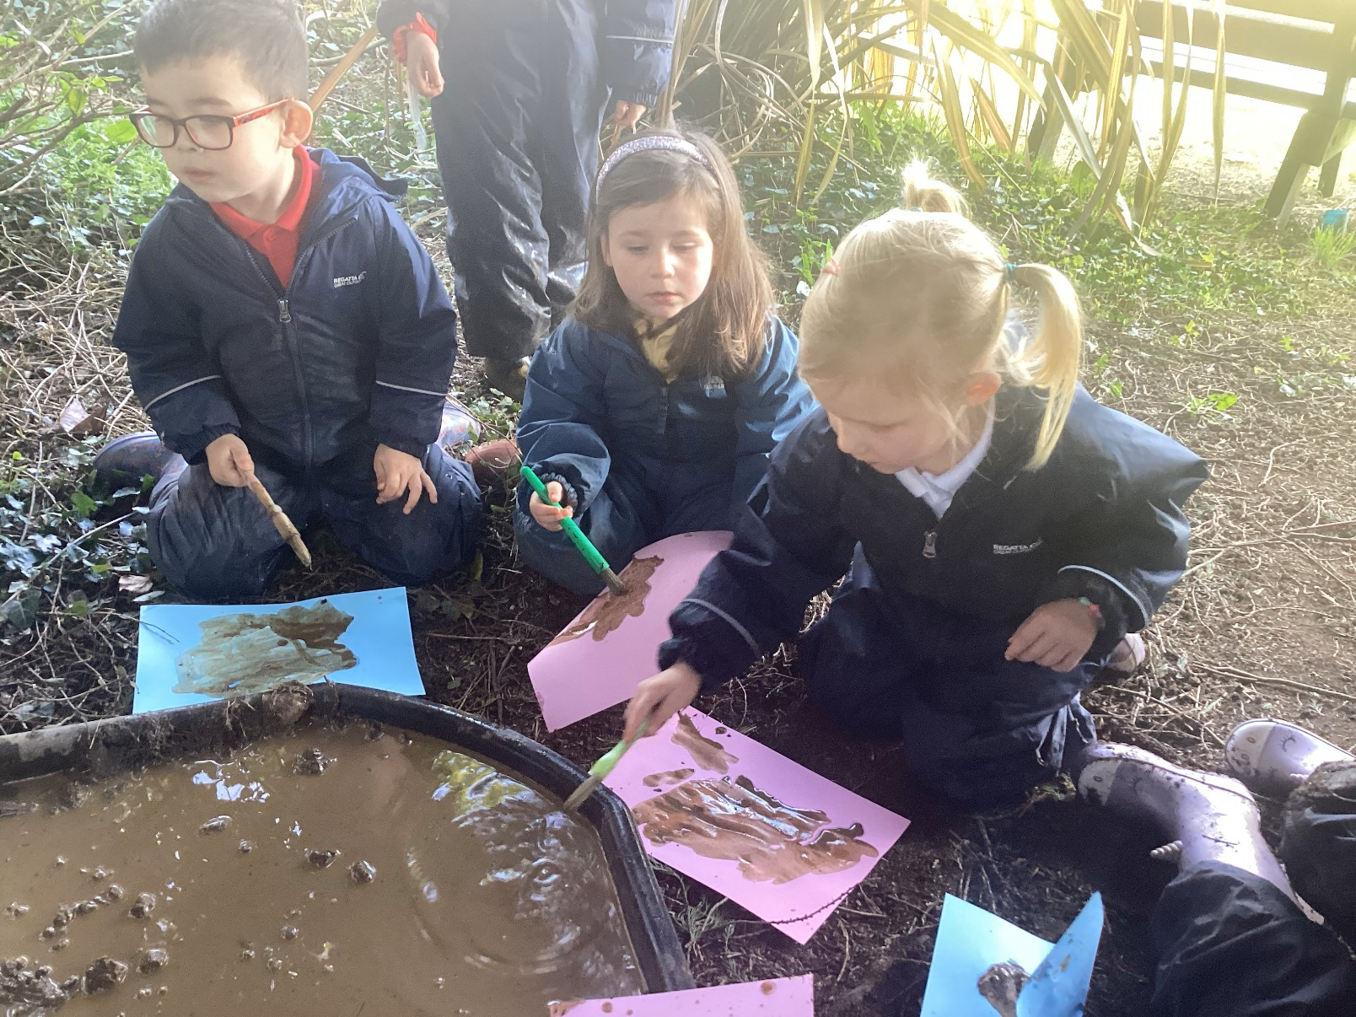
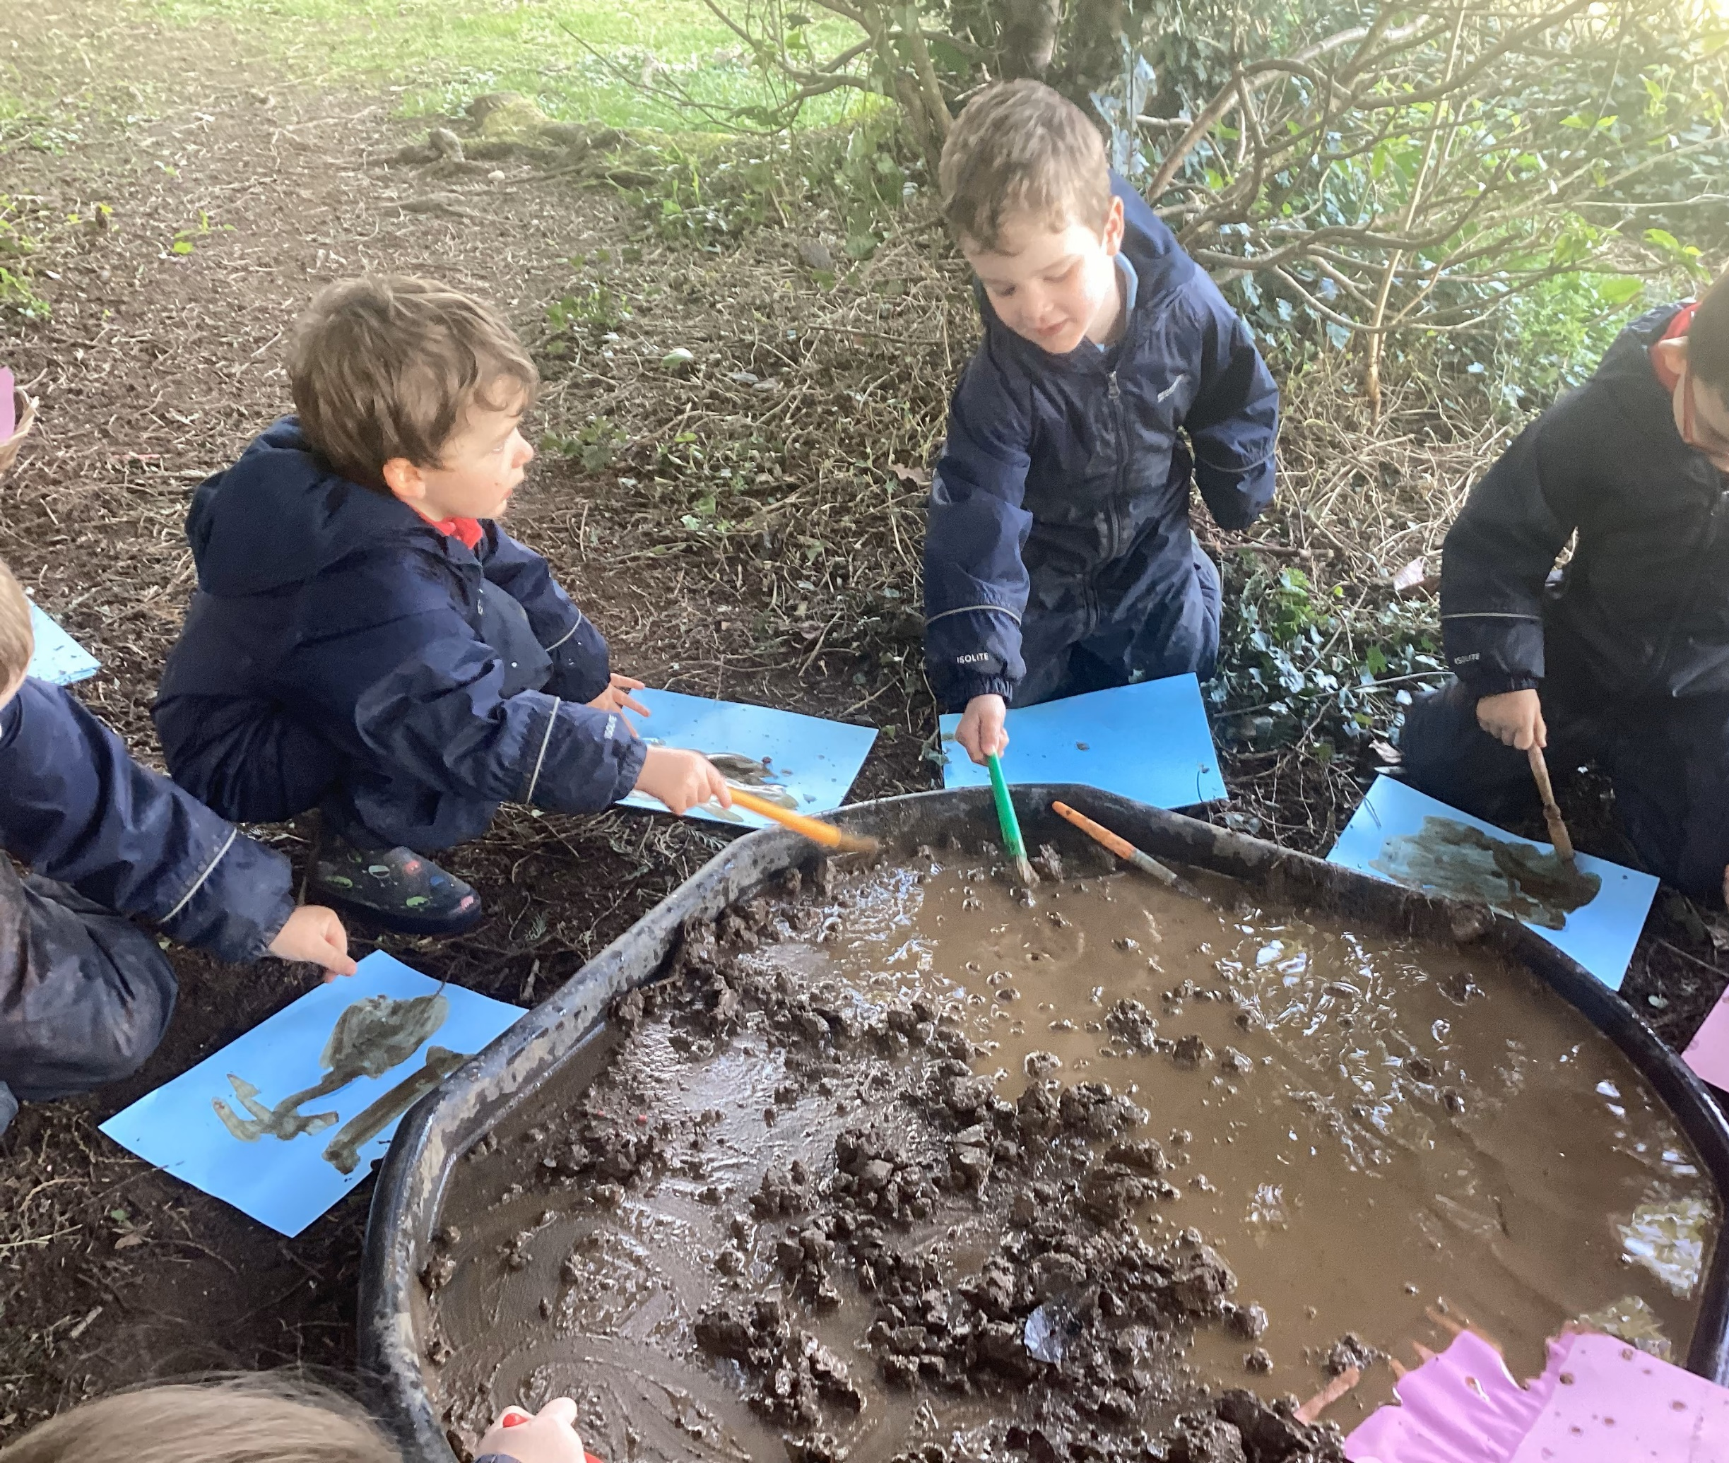
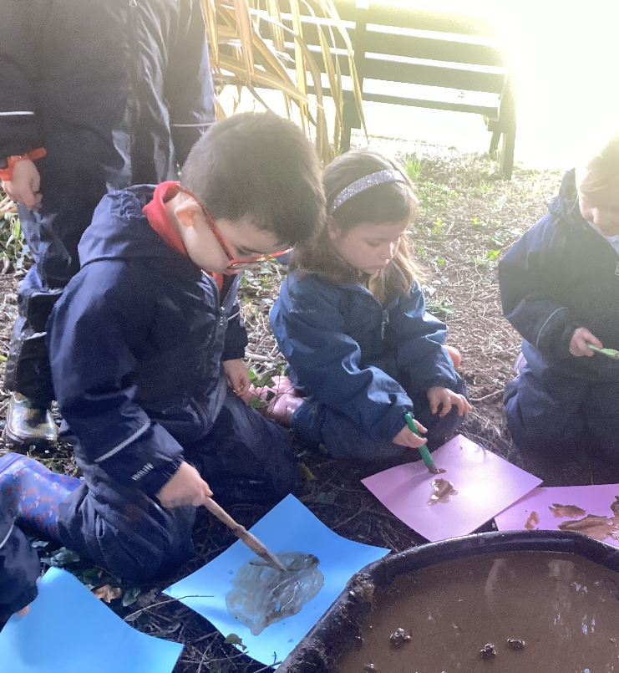

Slide 7
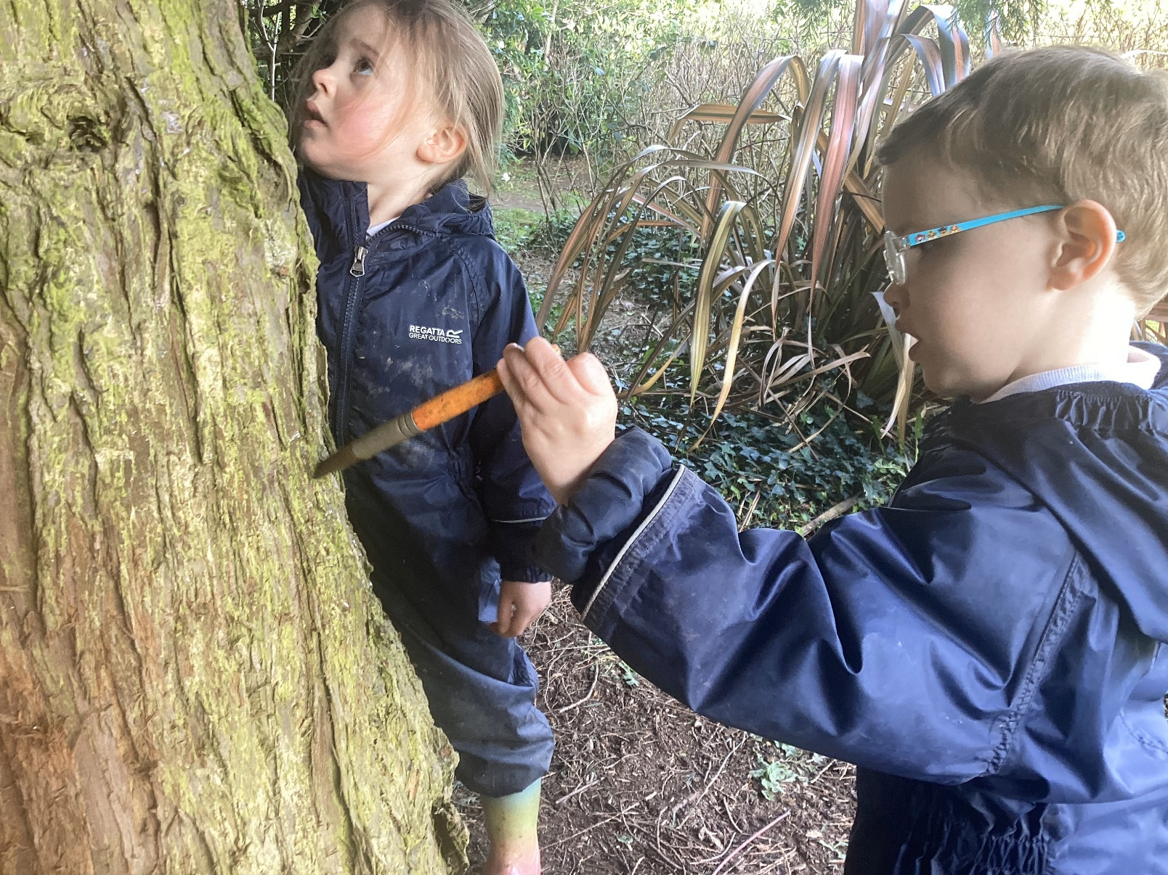
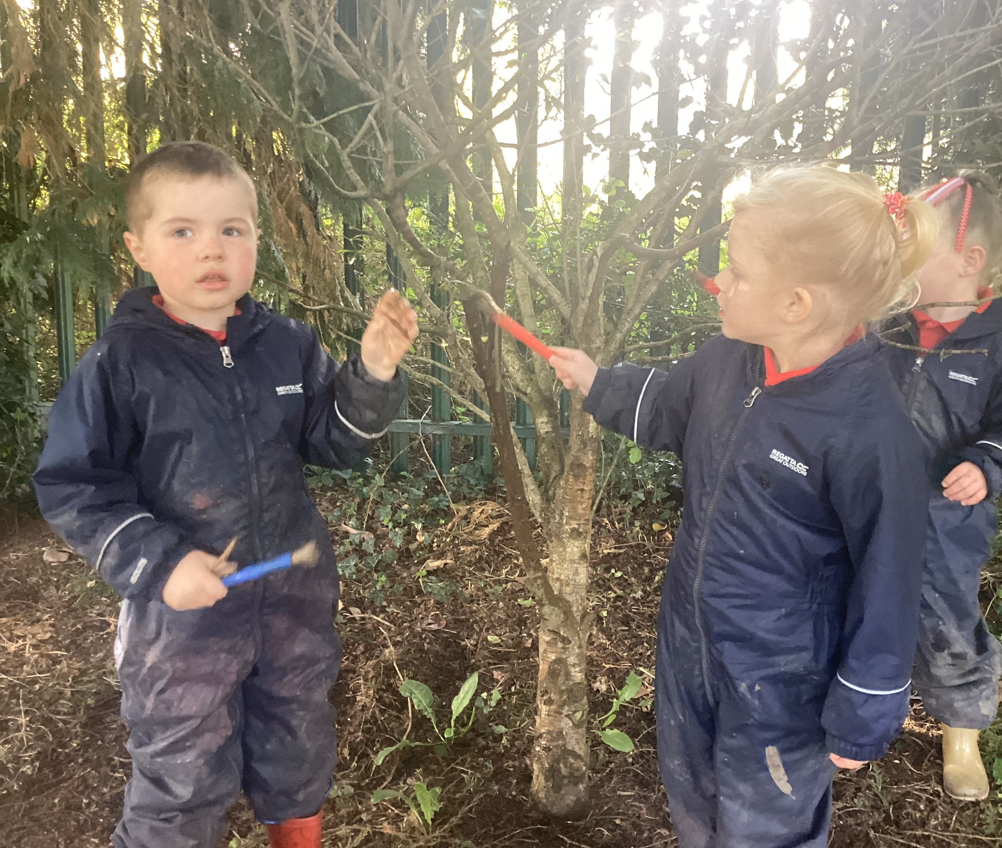
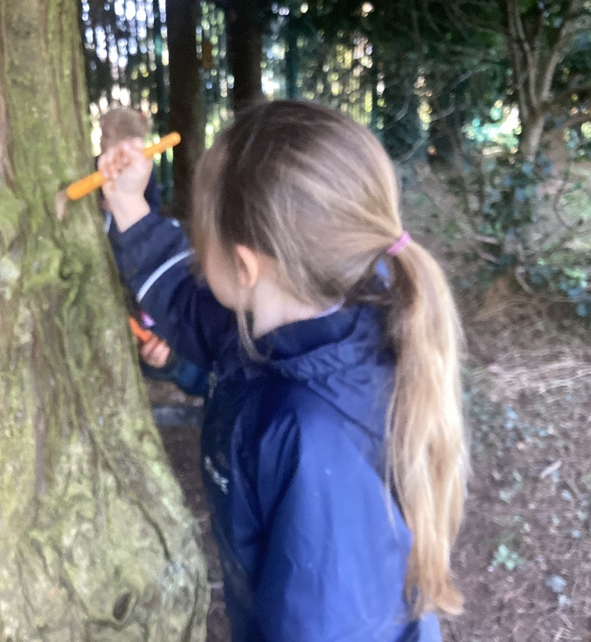
Some children wanted to paint on the trees with the mud.
Great idea!

Slide 8
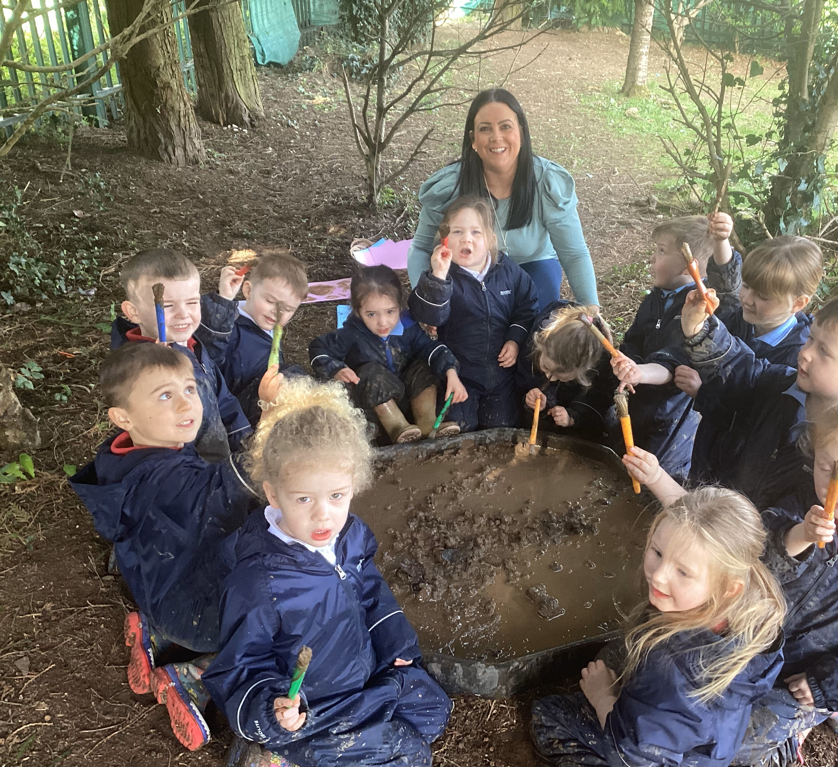
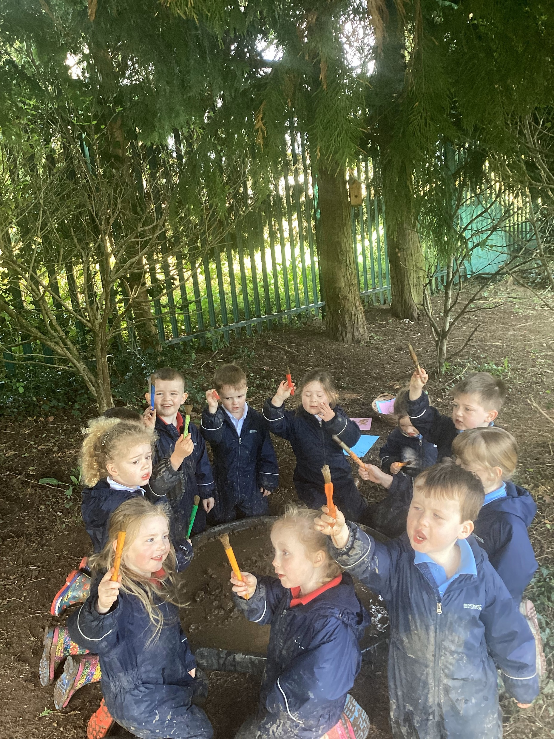

Slide 9
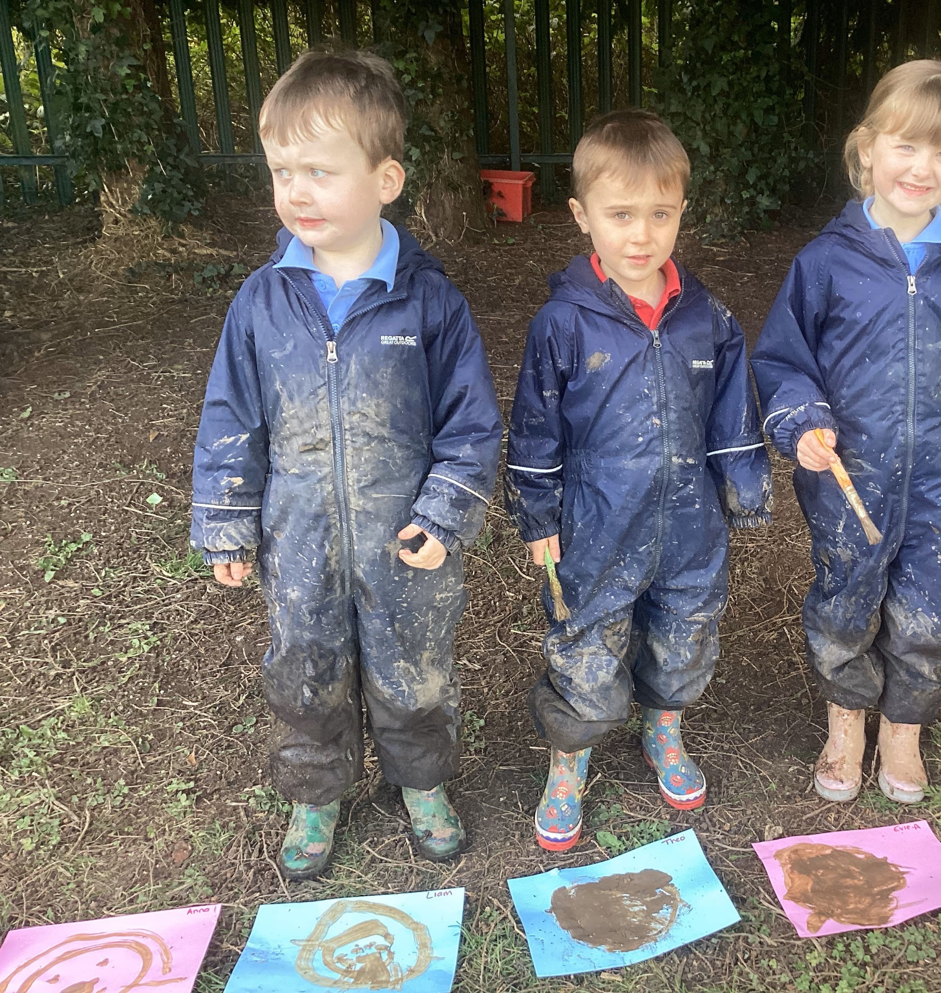
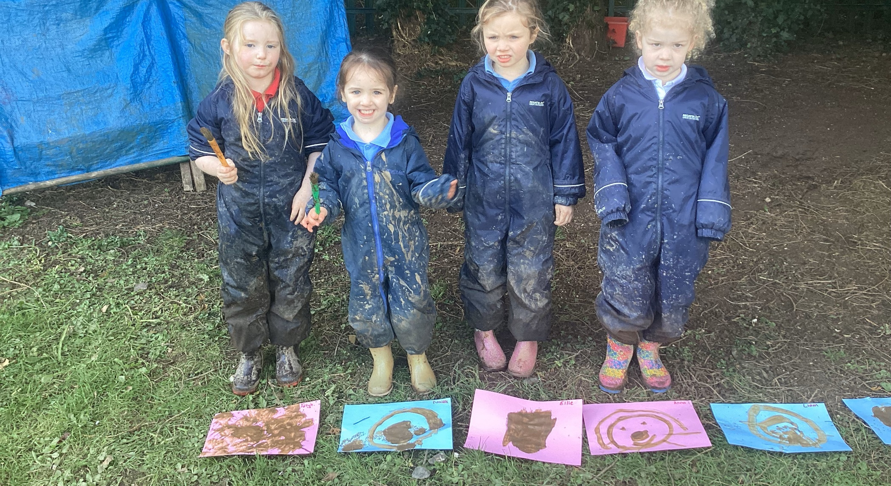
Look at our fantastic mud art!

Slide 10
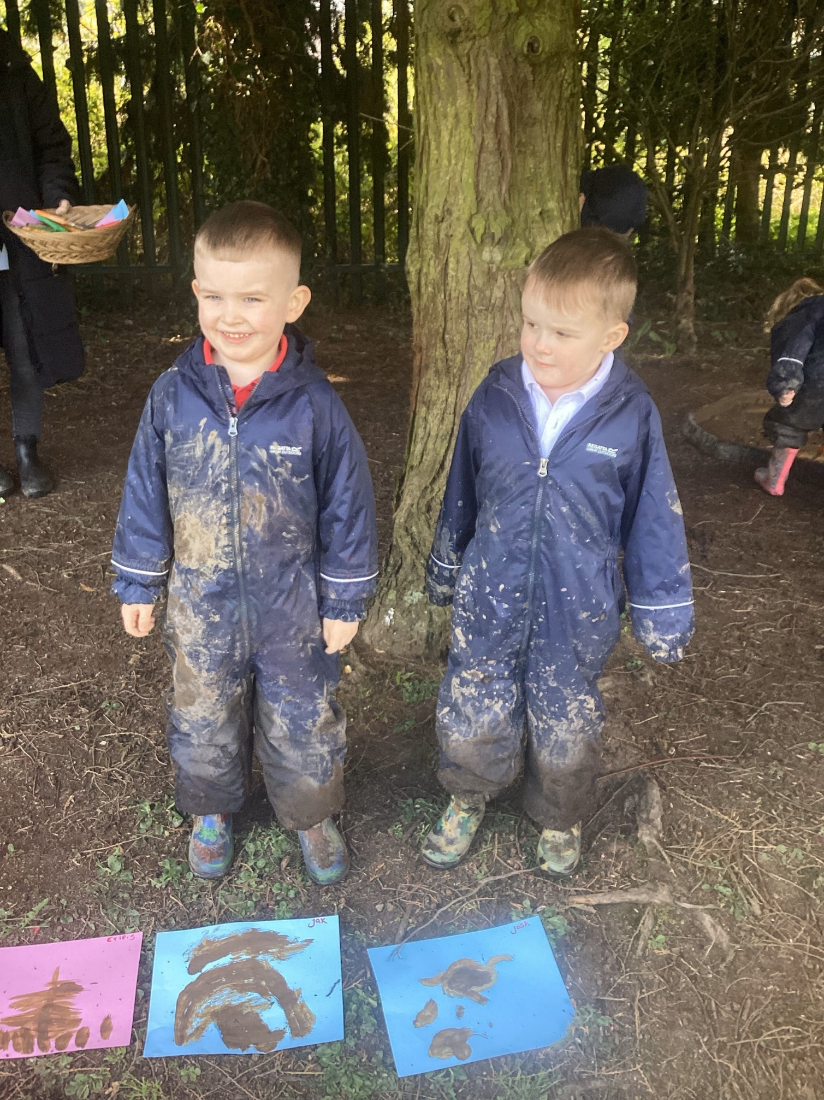

Slide 11
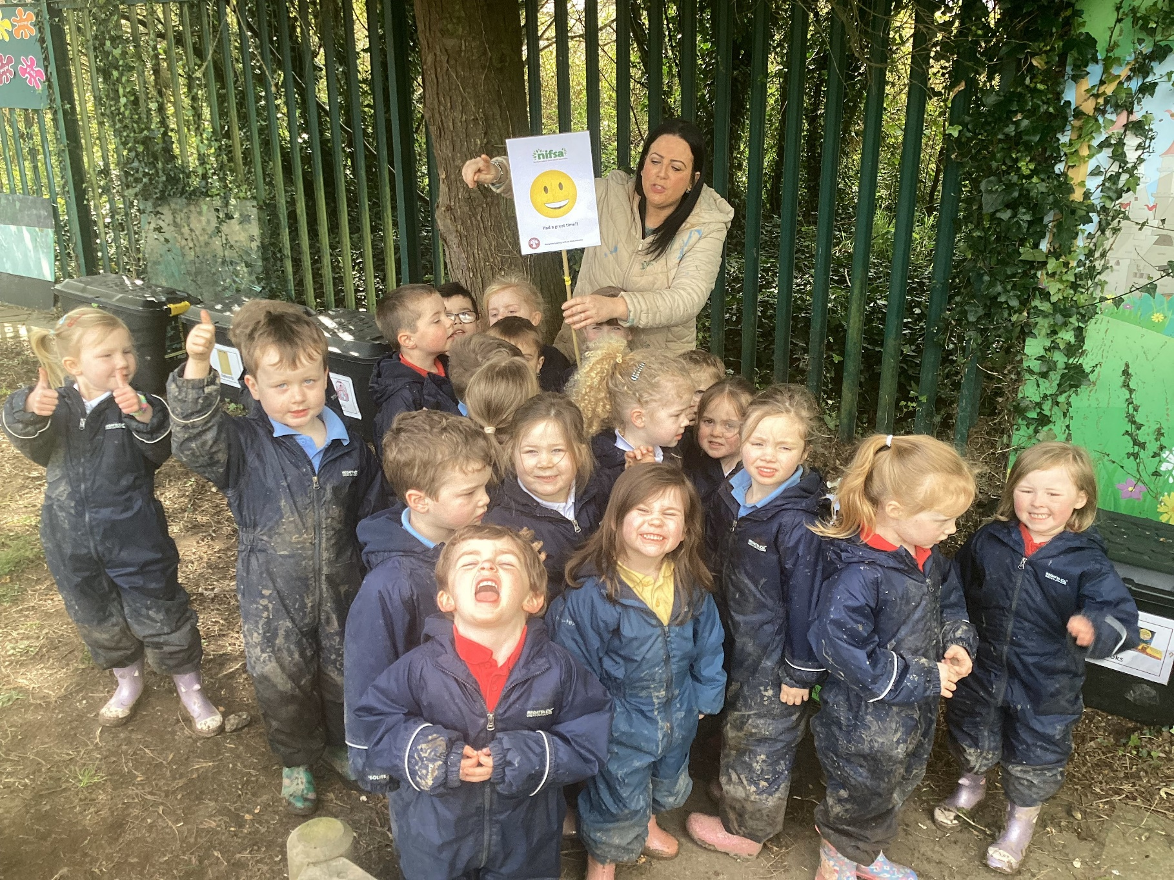
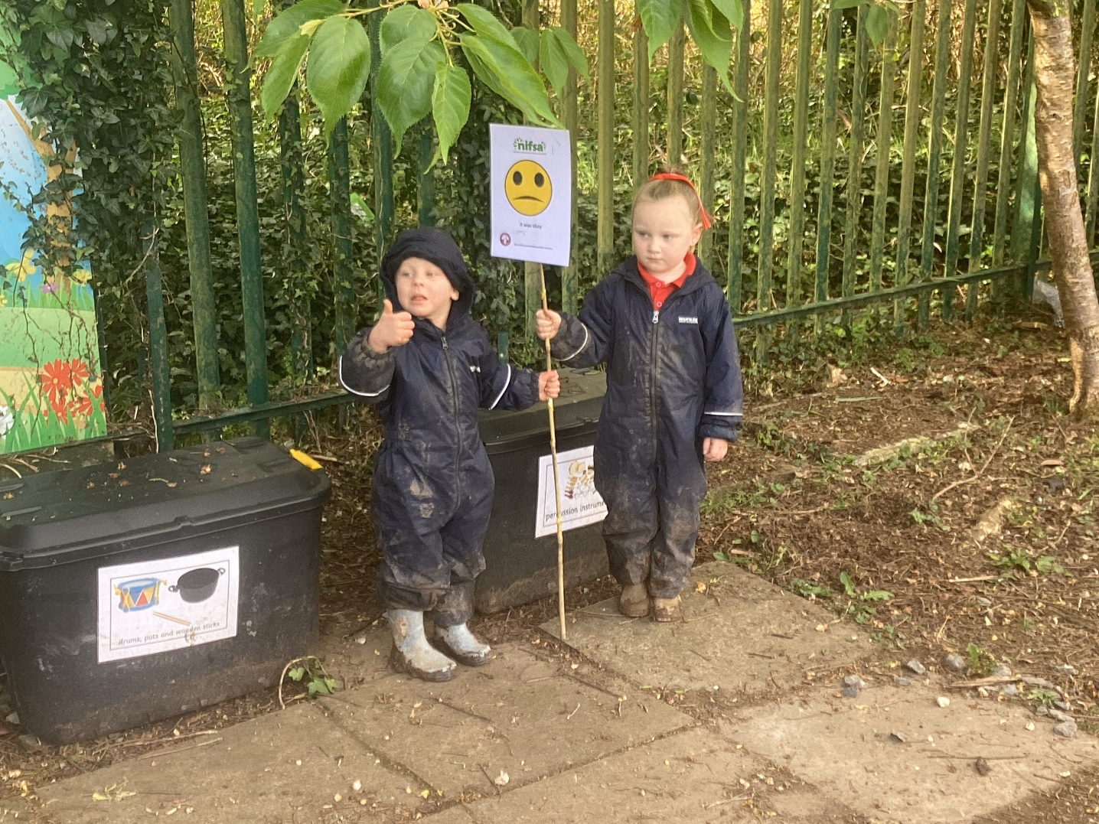
Did you enjoy it?
Most of the children said yes! 2 children said they didn’t because they were too tired.

Slide 12
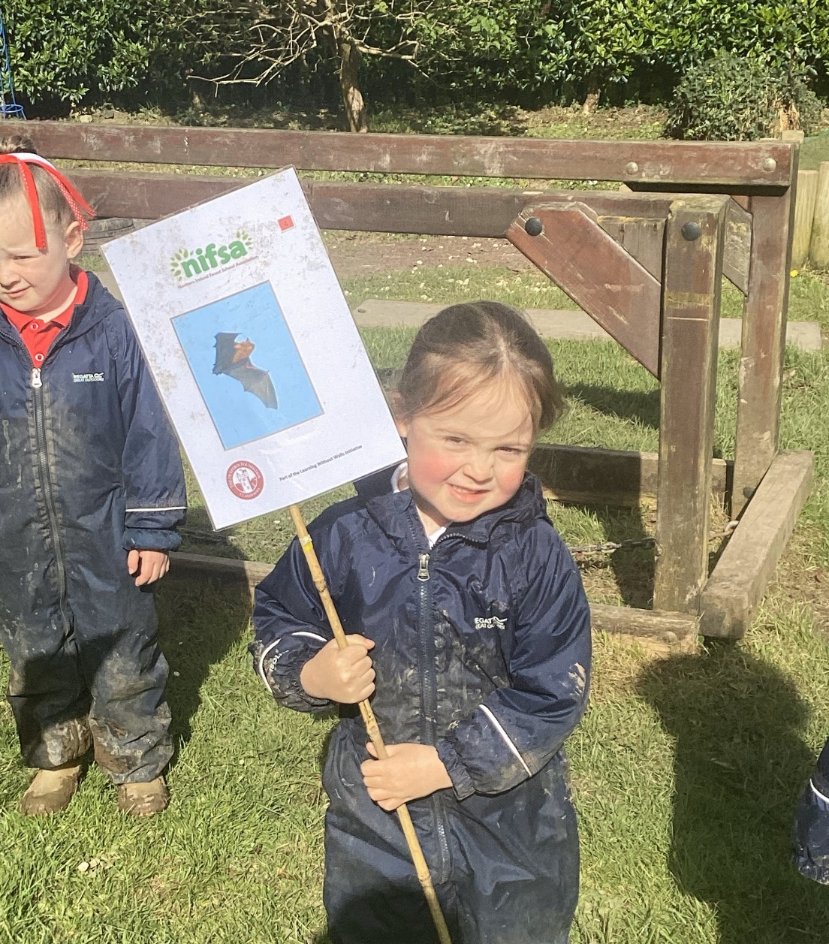
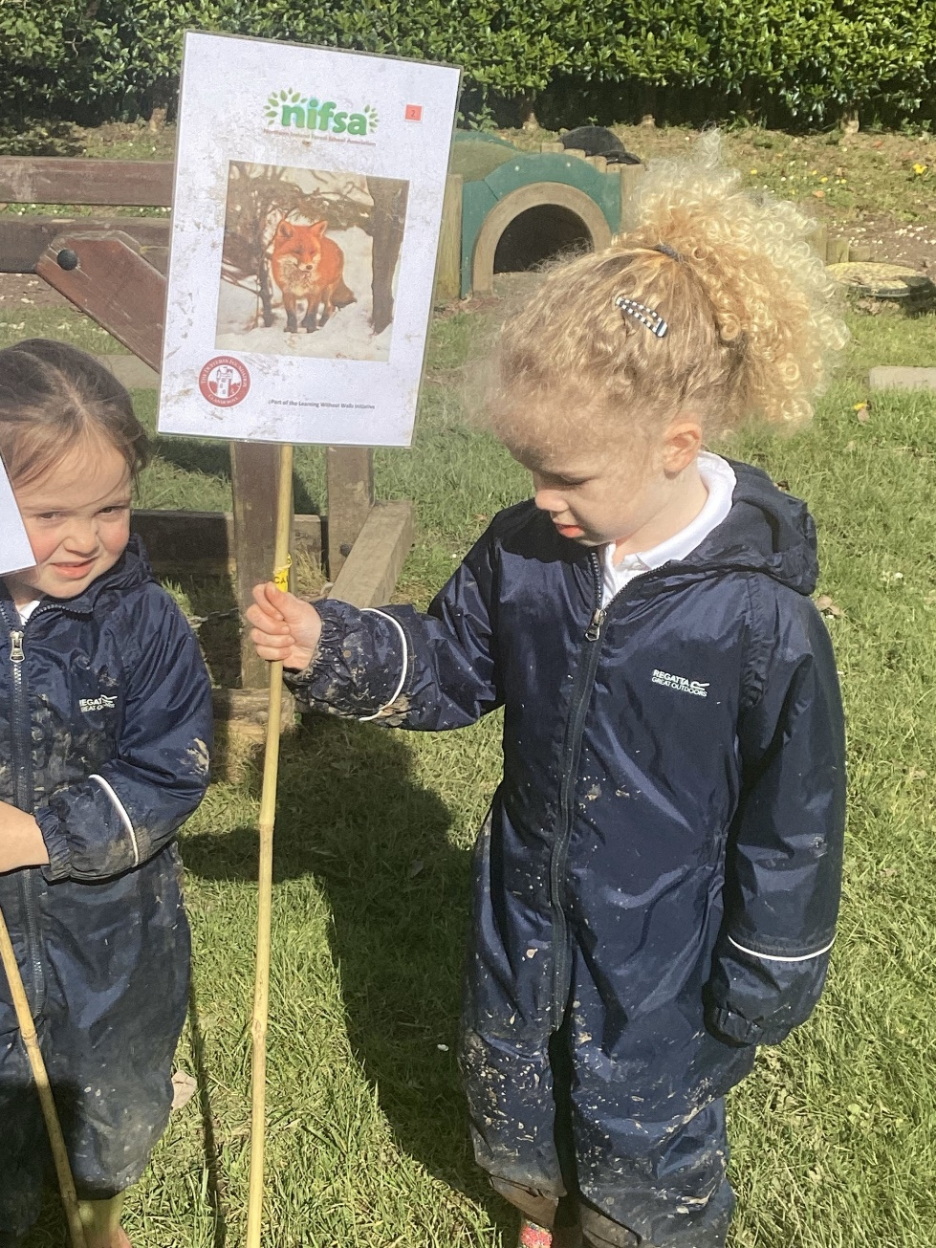
Leave No Trace
We have to tidy up afterwards to make it safe for wildlife.
We gathered up all of our boundary signs again to finish our session.

