Slide 1
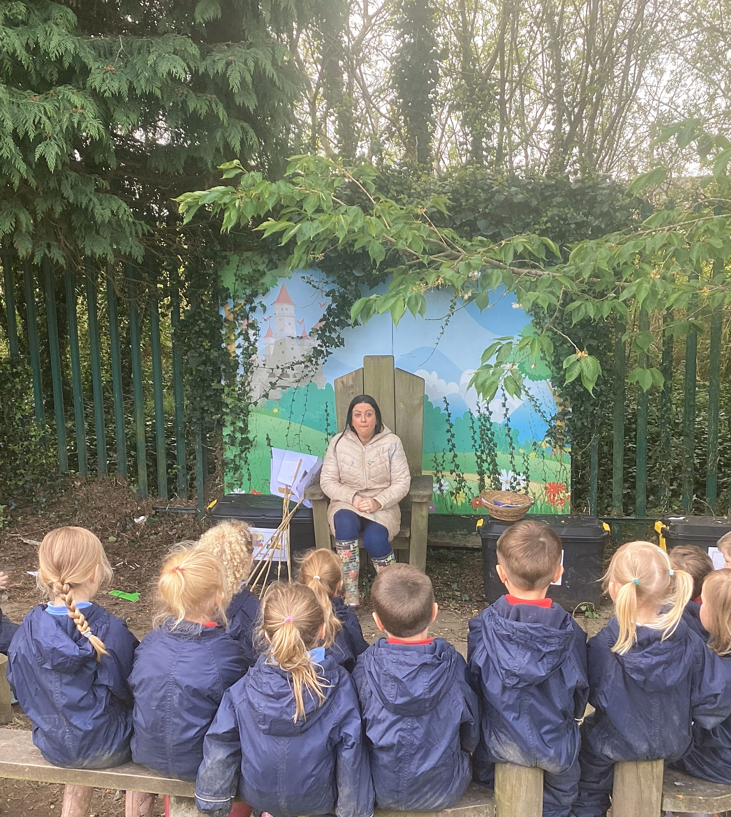
Glenbrook Nursery School
Forest School Diary
Class 2
26/4/24
Wellie Boot Printing

Slide 2
Our Rules
We listen to our rules –
1 whistle = stop, 2 whistles = back to base and 3rd rule = have fun and learn.
We also remember to respect nature

Slide 3
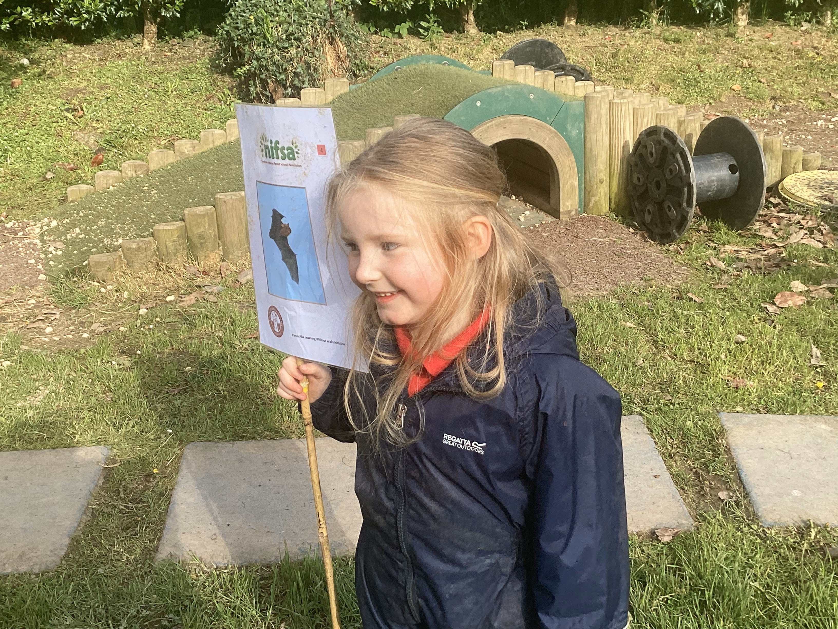
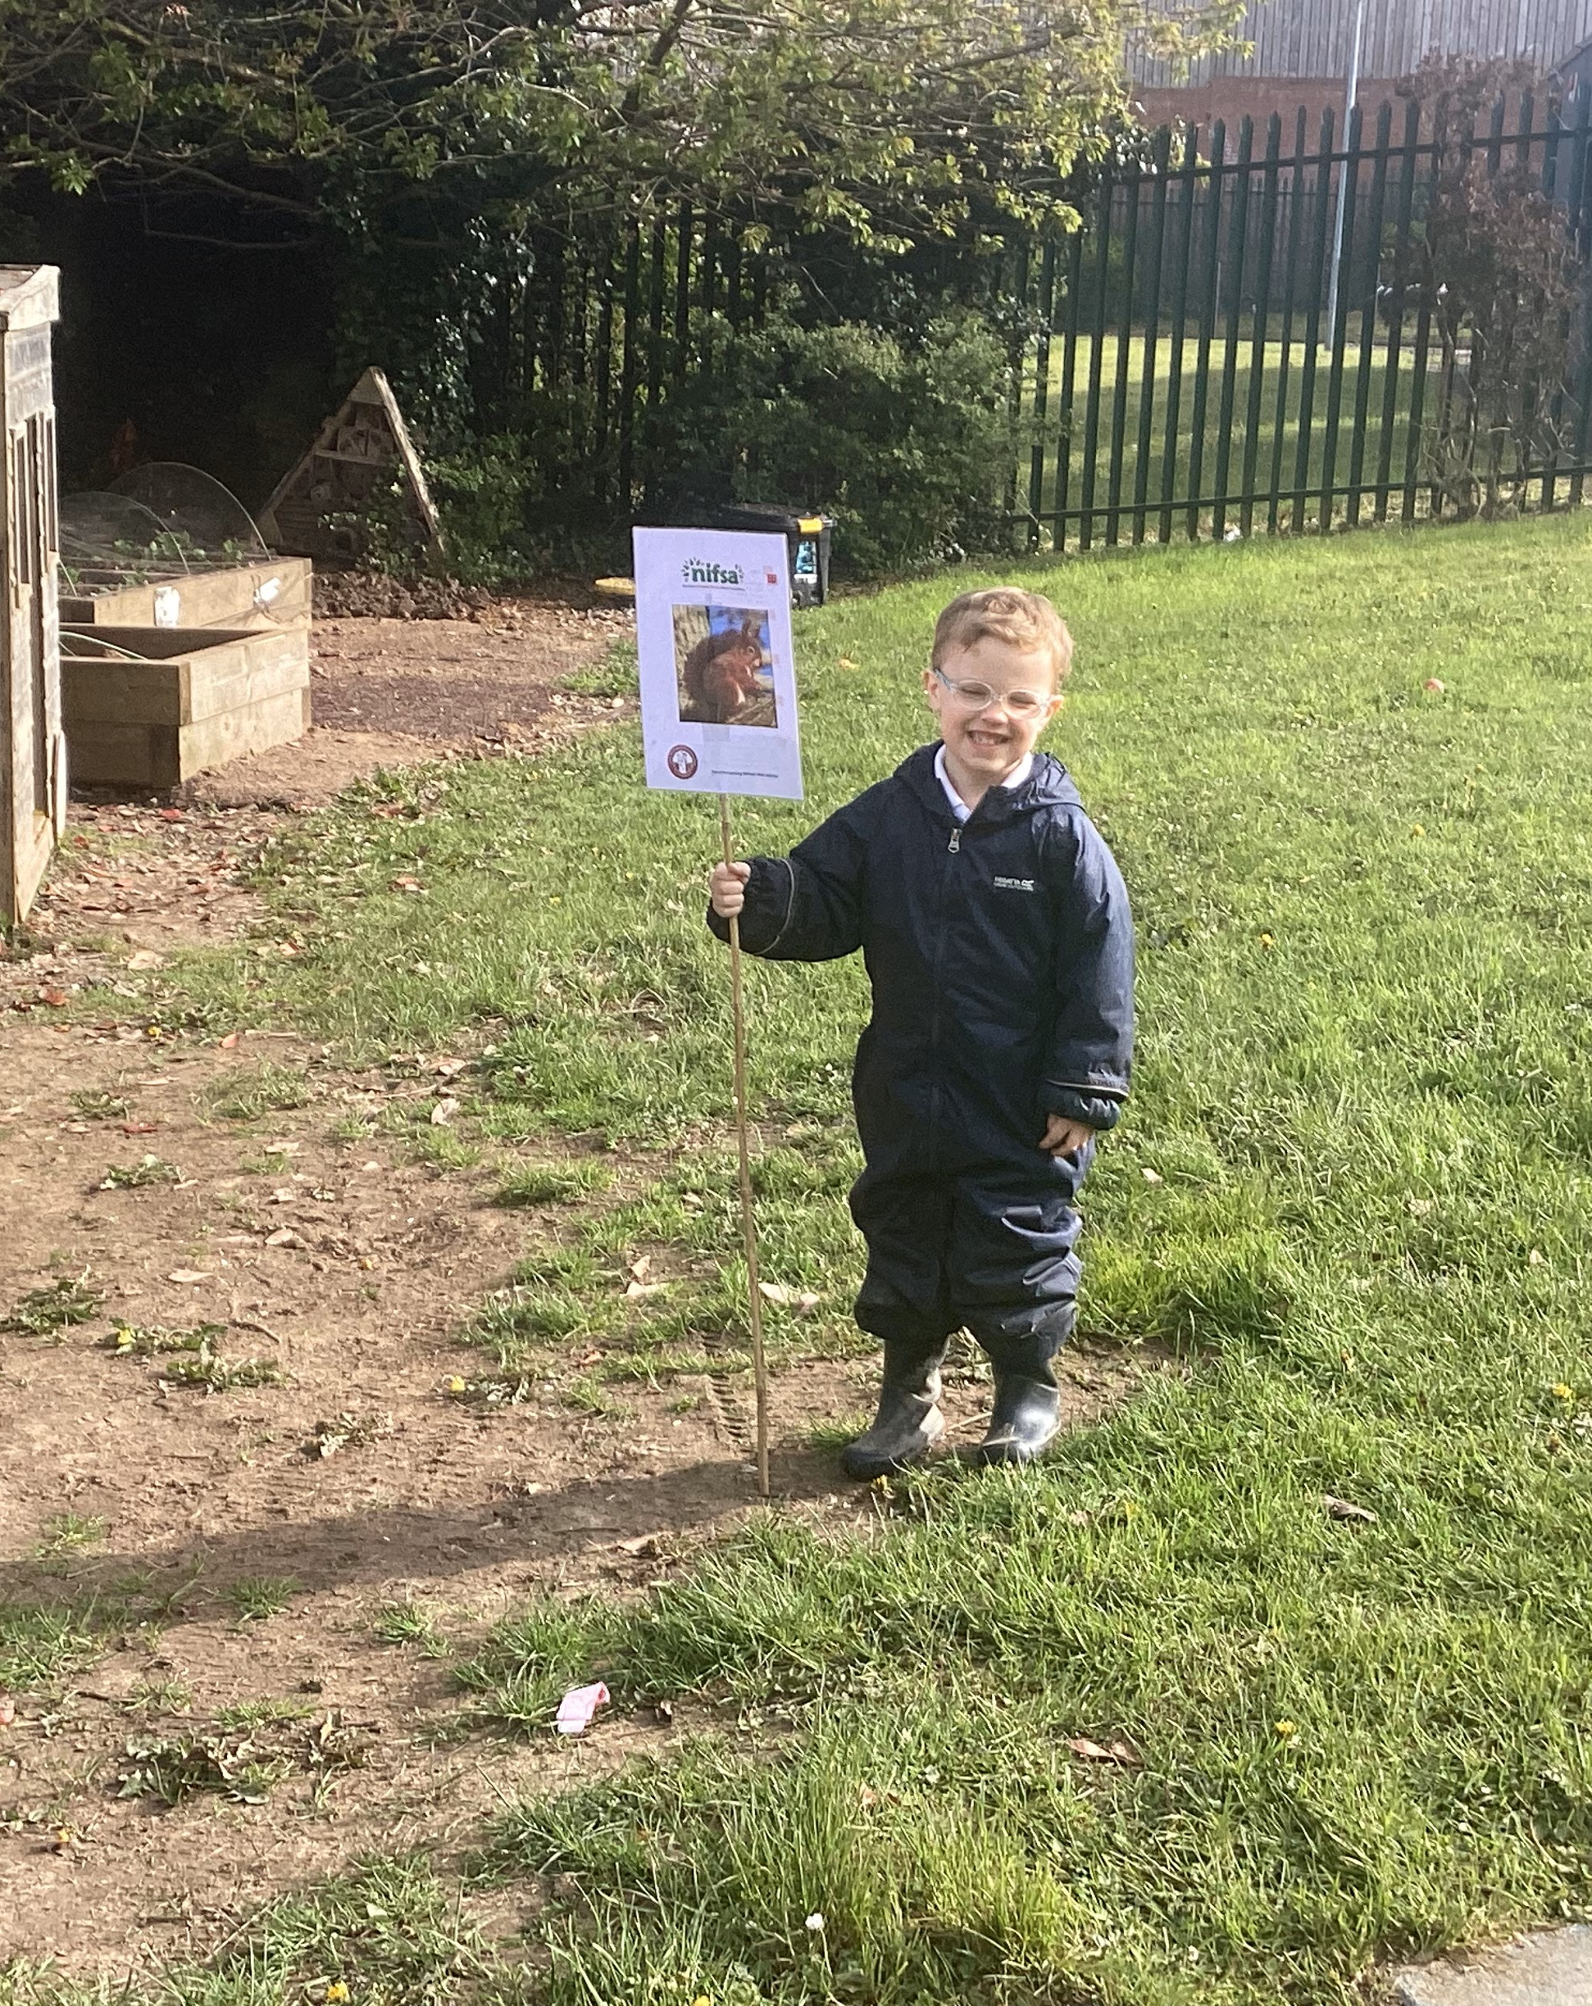
Staying Safe
We put out our boundary flags for us to stay inside.
We had some great helpers!

Slide 4
We couldn’t wait to jump in the mud!

Slide 5
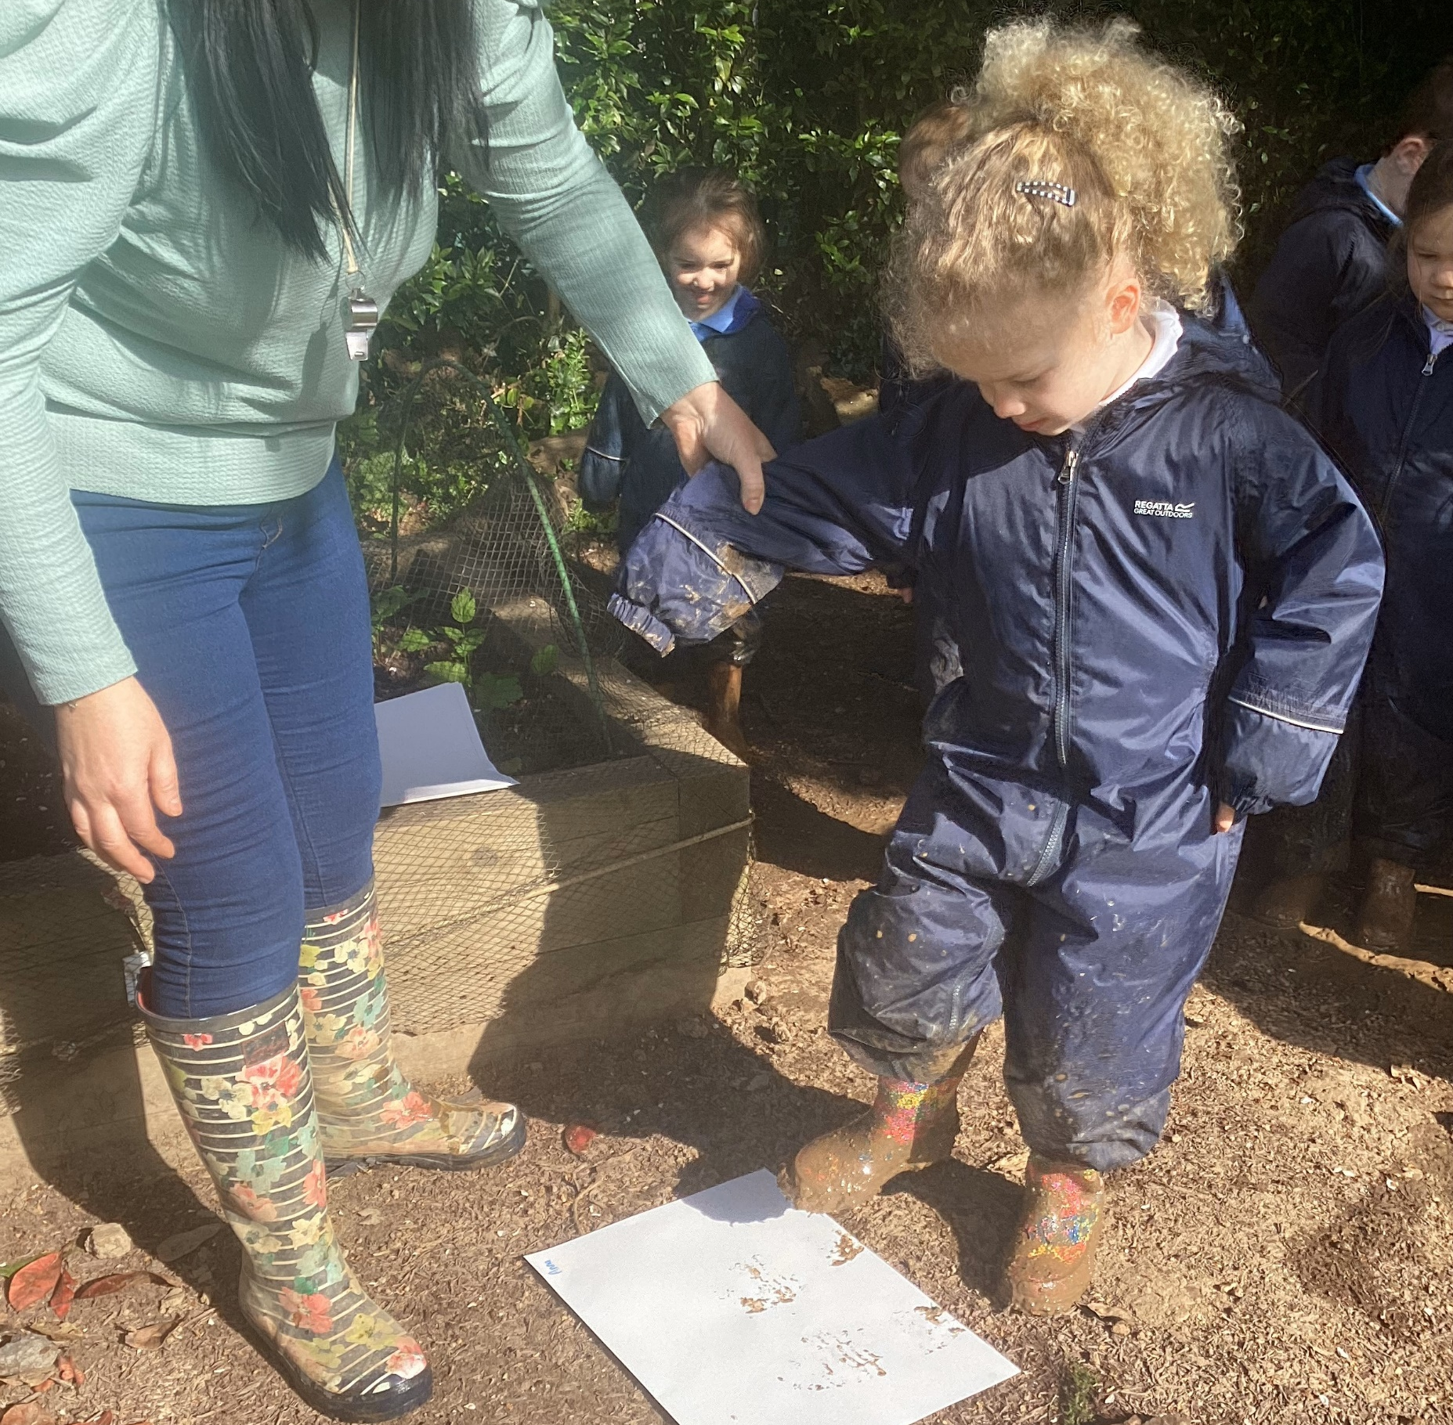
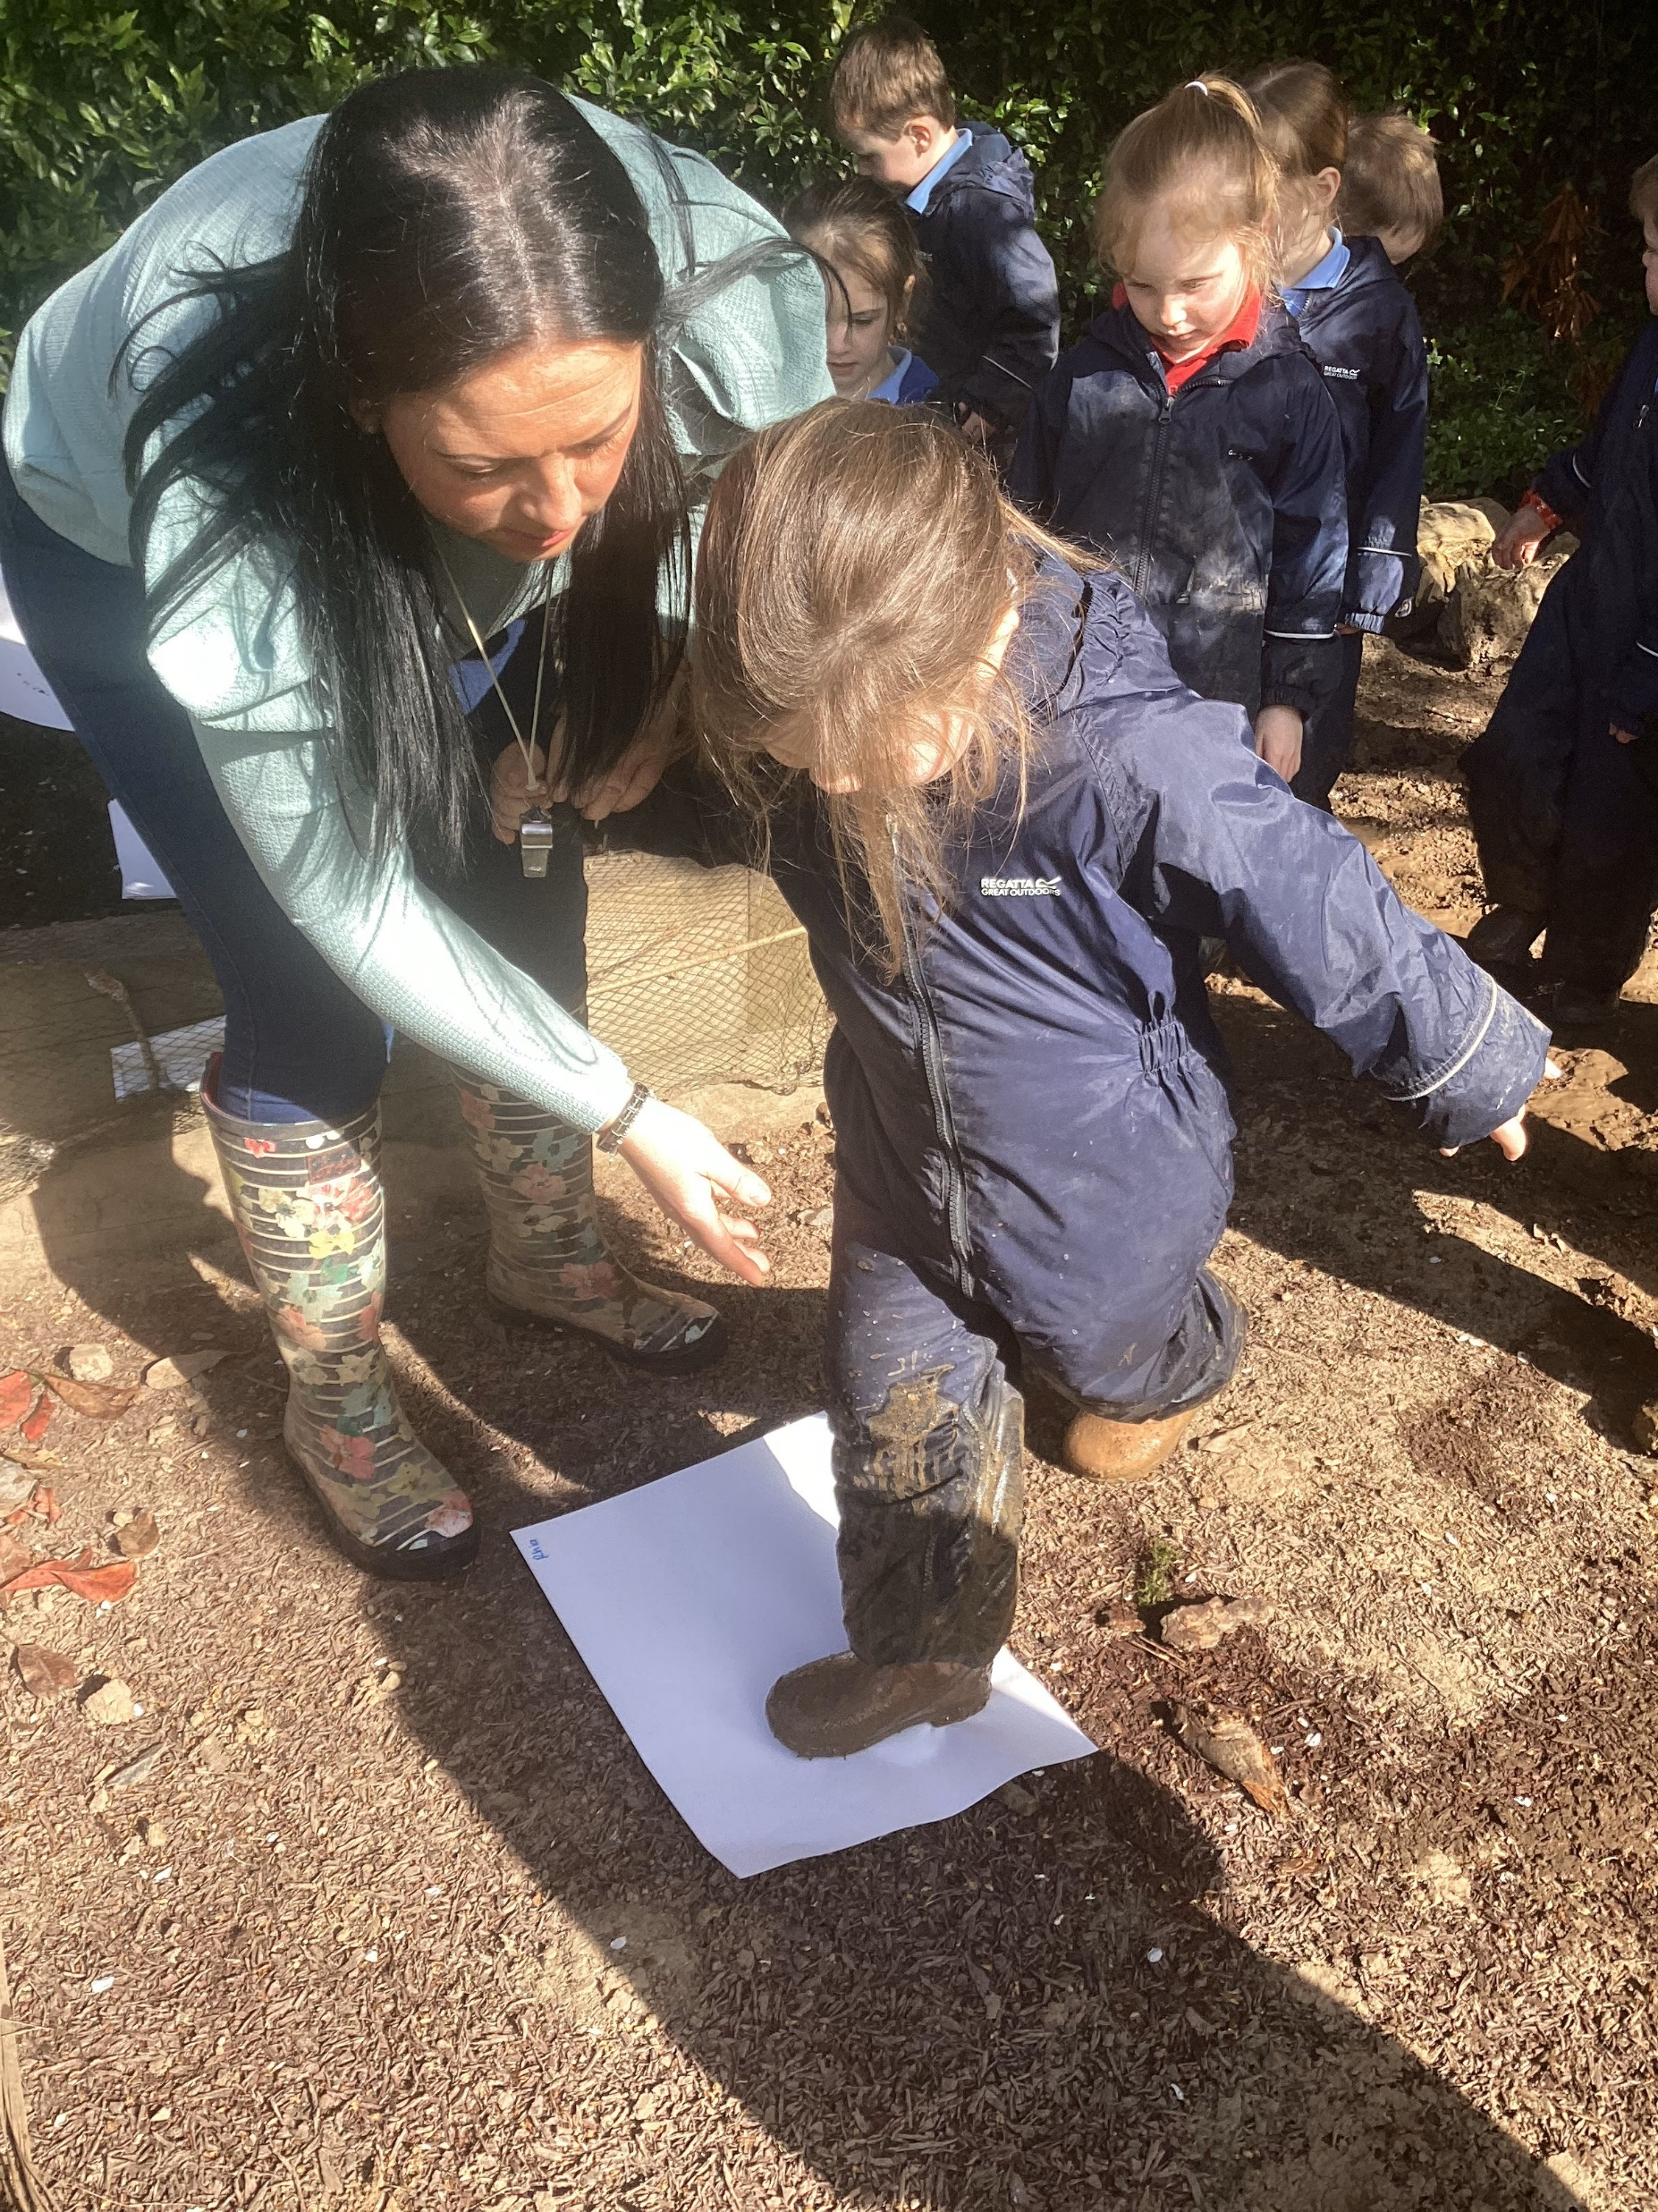
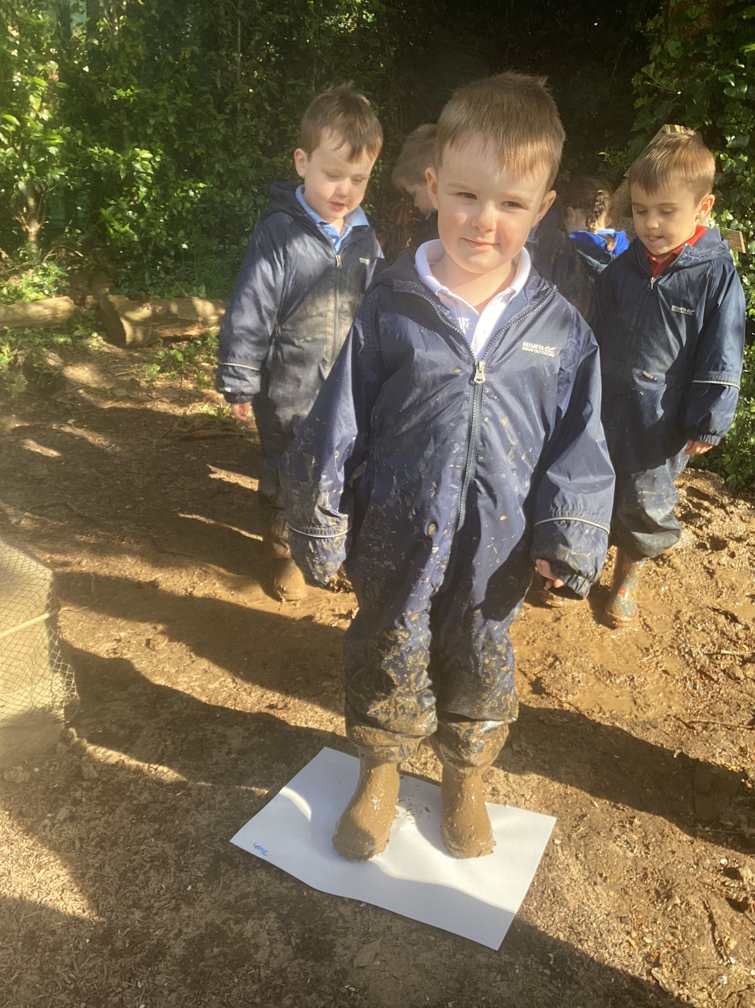

Slide 6
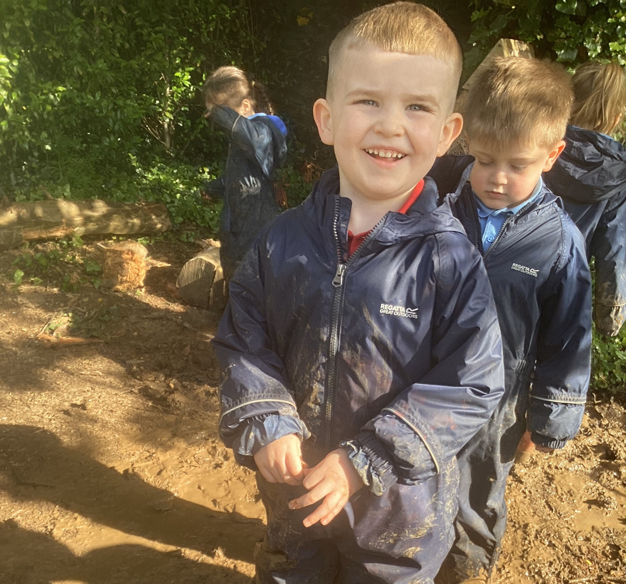
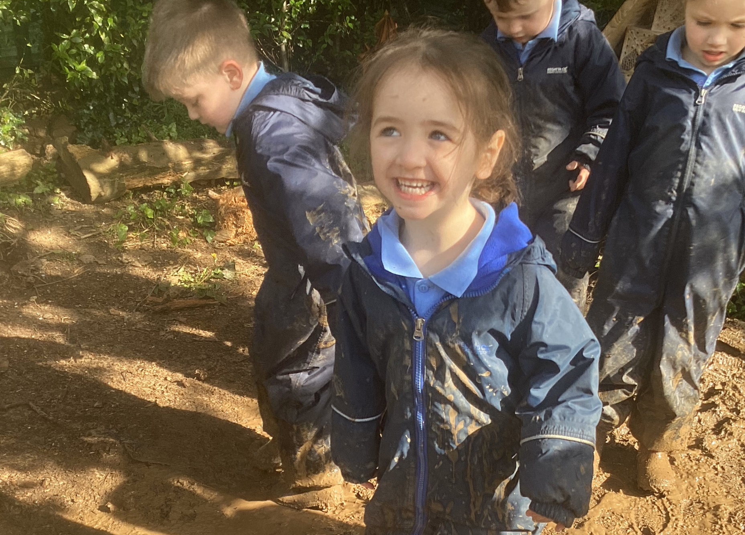

Slide 8
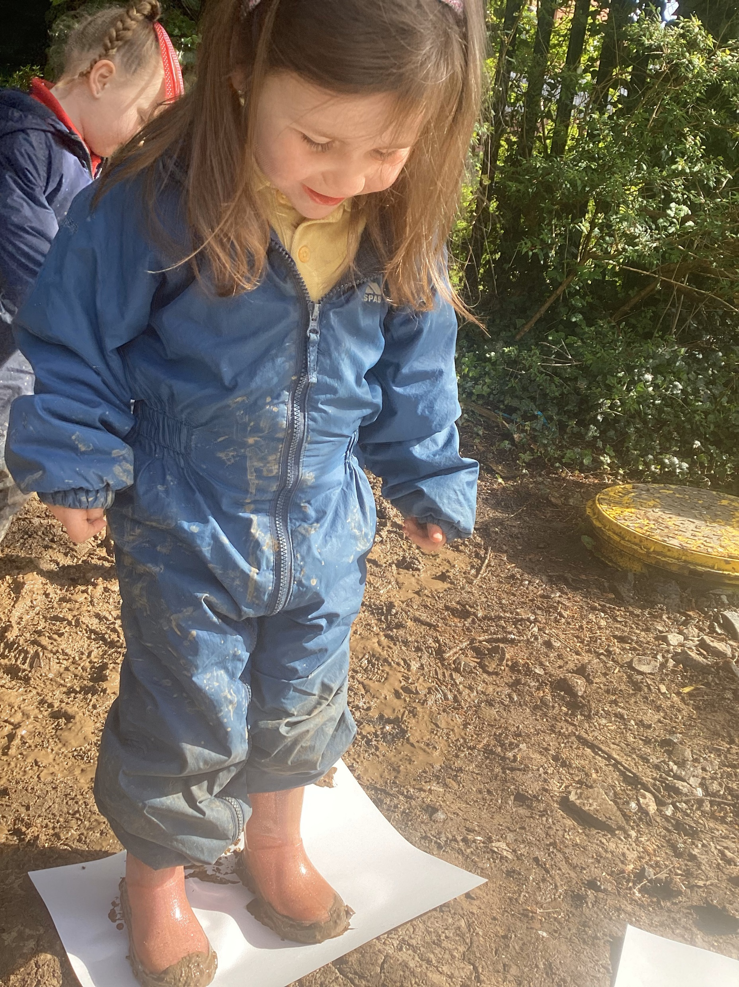
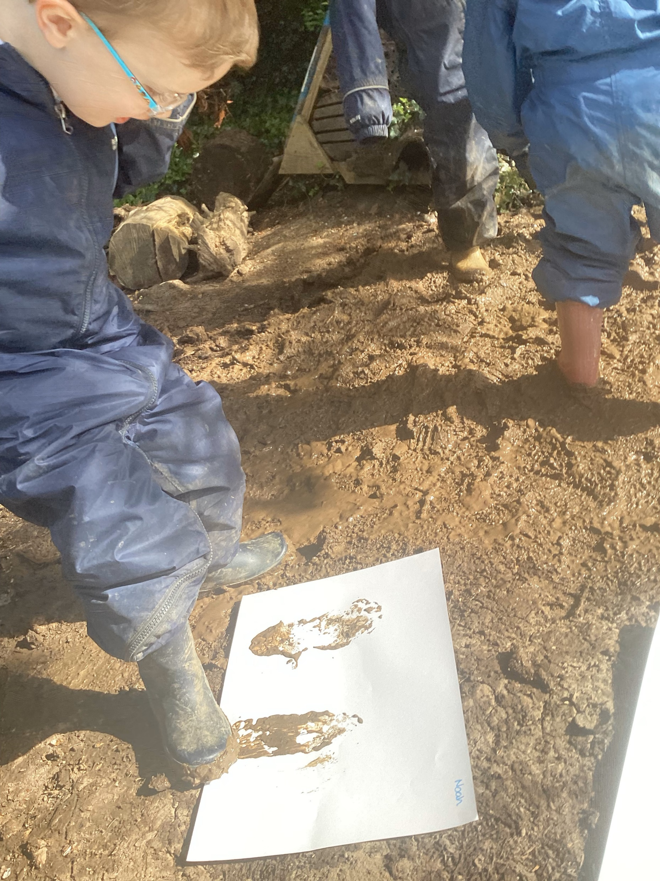

Slide 9
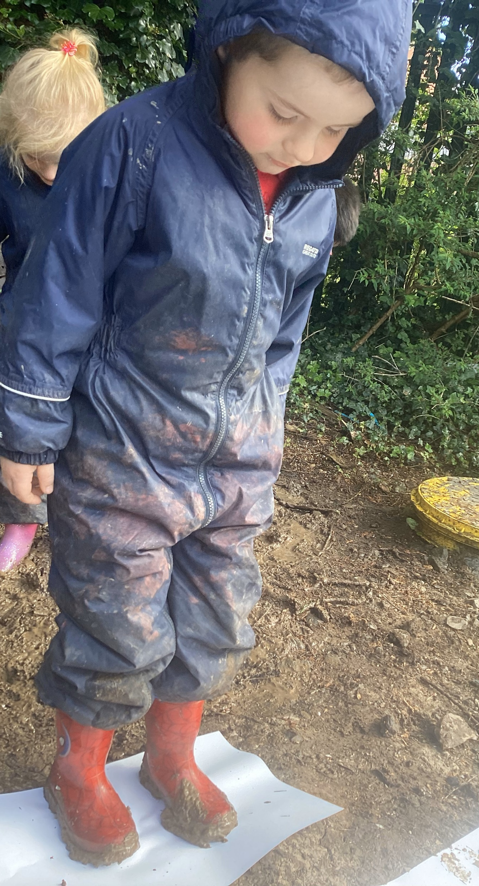
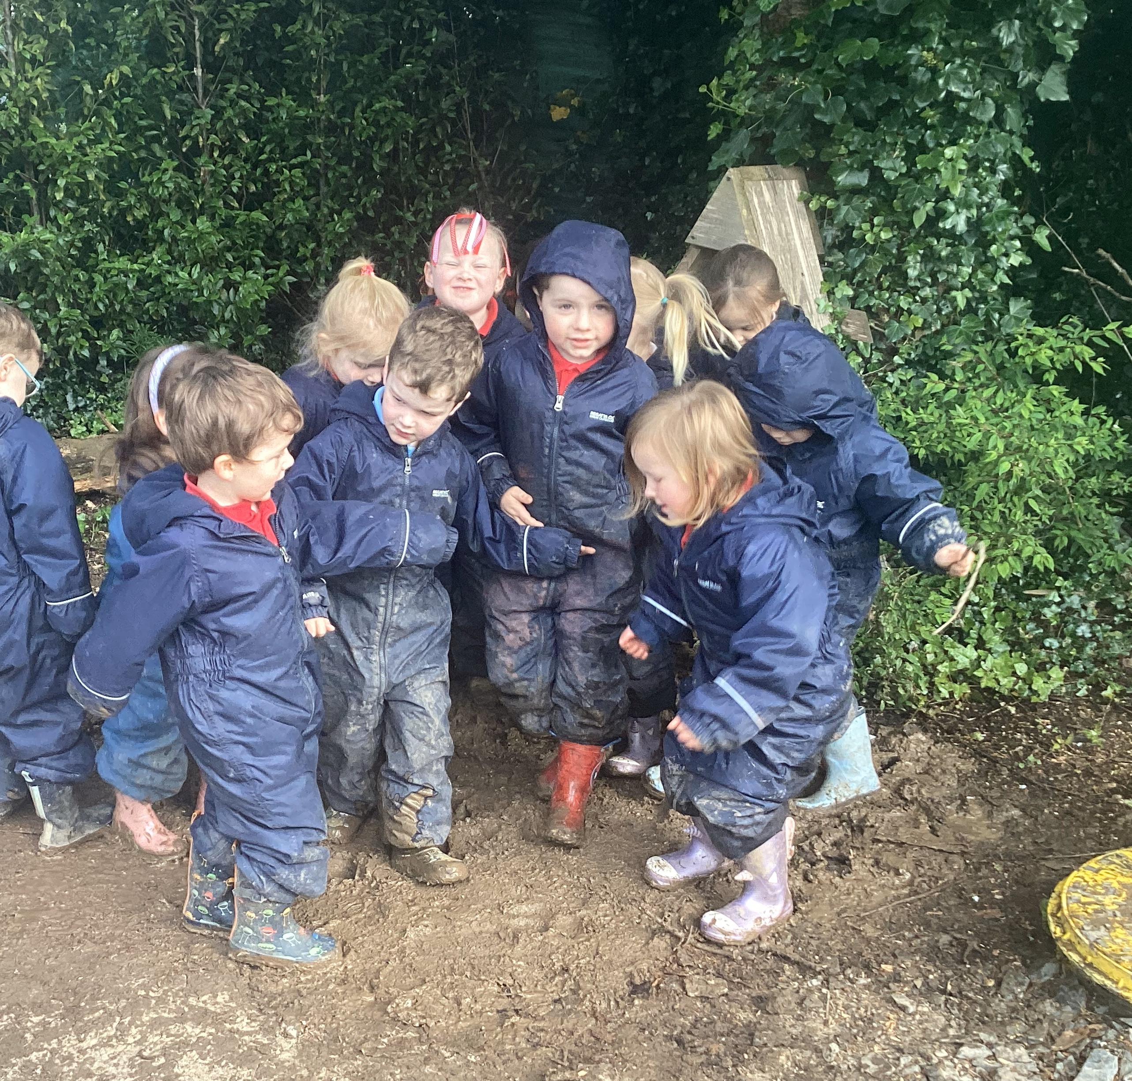
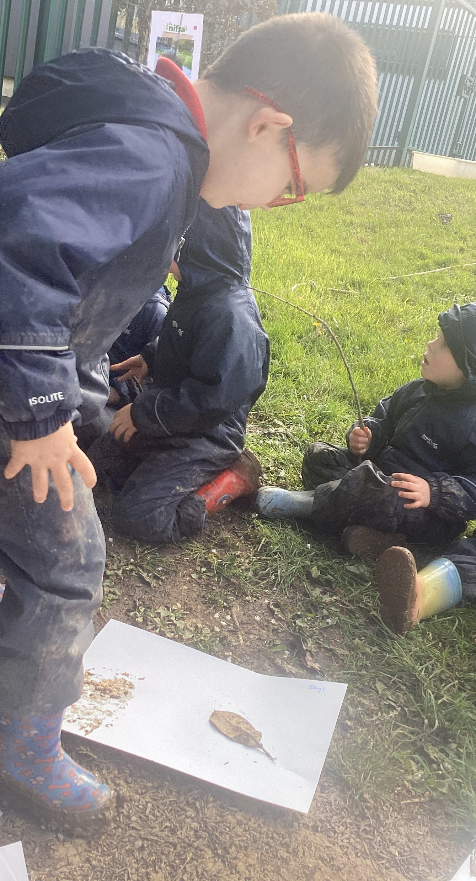

Slide 10
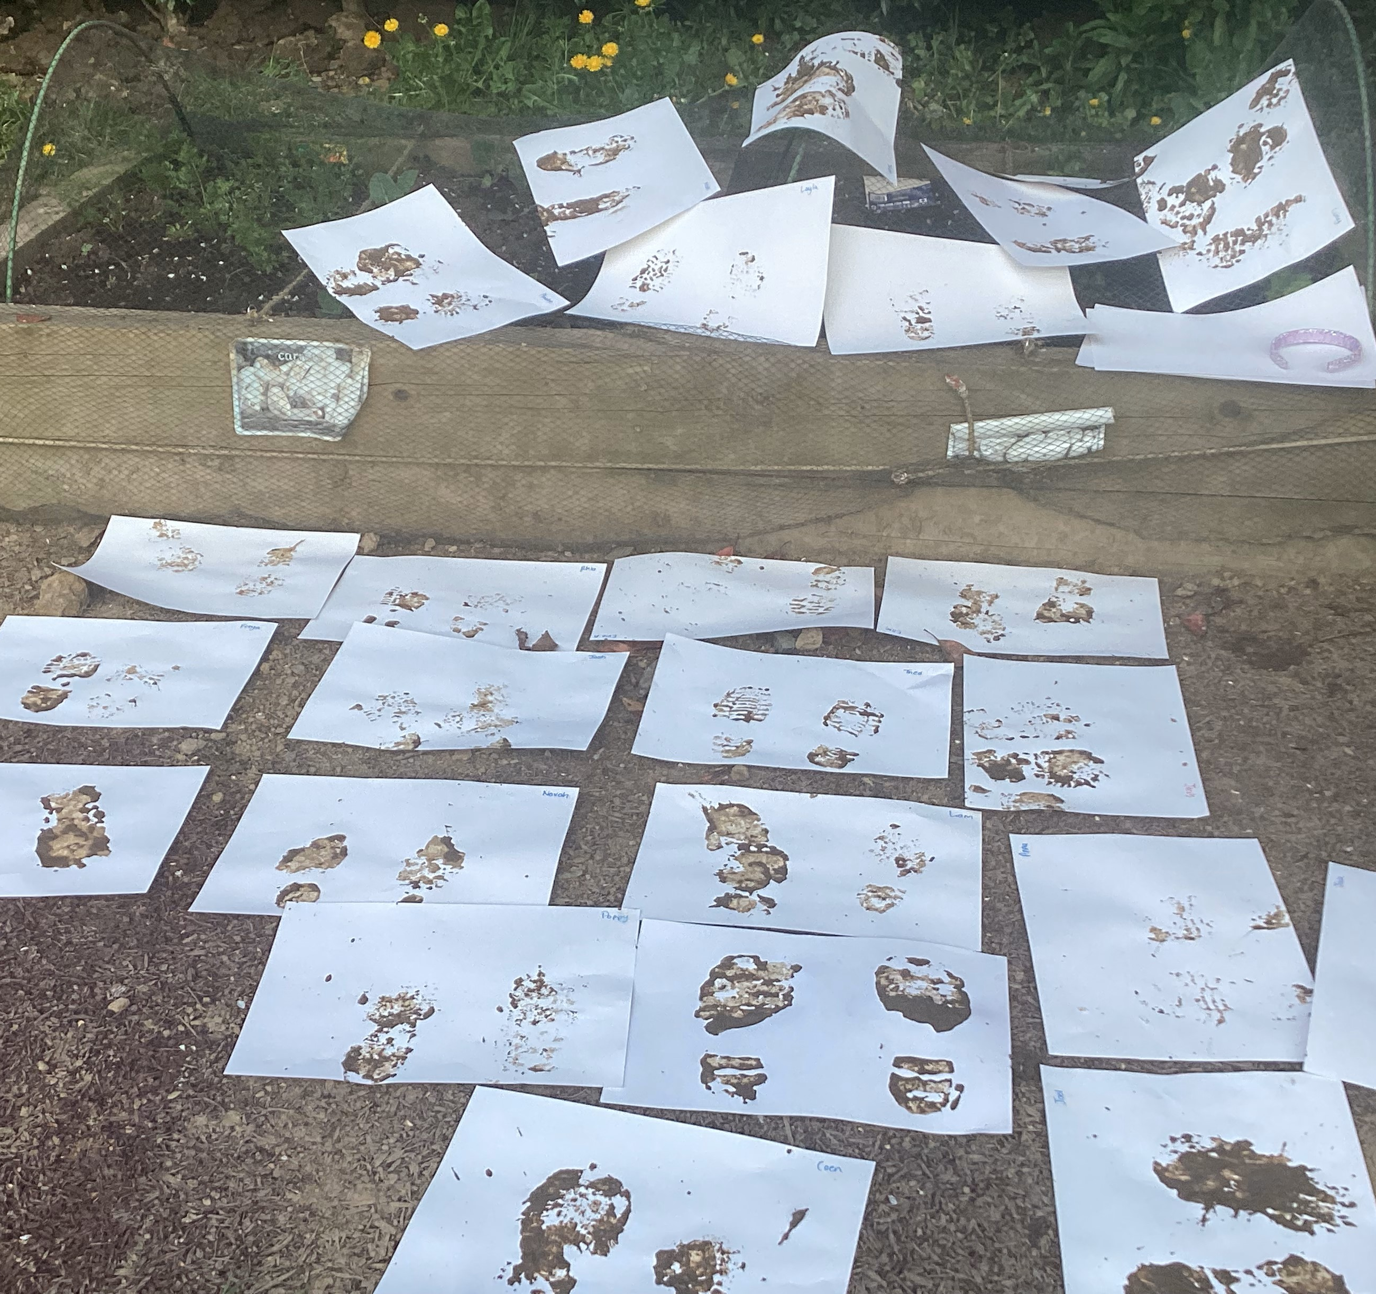

Slide 11
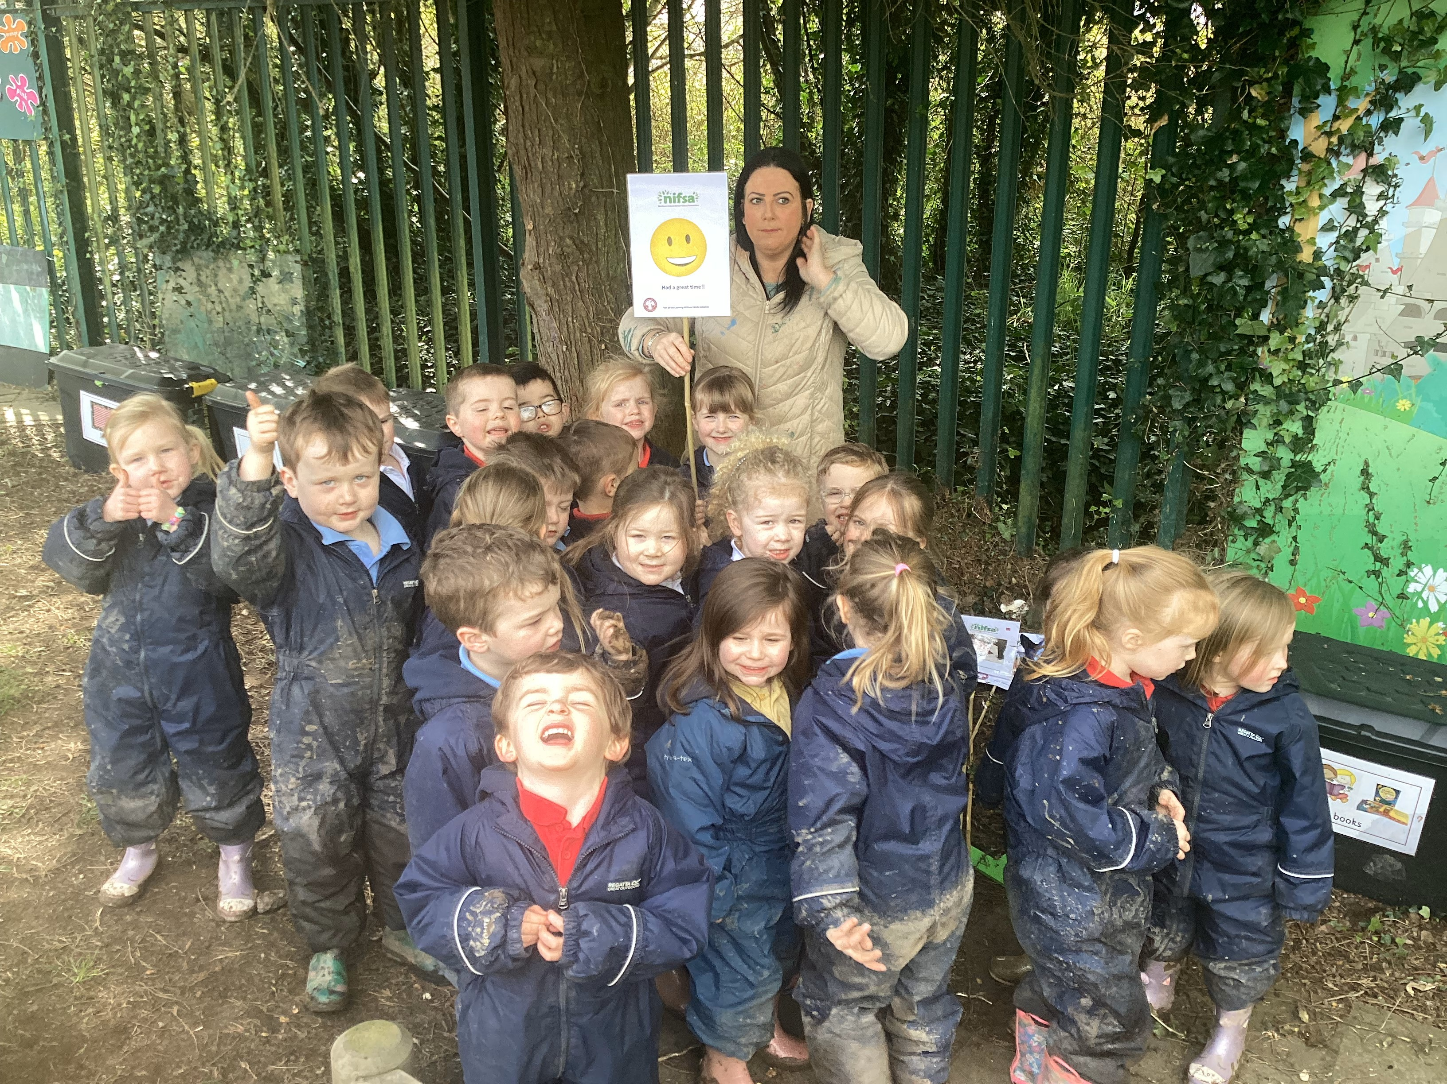
Did you enjoy it?
We all had great fun!

Slide 12
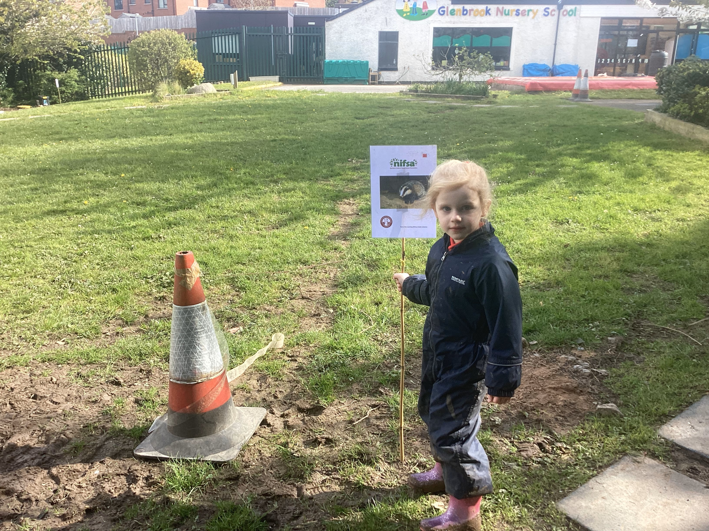
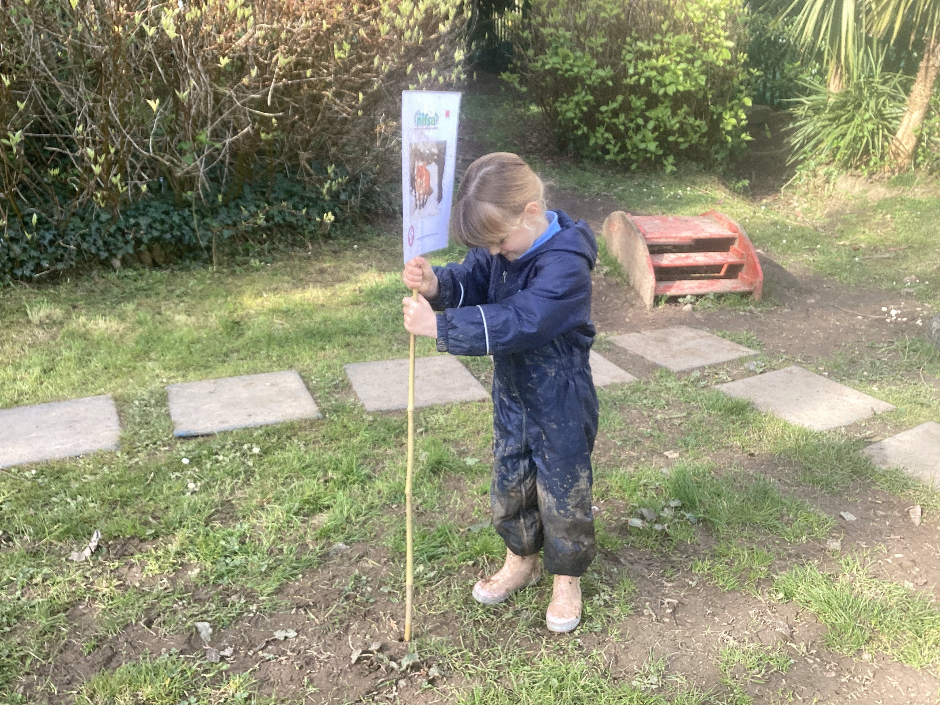
Leave No Trace
We have to tidy up afterwards to make it safe for wildlife.
We gathered up all of our boundary signs again to finish our session.

