Slide 1
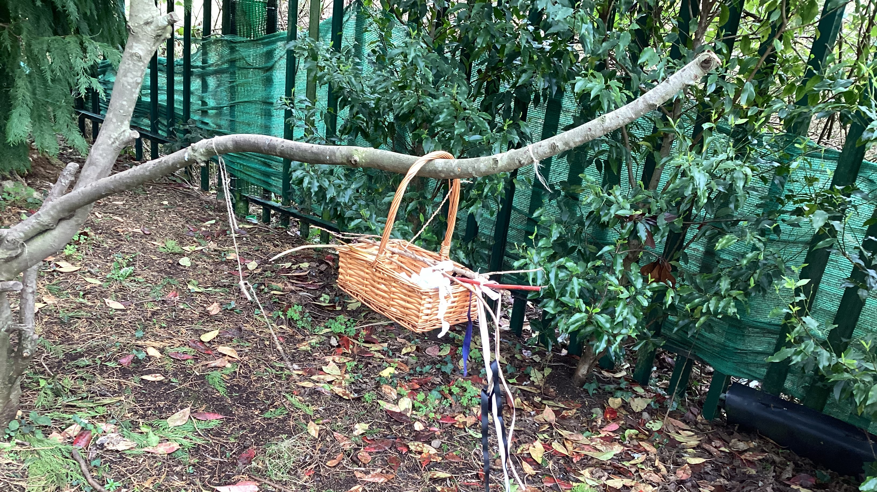
Wind streamer session:

Slide 2
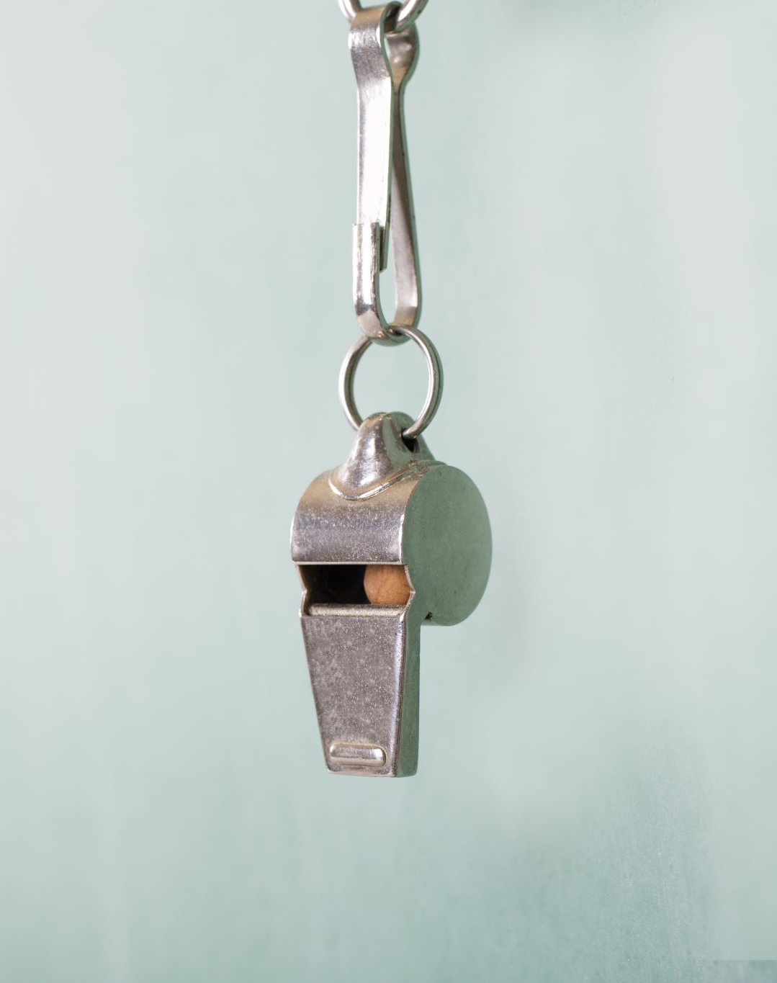
Rule reminders……
Boundary flags – remain within those
1 whistle
2 whistles
Have fun!

Slide 3
Selecting sticks for wind streamer…..

Slide 4
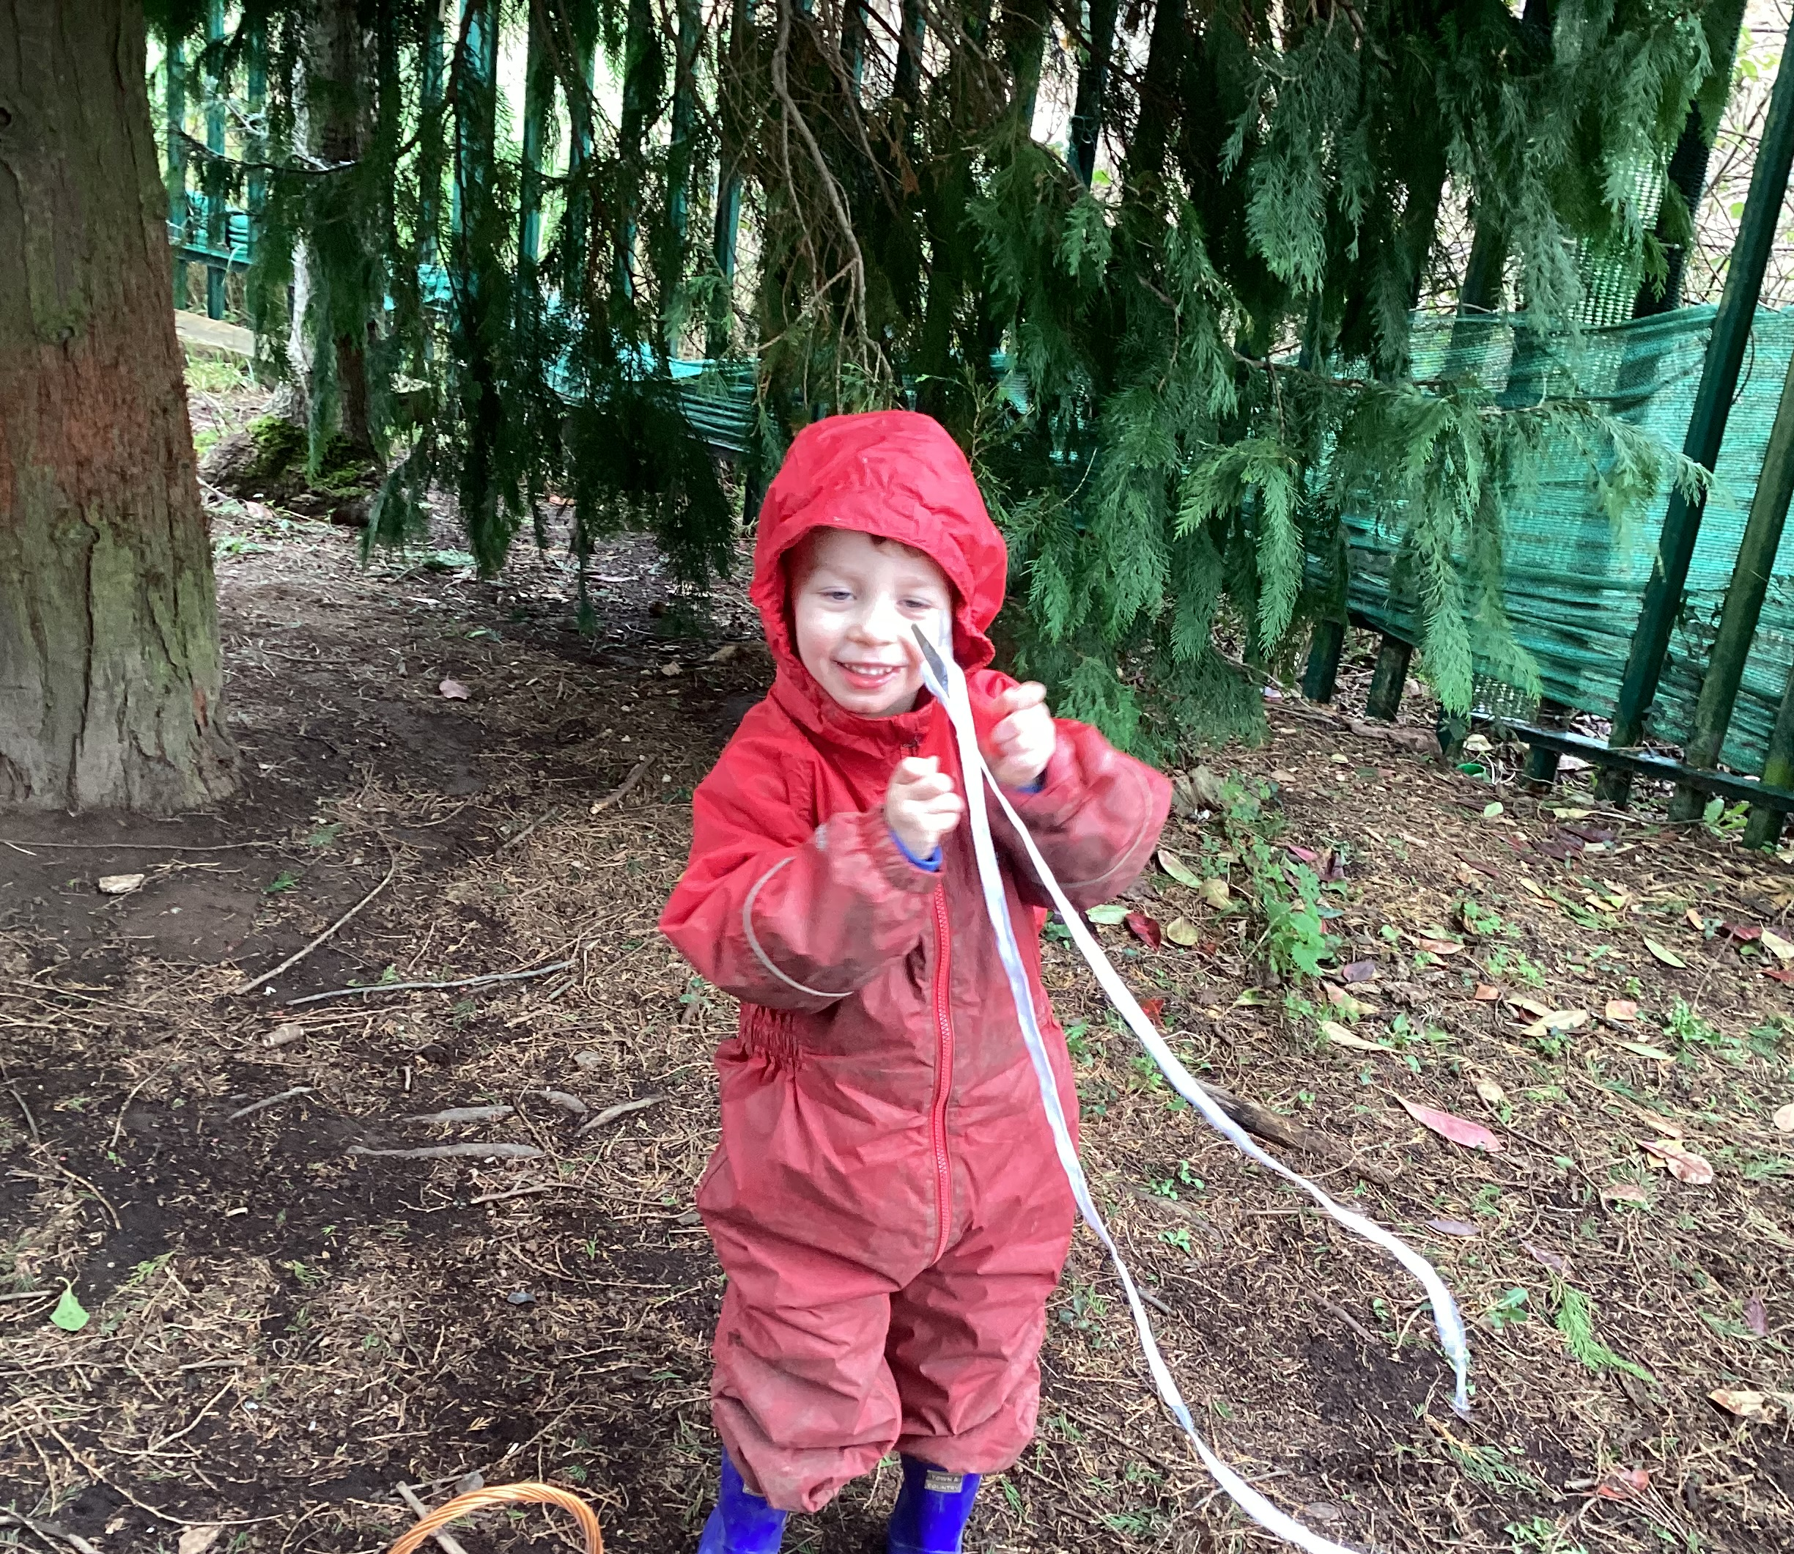
Cutting ribbon to length….

Slide 5
Experimenting…..

Slide 6
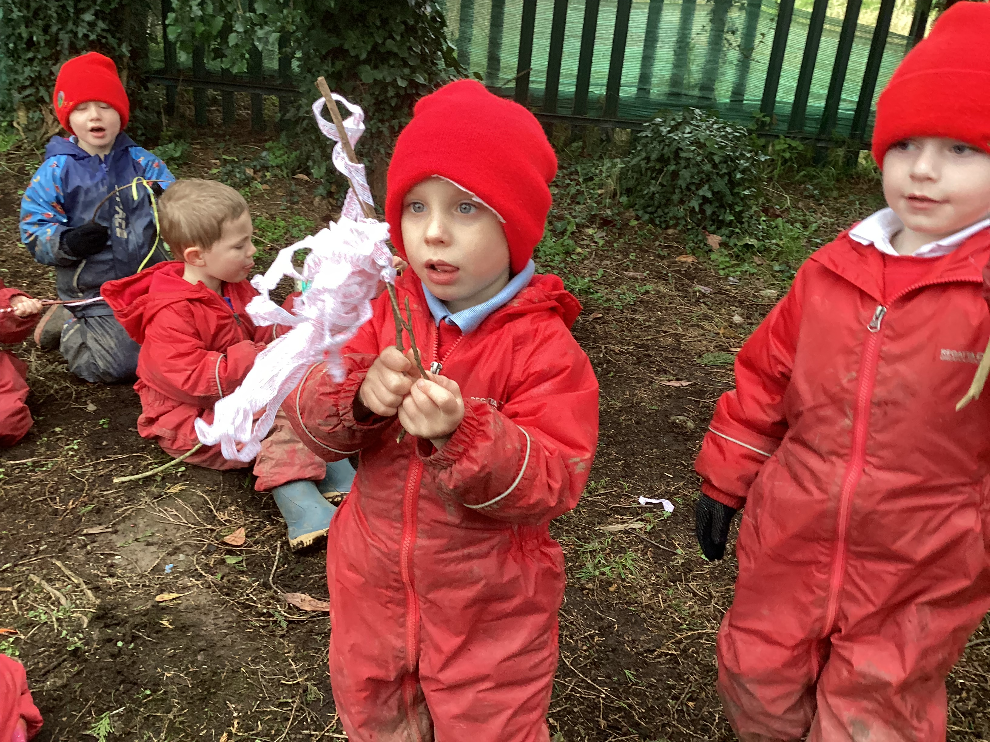
Testing our wind streamers……

Slide 7
adding movement……

Slide 8
Did we enjoy it? Lots of happy faces….later chose the smiling emoji sign

Slide 9
Leave no trace…. gathering items back in

