Slide 1
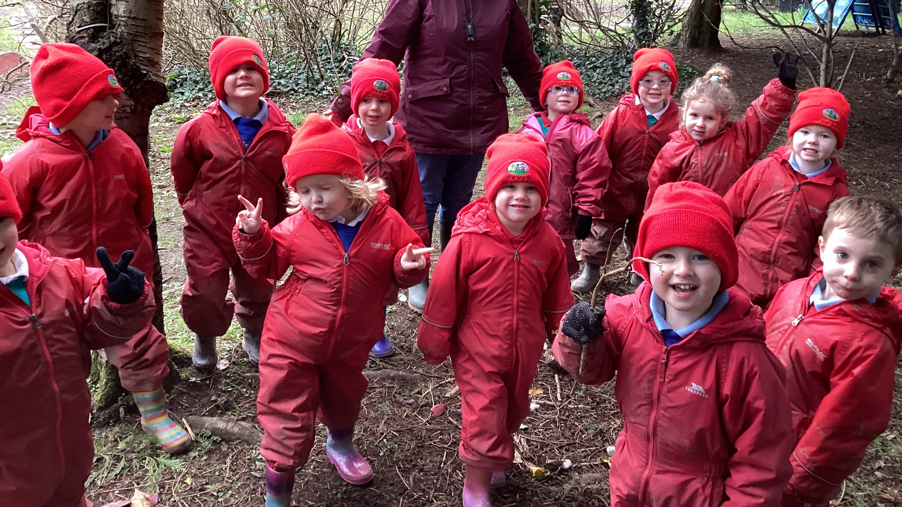
Glenbrook Forest School Diary
Early Mathematical experiences in the Forest

Slide 2
Getting started : Group time, rule reminders

Slide 3
Demonstration of activity: long & short

Slide 4
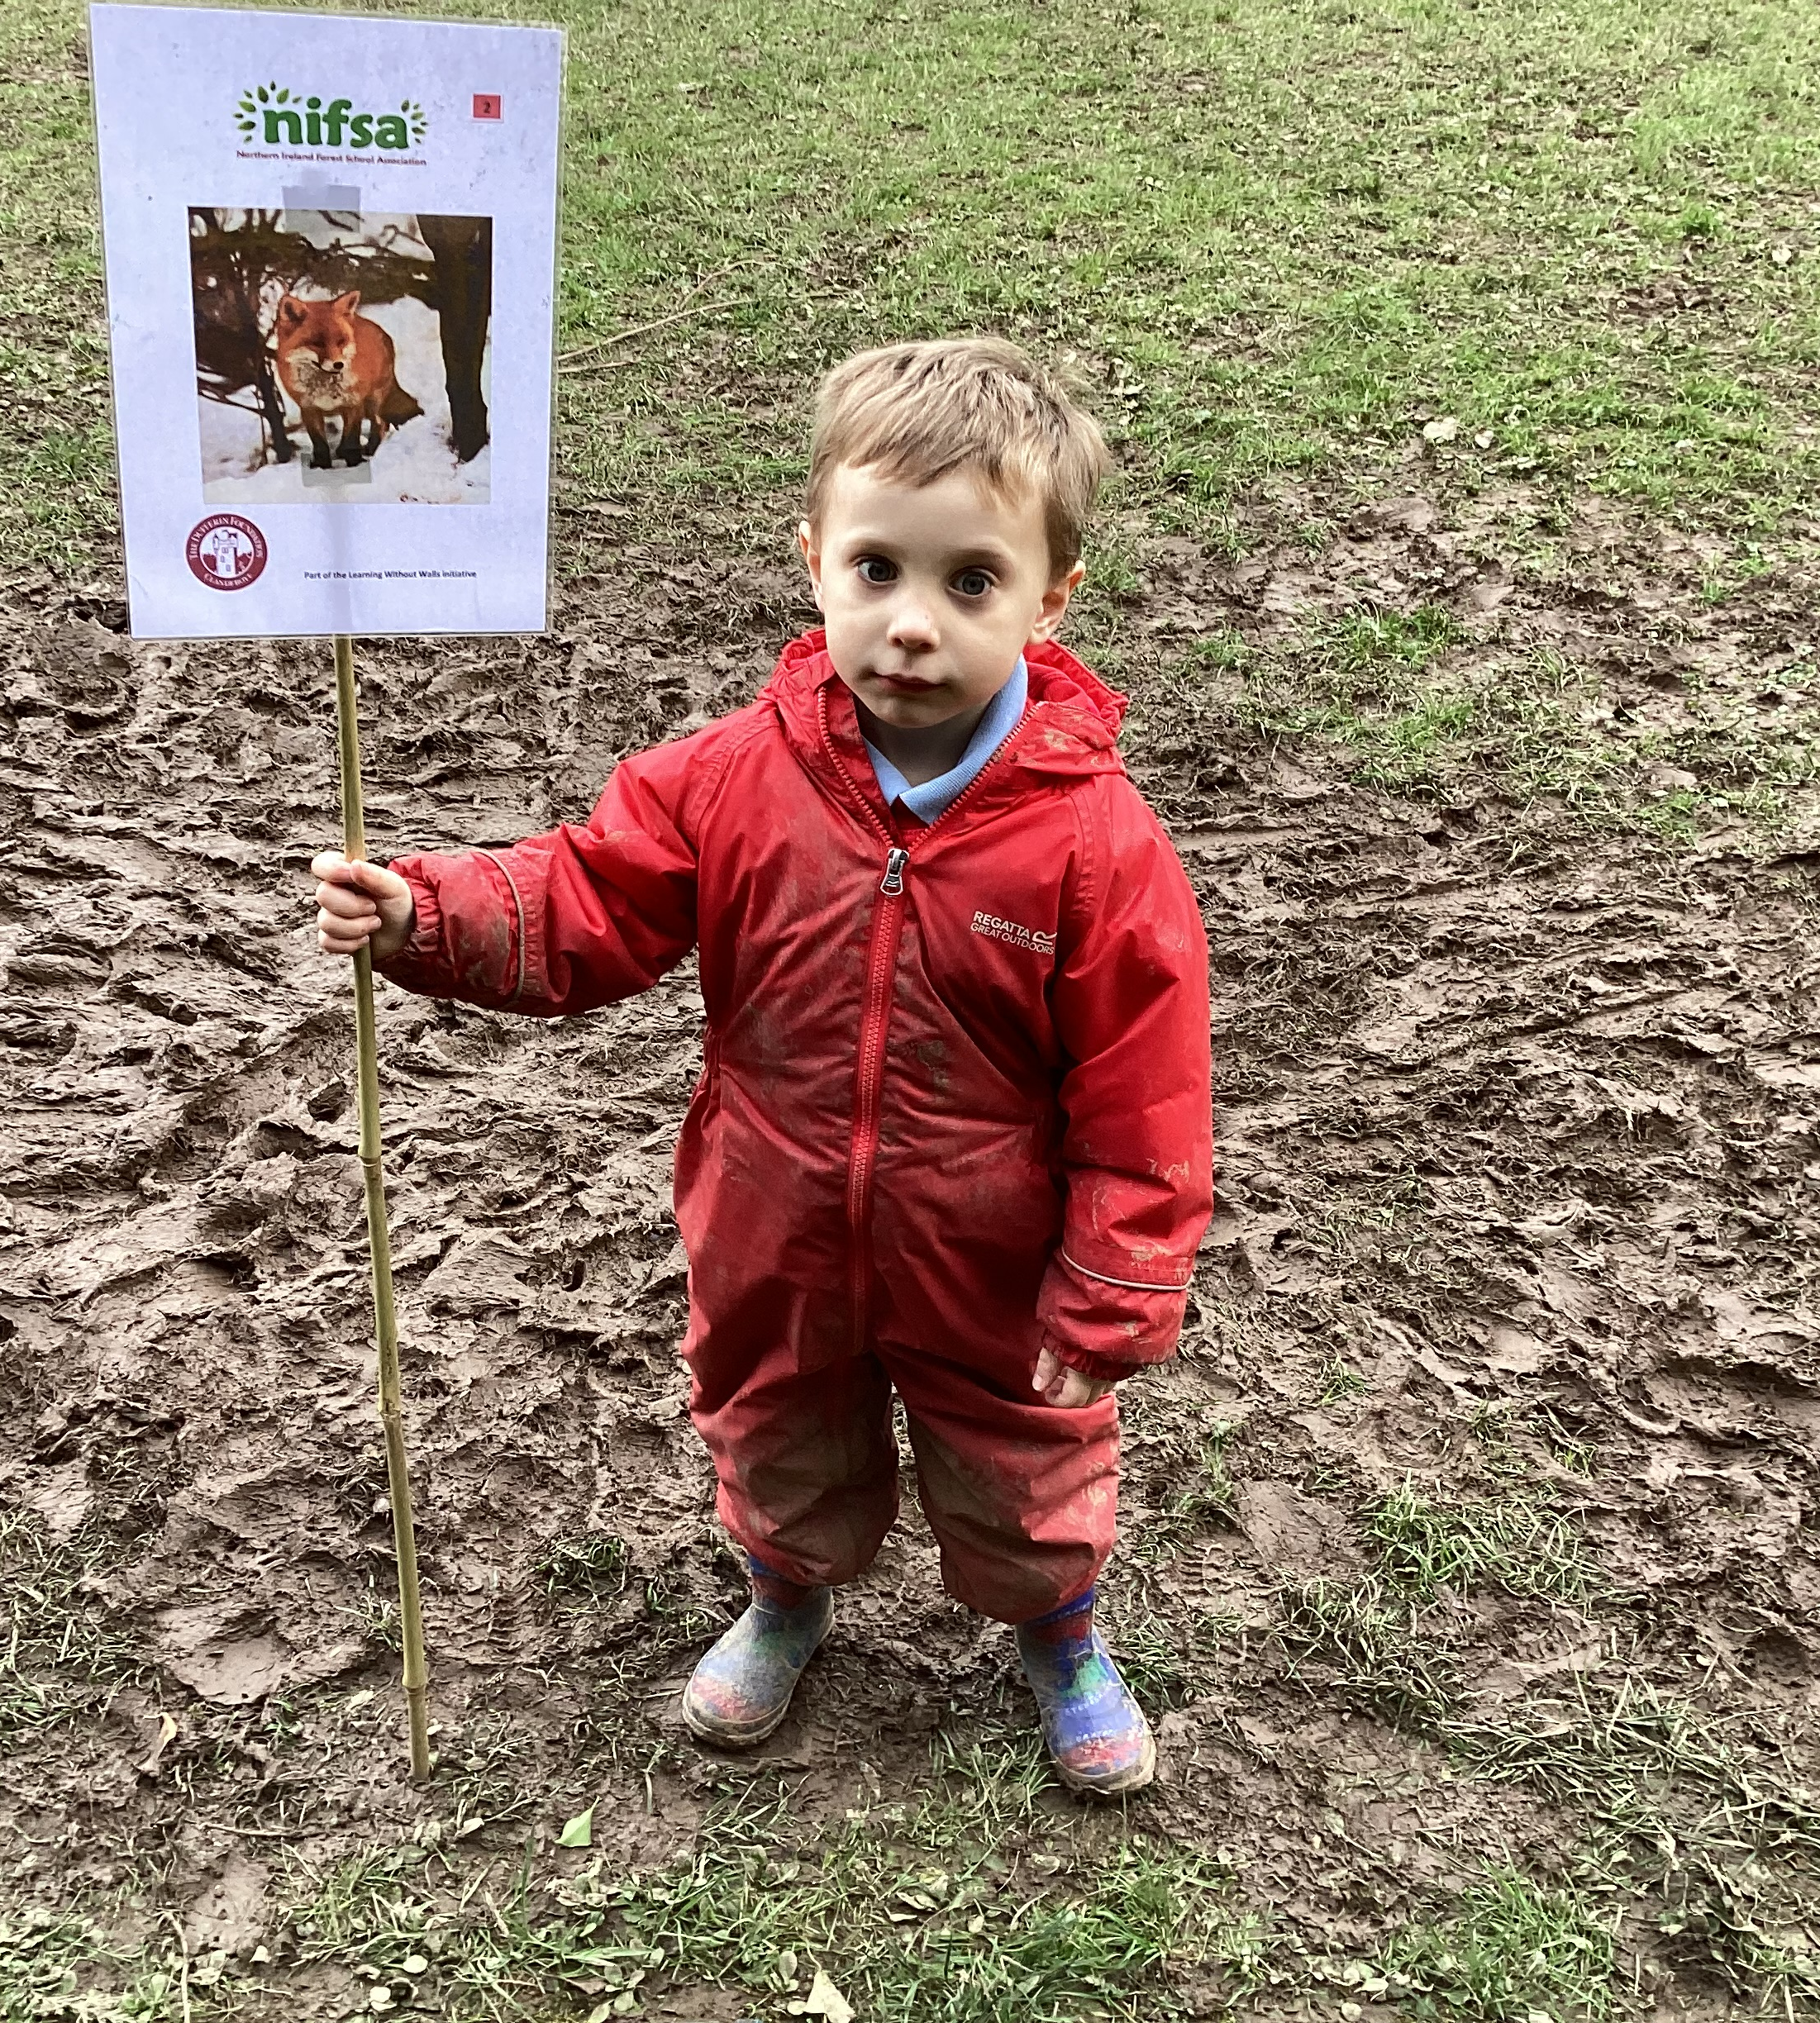
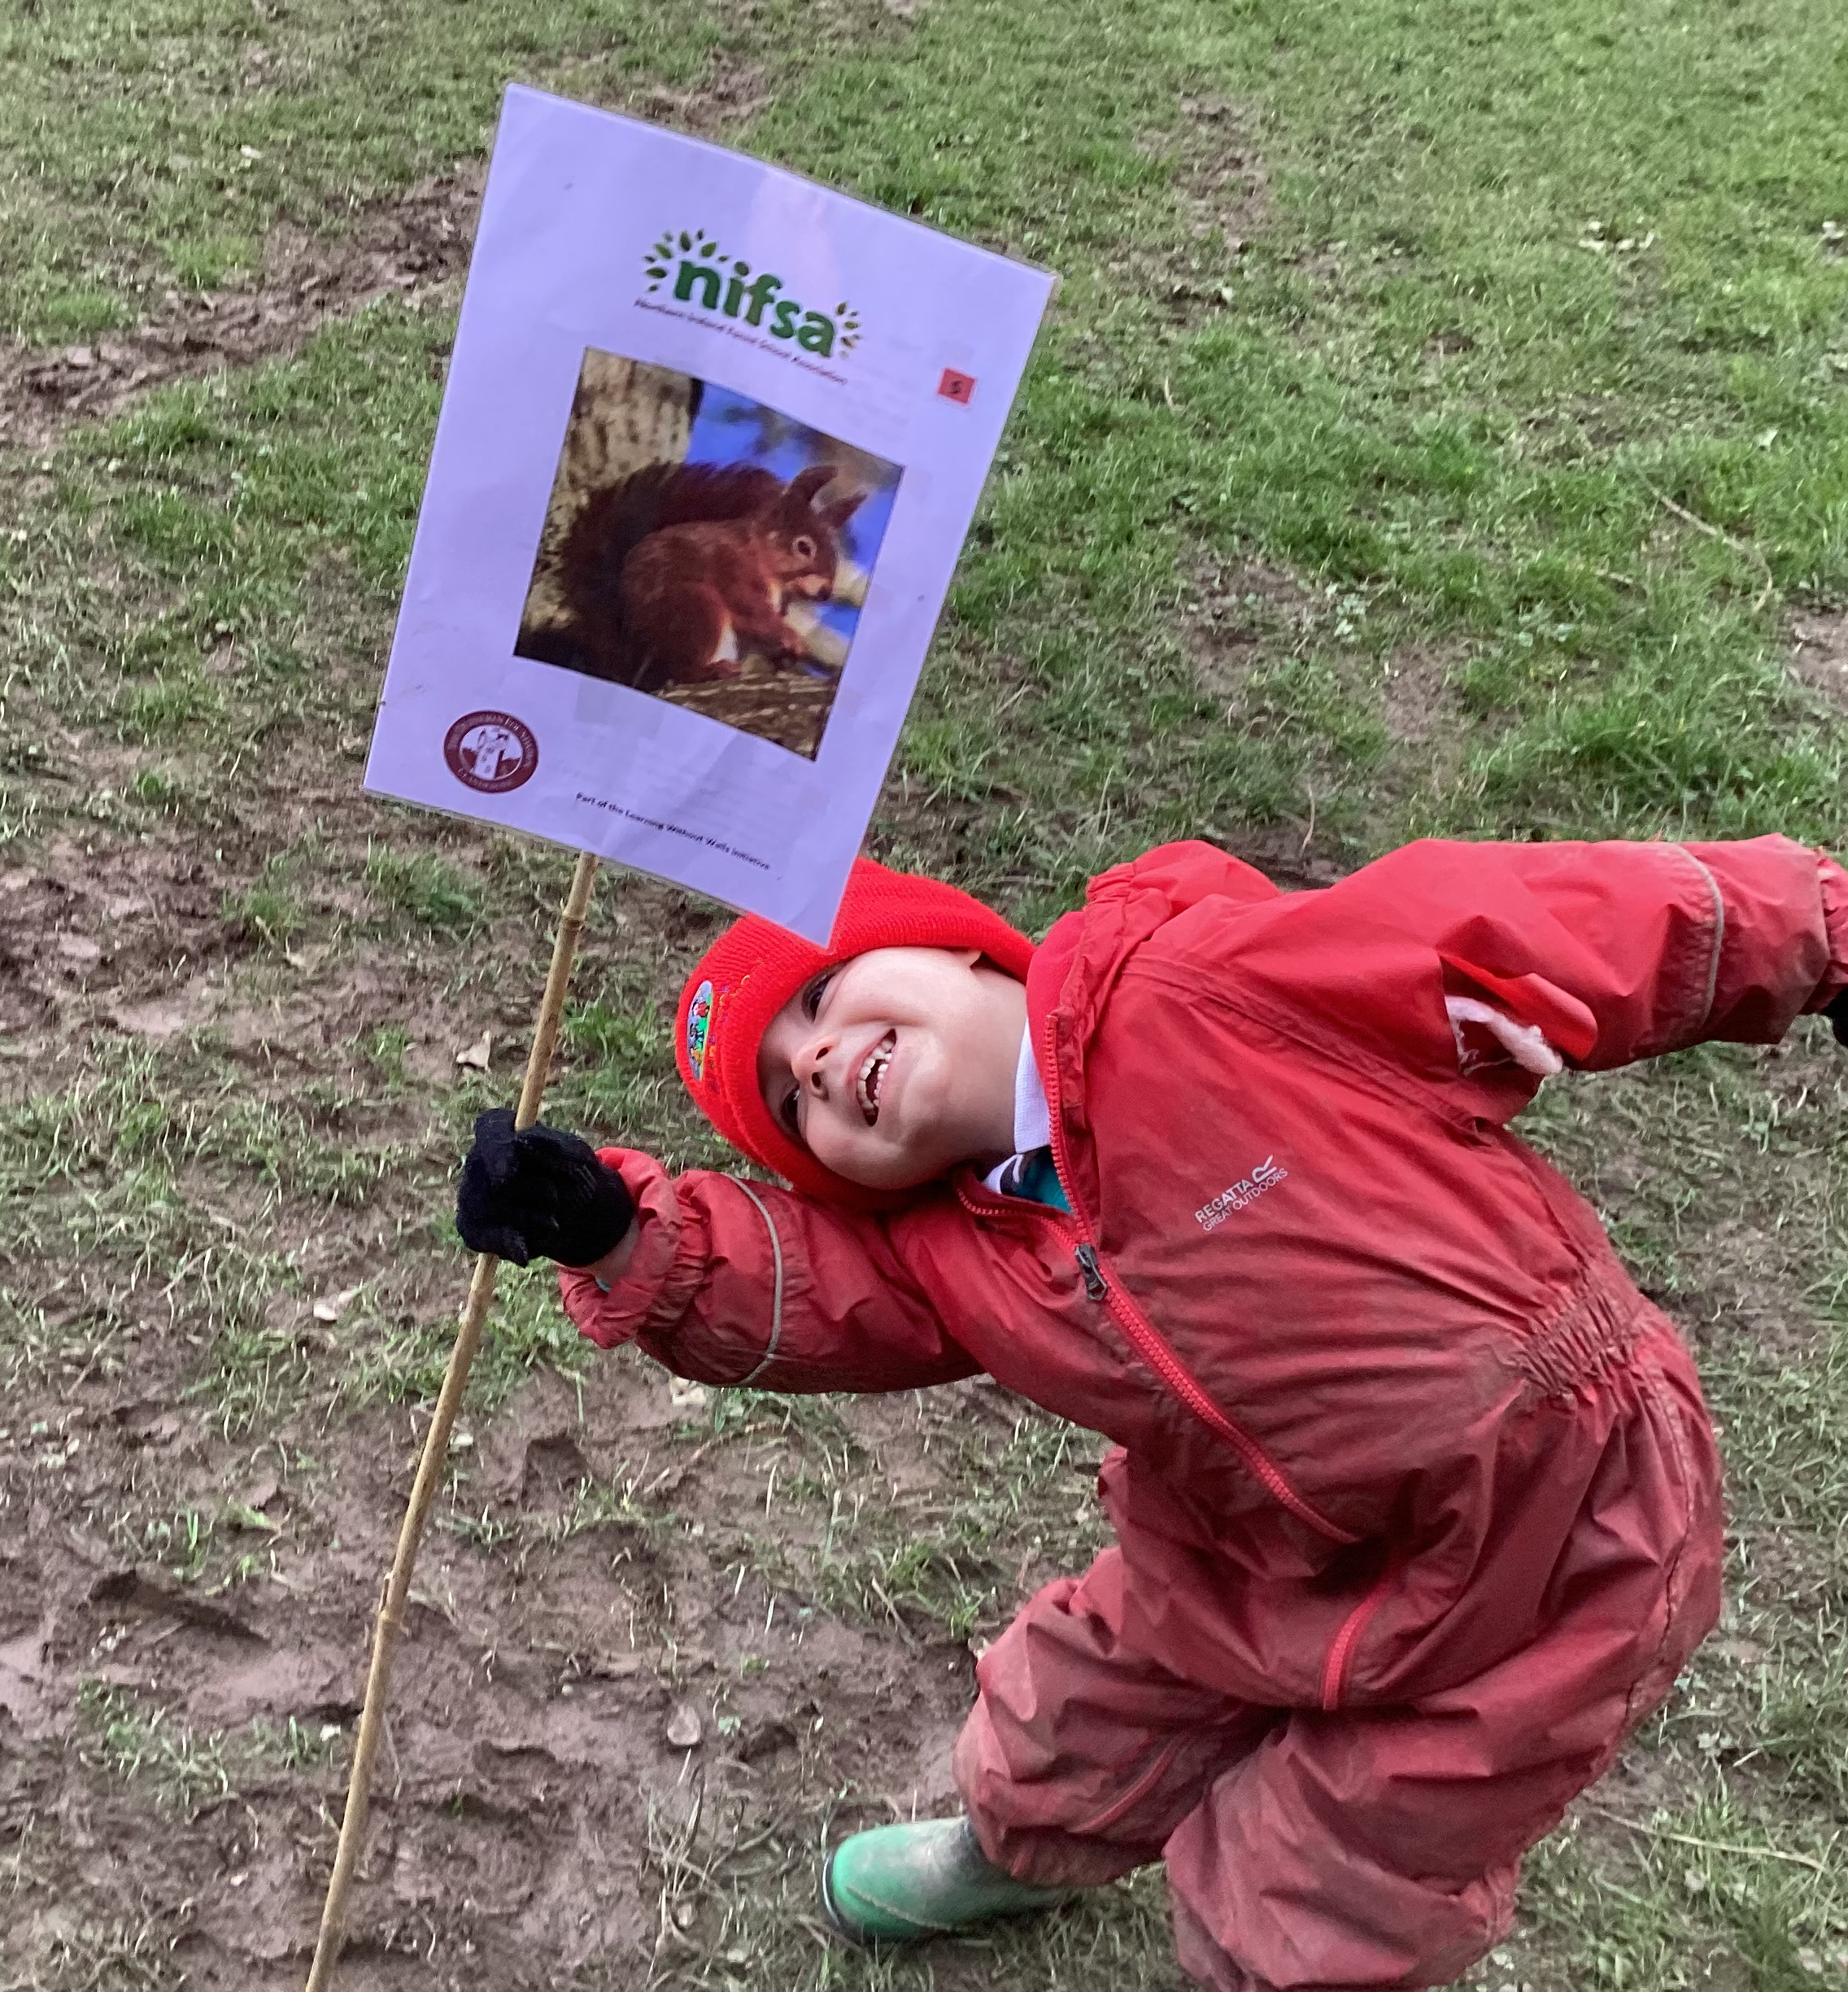
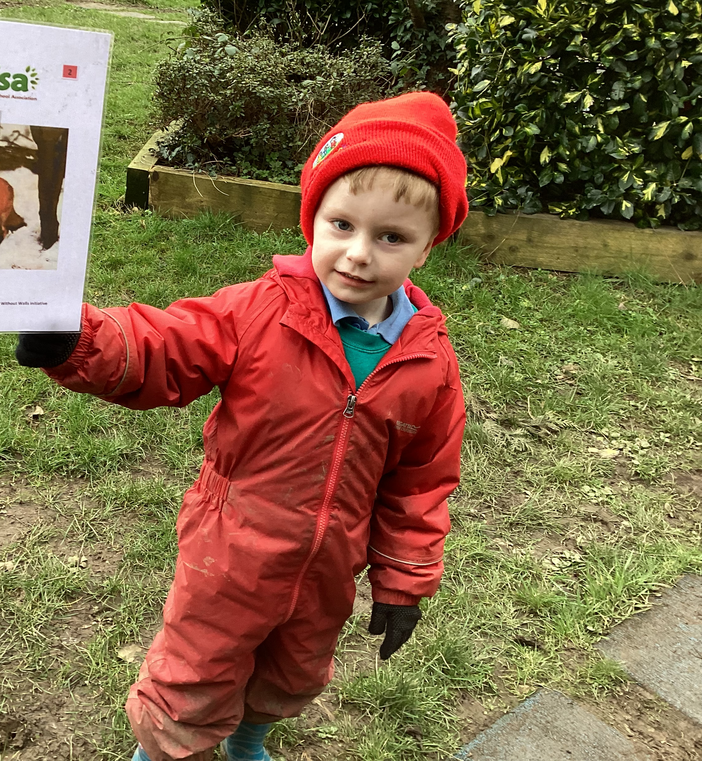
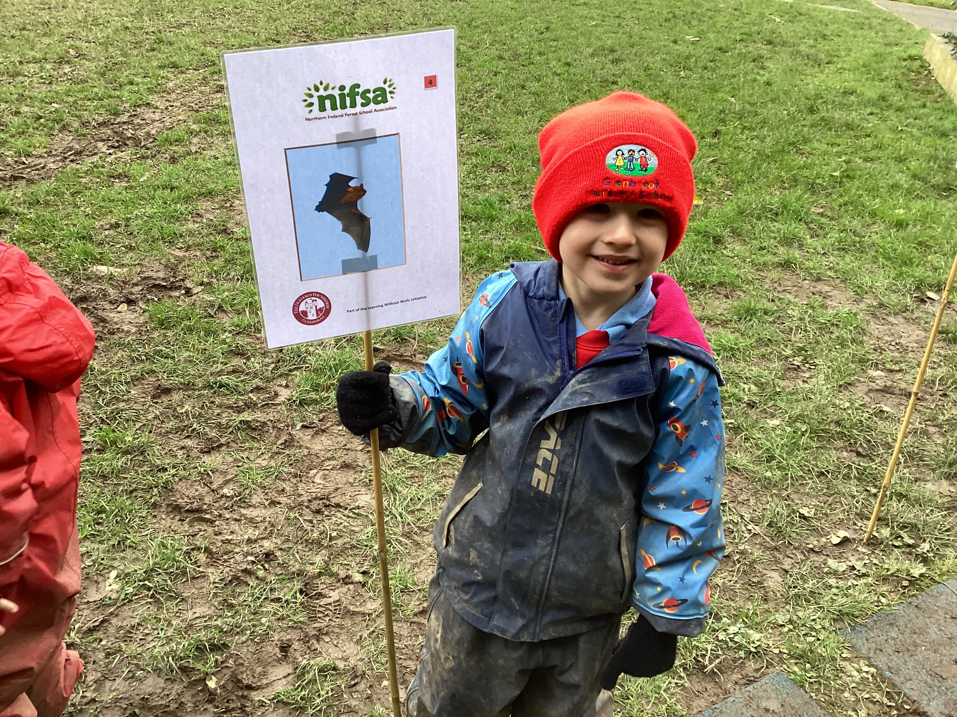
Boundary flag set up

Slide 5
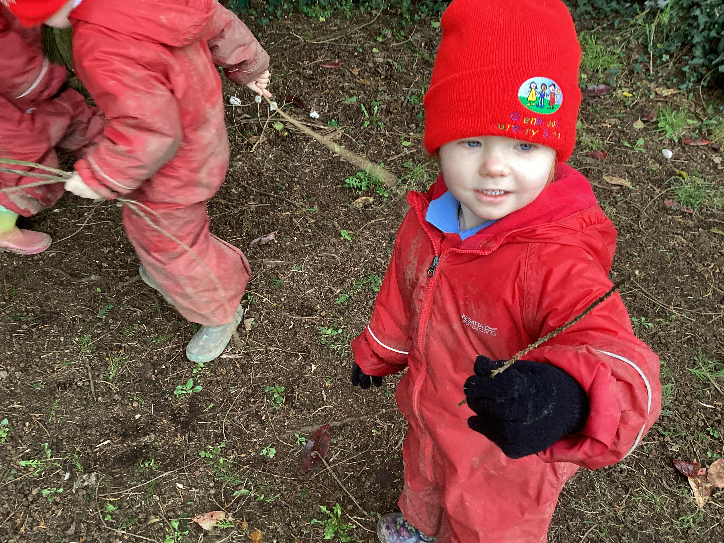
Finding sticks to measure

Slide 6
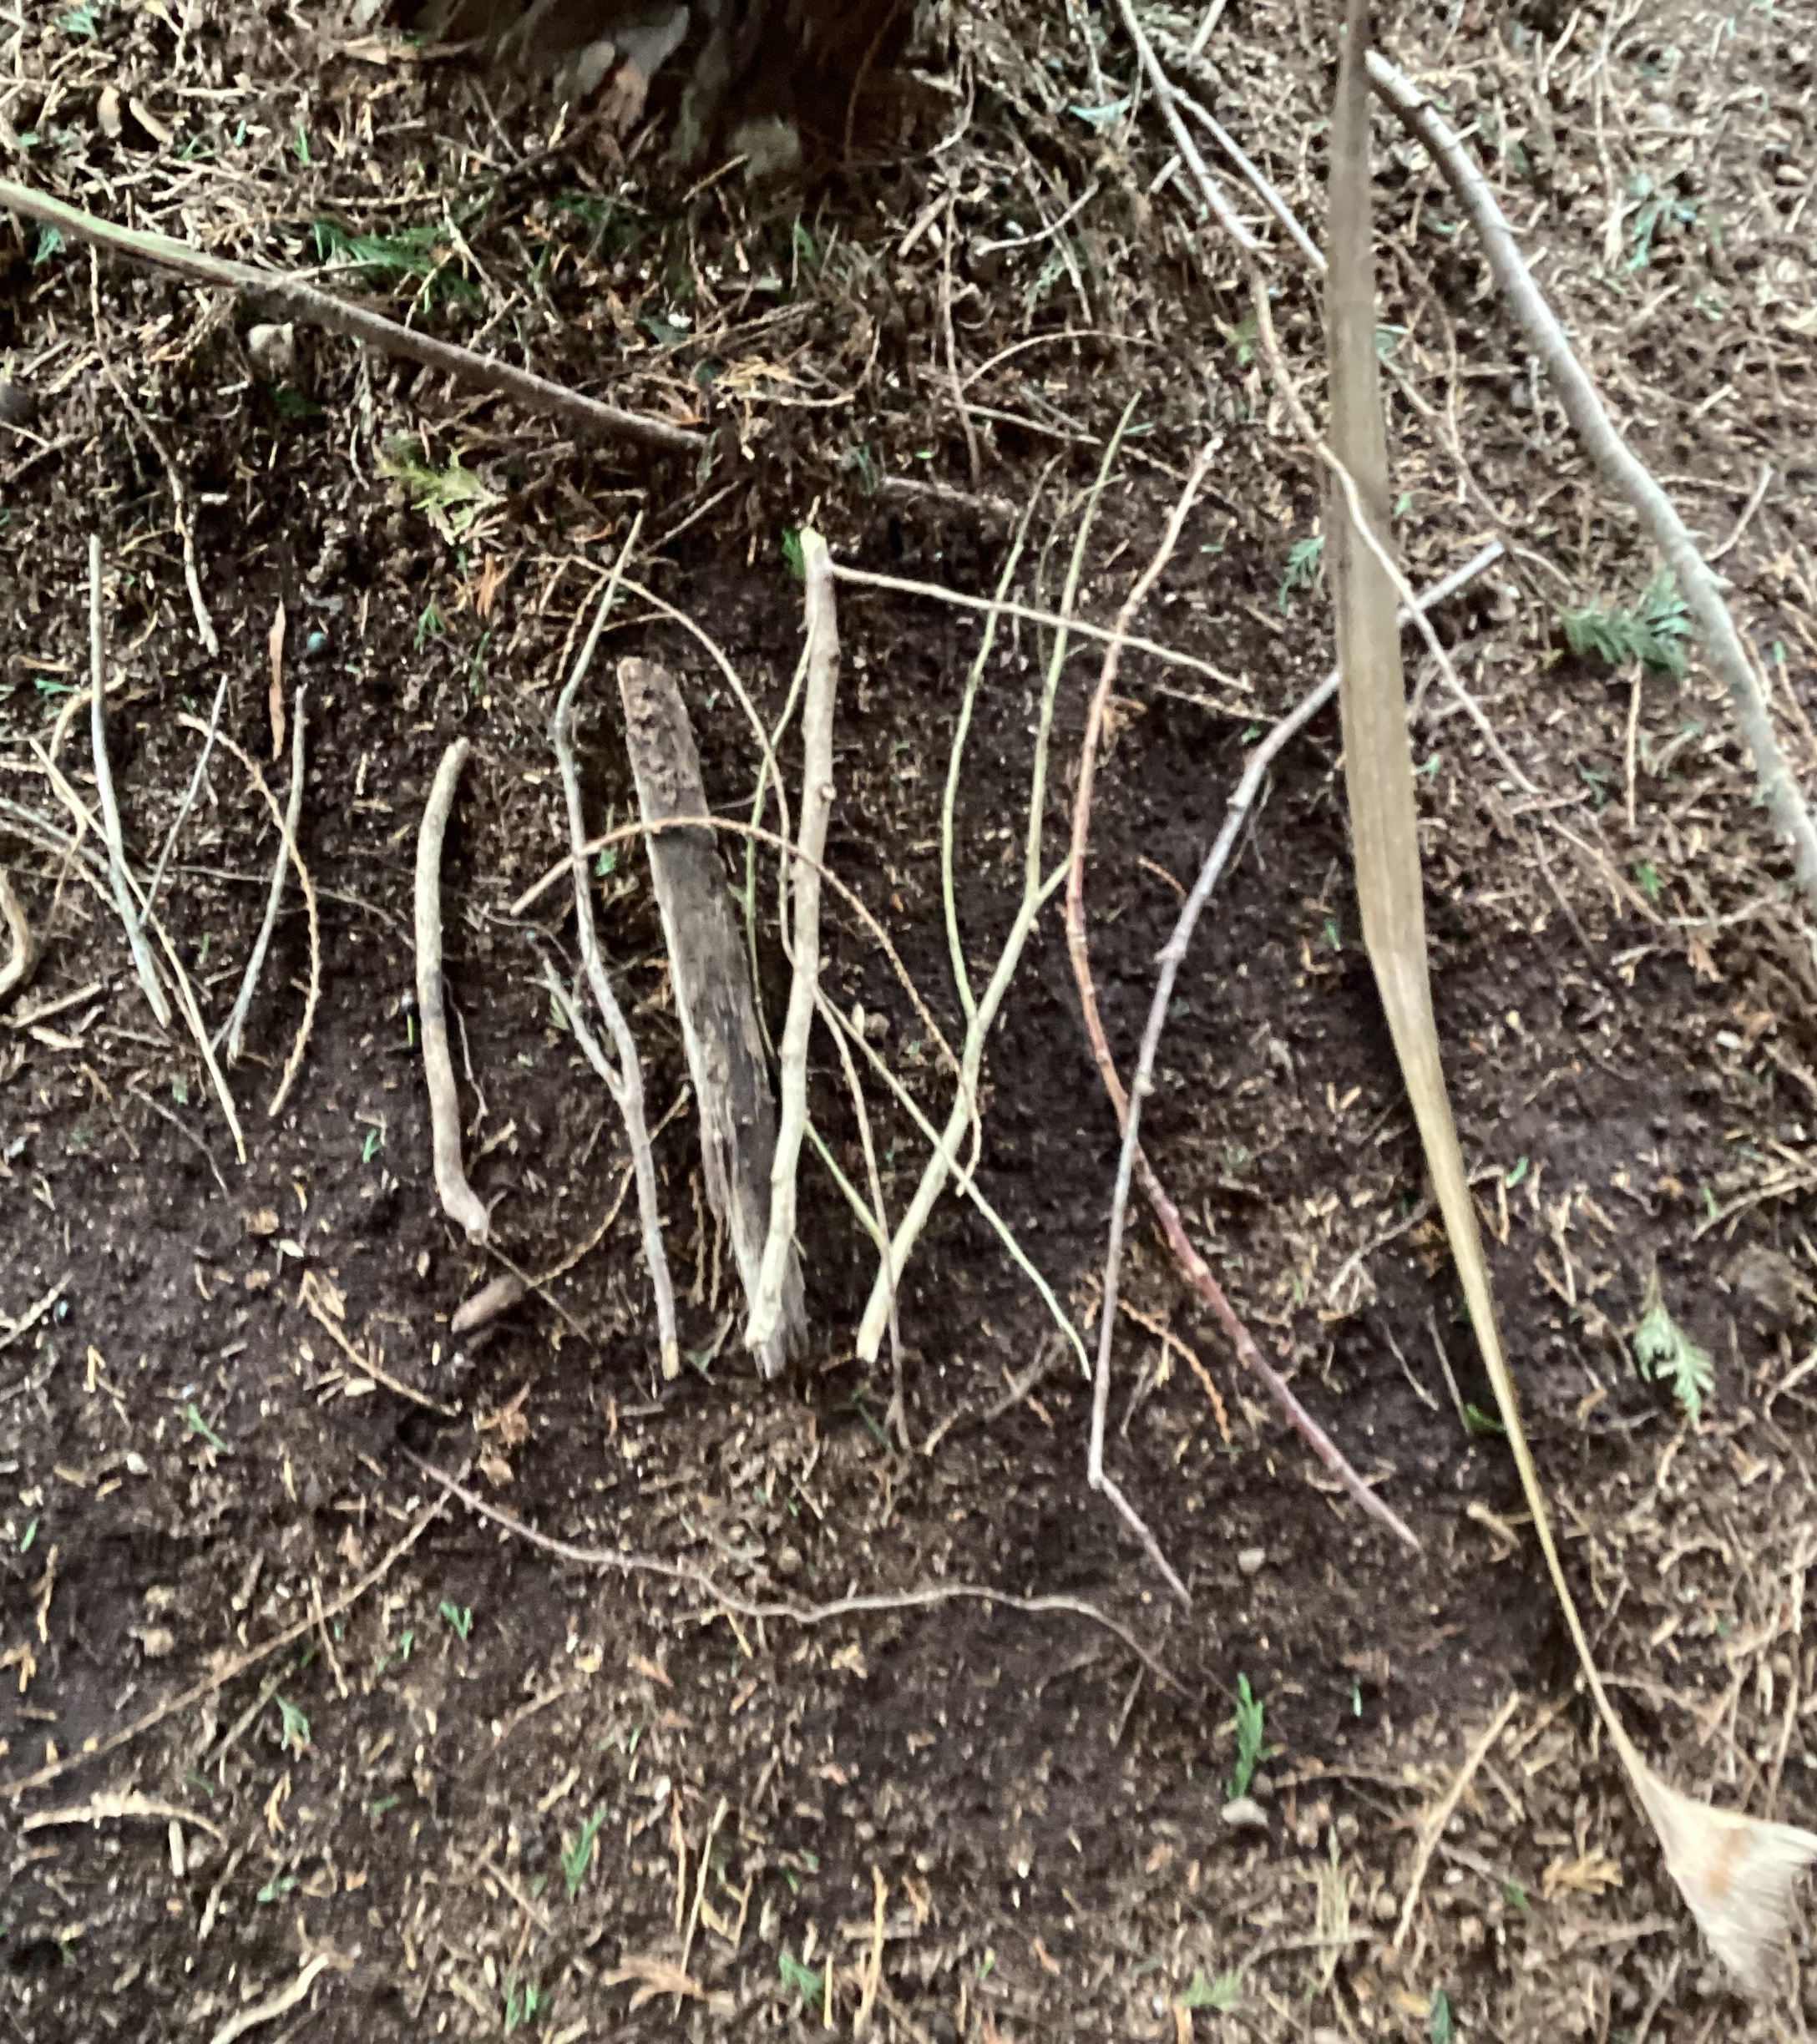
Ordering our sticks – shortest to longest

Slide 7
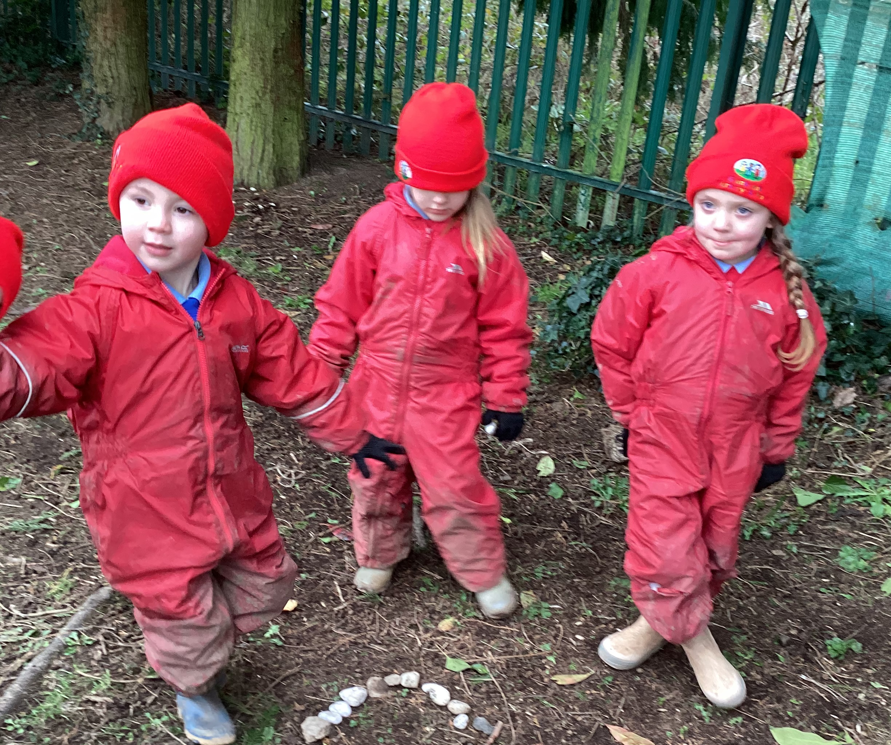
Next activity – small groups – make 2D shape using natural materials found on the Forest floor

Slide 8
Making our minds up…..did we enjoy Forest school this week?

