Slide 1
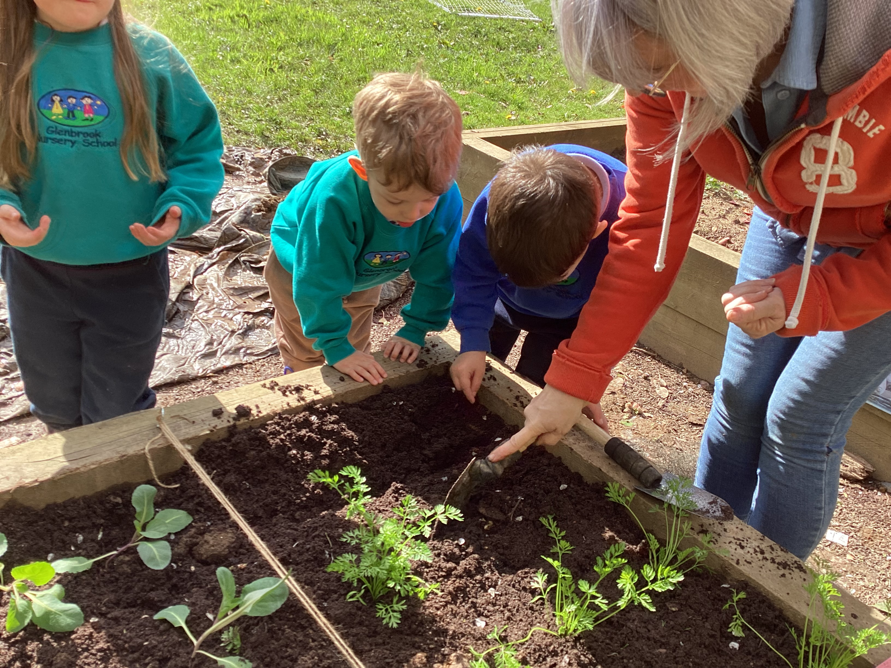
Glenbrook Forest School Diary
Planting

Slide 2
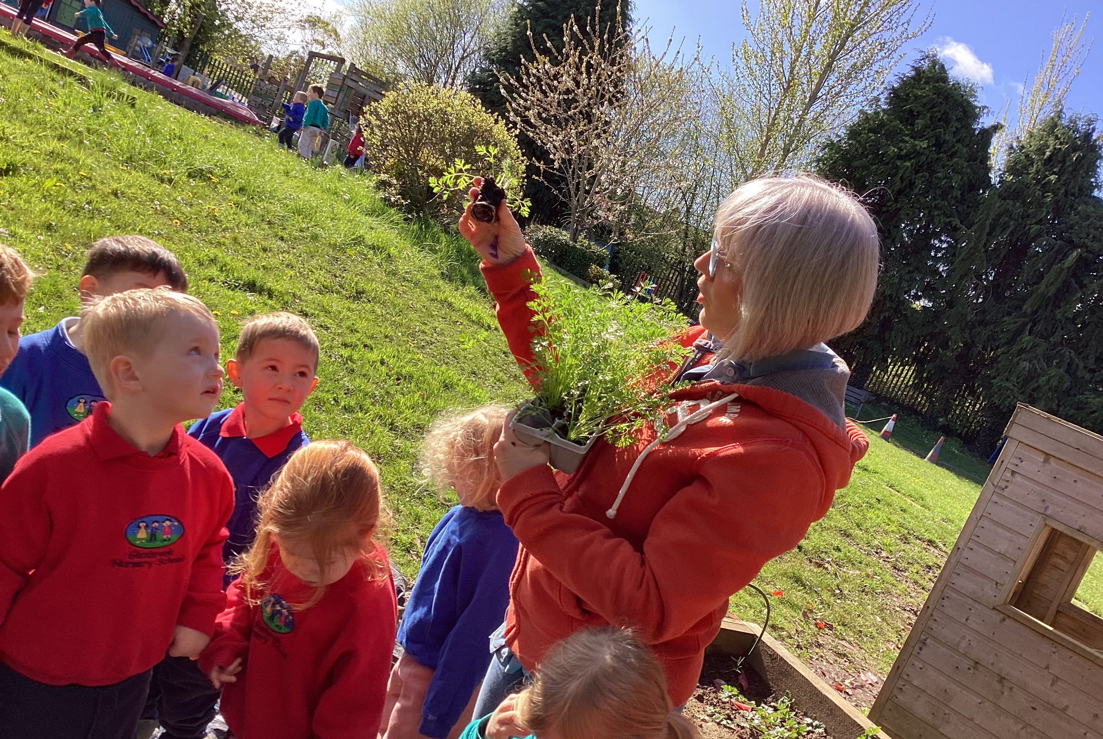
The explanation about the activity

Slide 3
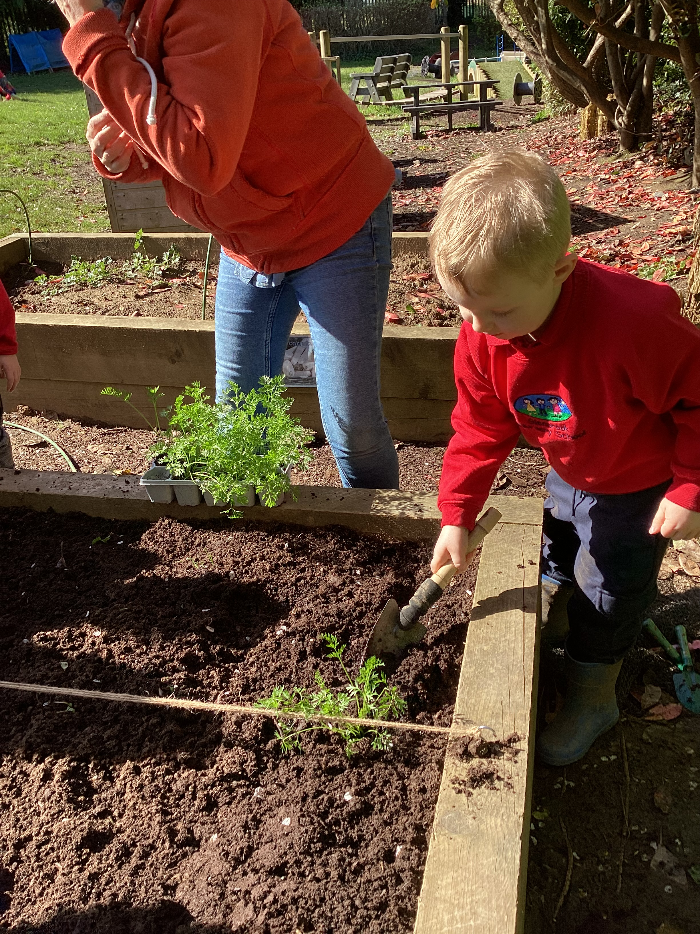
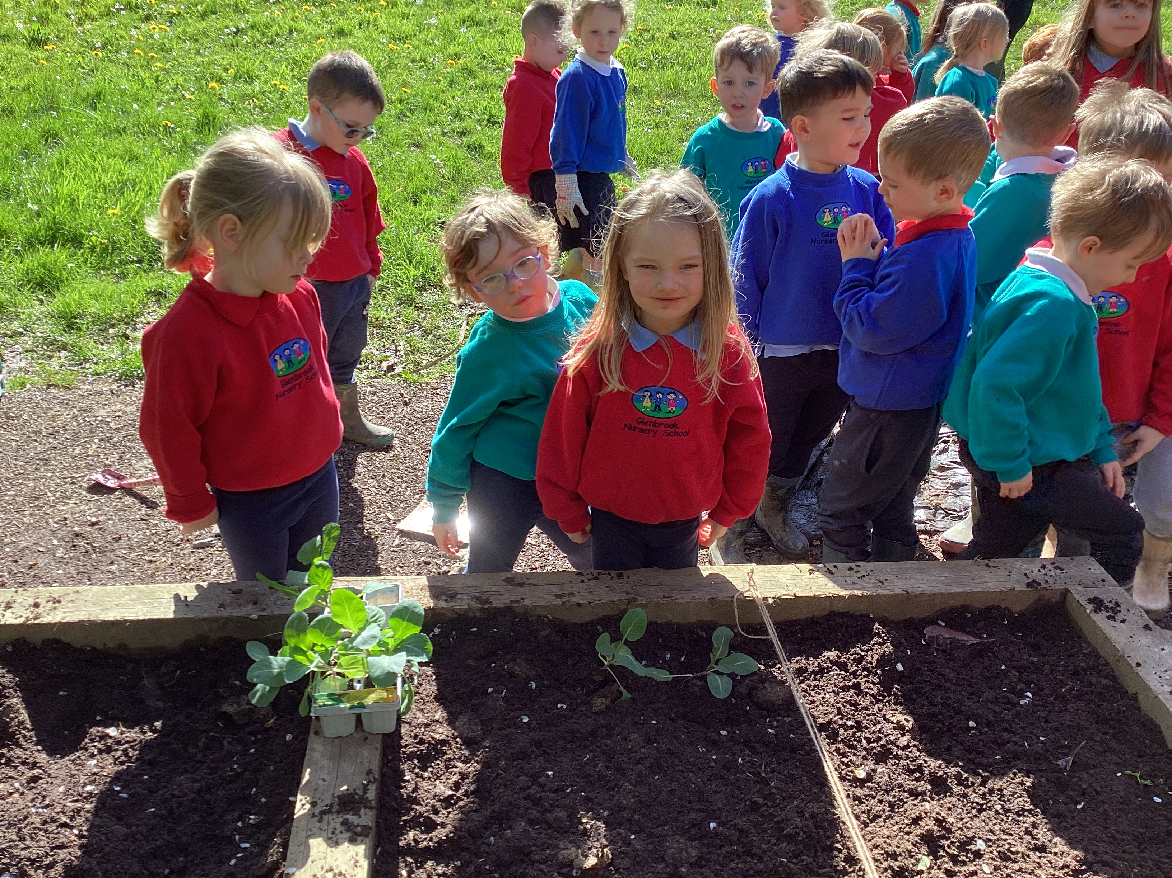
Getting involved - planting

Slide 4
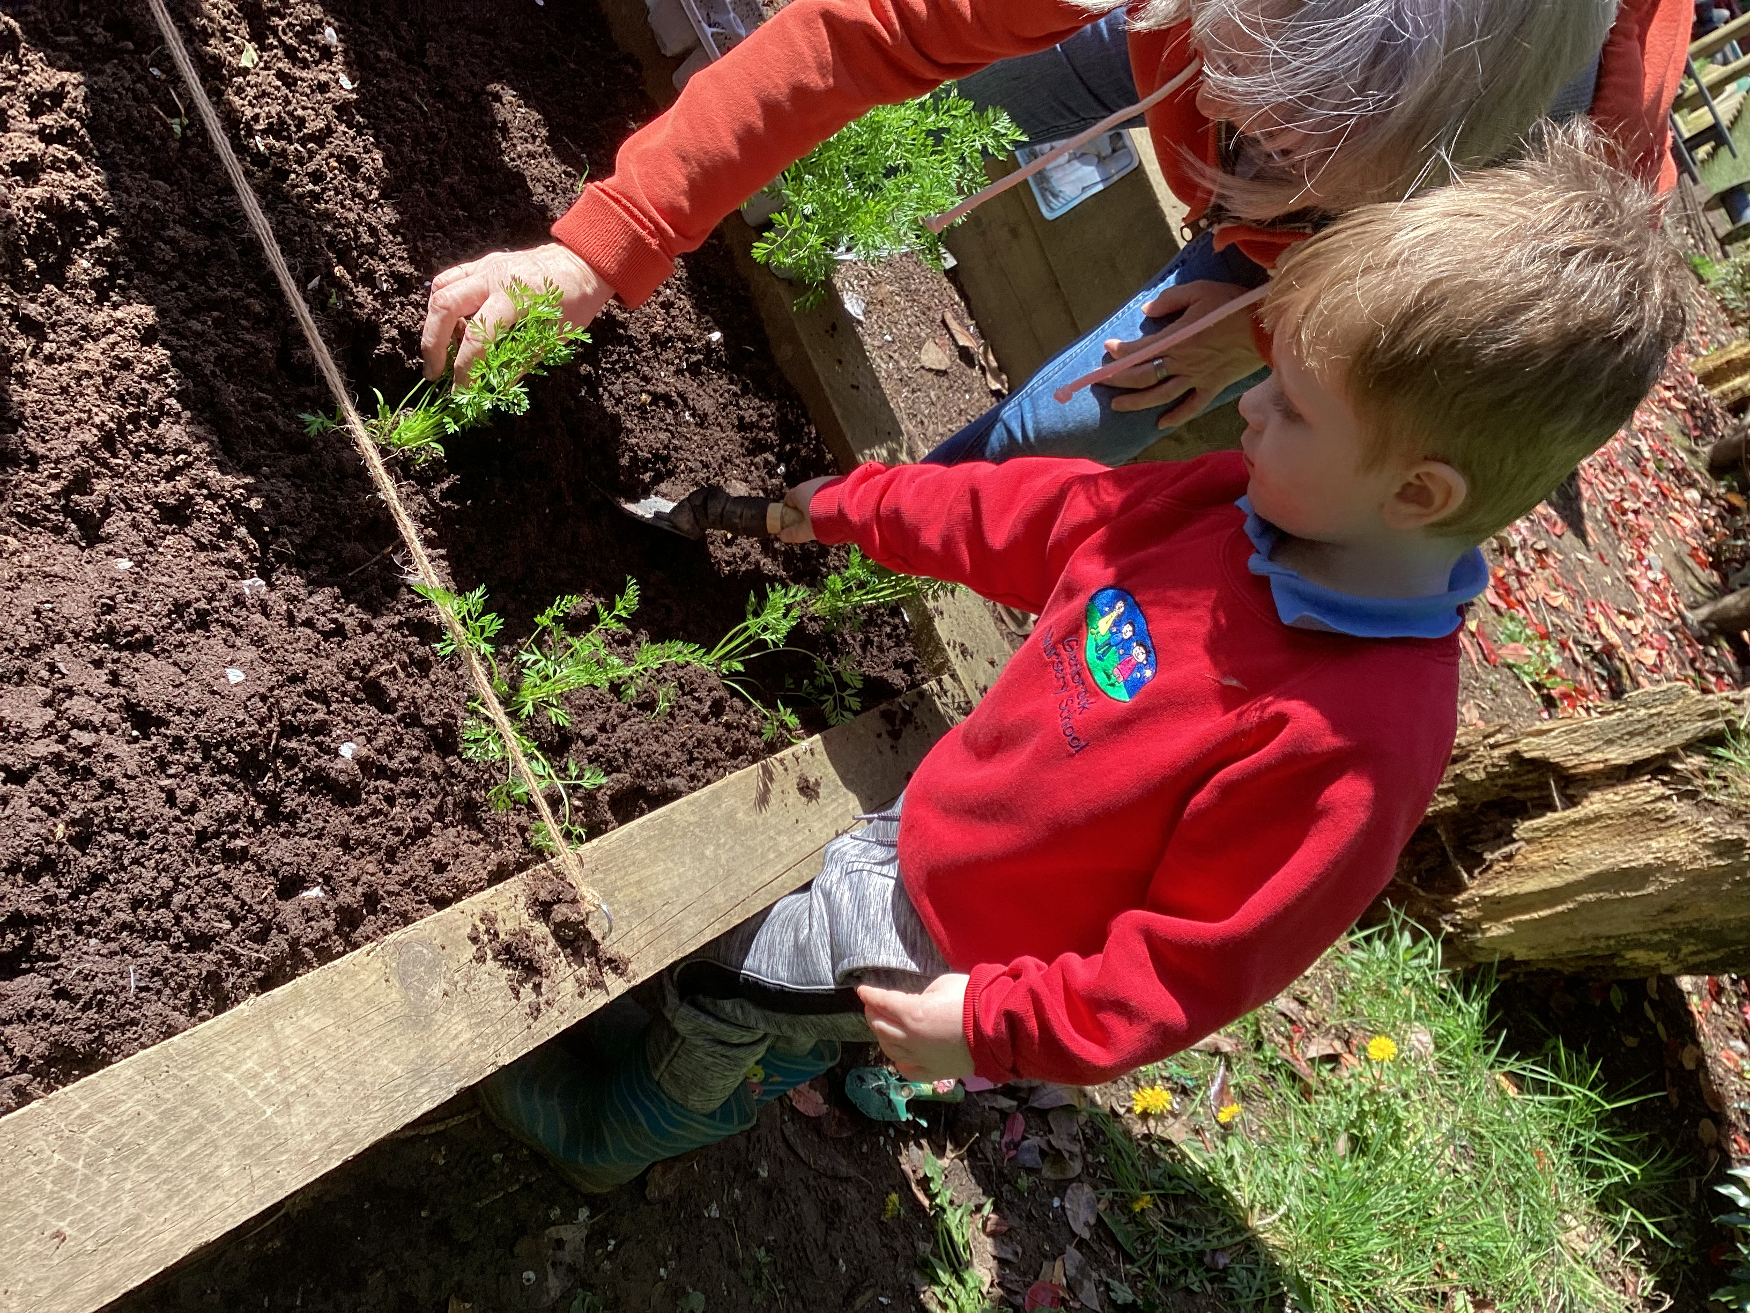
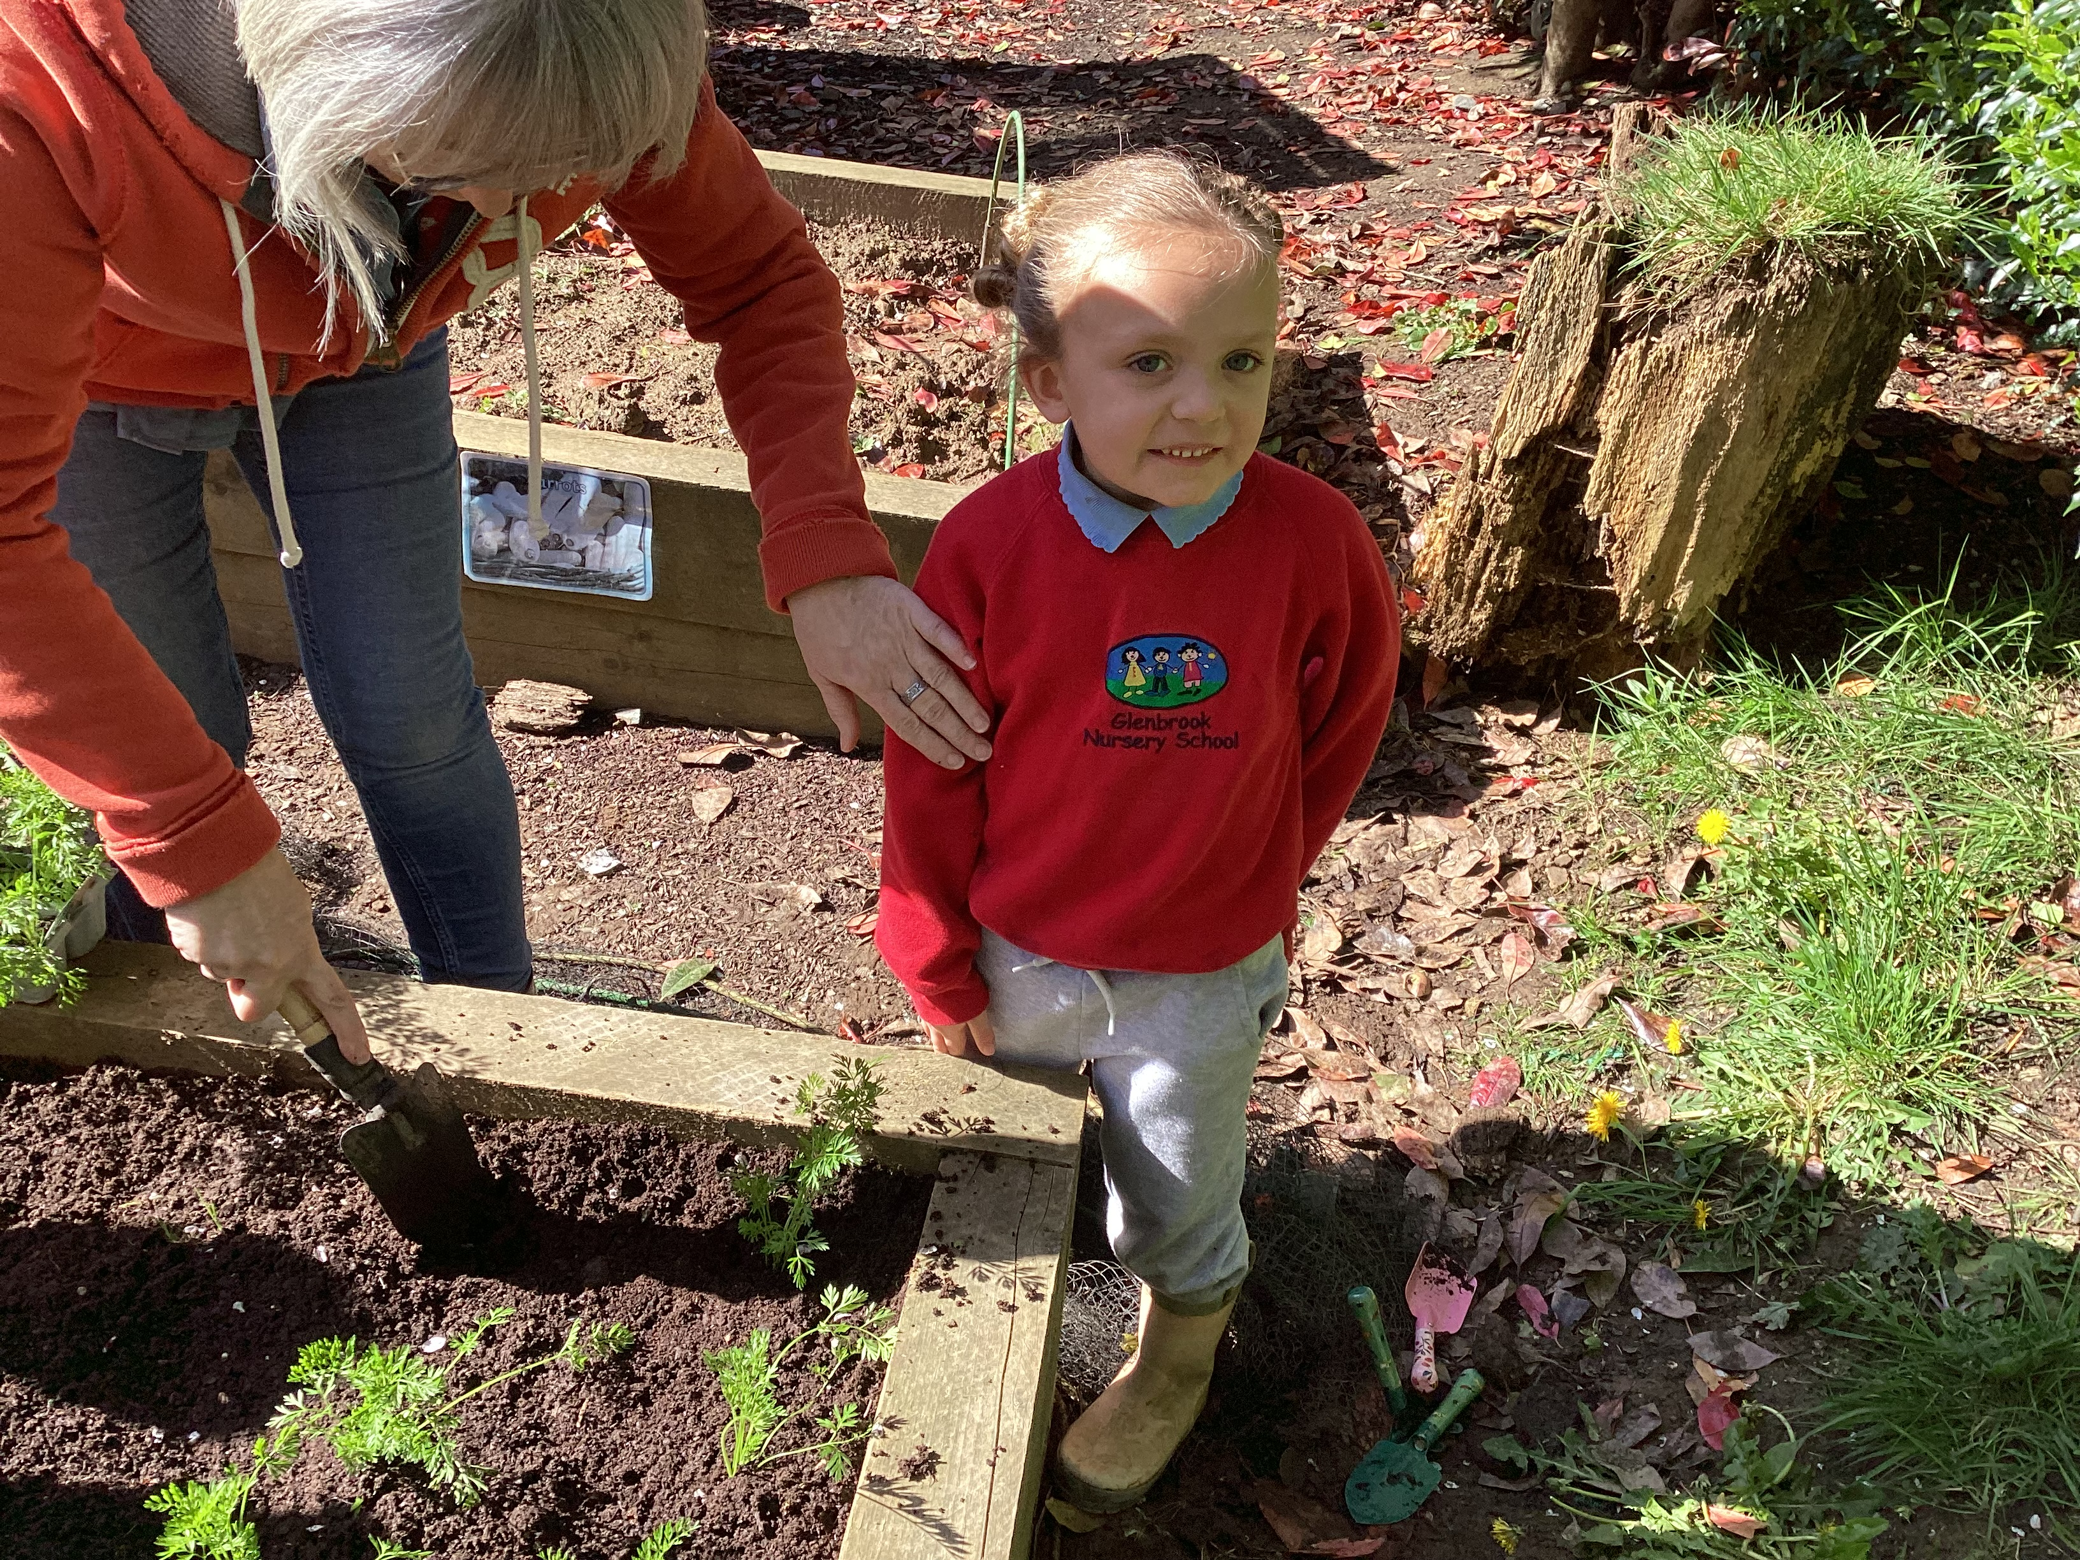
More planting

Slide 5
Finding out about other plants in our garden

Slide 6
Finding worms!

Slide 7
Tidying up at the end and returning to our classroom

